Slide 1
Progress towards the development of Climate Change and Sea Level Rise Scenarios for South Florida
Jayantha Obeysekera and Jenifer Barnes
Hydrologic & Environmental Systems Modeling
South Florida Water, Sustainability, and Climate Project
Key Largo, March 3, 2013

Slide 2
Outline
SFWMD research on climate change – progress summary
Results of a 2 month exercise for the workshop on “Predicting Ecological Change in the Florida Everglades in a Future Climate Scenario” (FAU-CES, USGS, Florida Sea Grant, Jan 24-25, 2013)
  Rationale for scenario selection
    Temperature
    Precipitation
    Sea Level Rise
  Scenario simulation using SFWMM (a.k.a. 2x2 model)

Slide 3
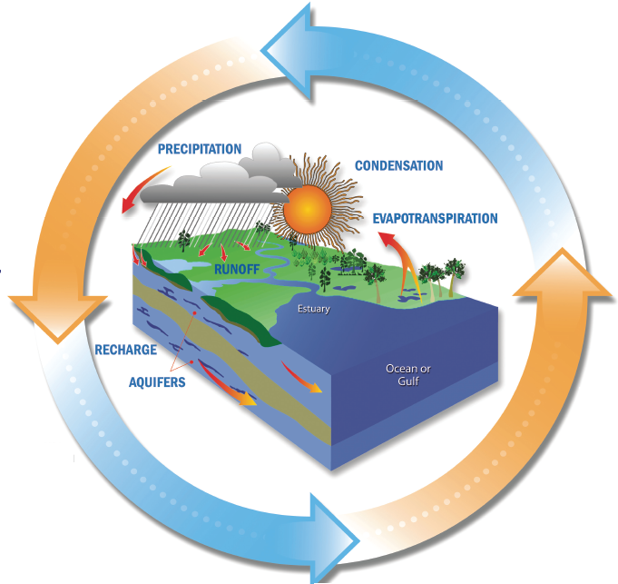
Hydrologic Cycle - new paradigm of “Non-stationarity”
Primary Variables of interest:
Temperature
Precipitation
Evapotranspiration
Saltwater Intrusion
Implications for:
Water Management
Energy
Agriculture
Tourism
Health
SOLAR RADIATION
SALTWATER INTRUSION

Slide 4
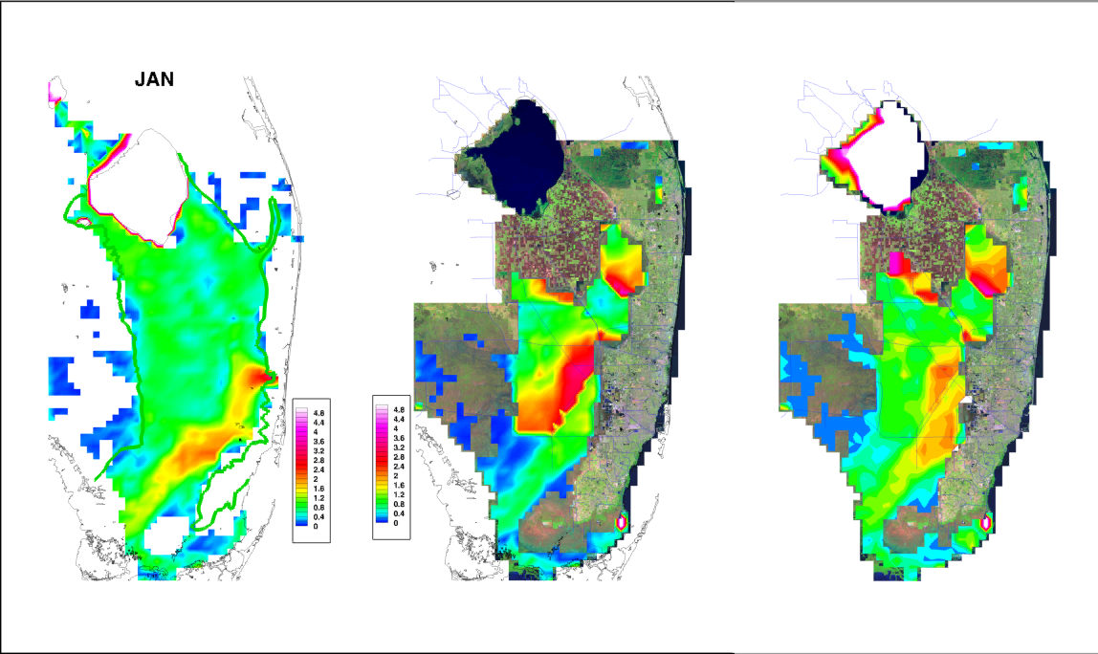
Everglades Restoration – Will traditional planning approach work?
Natural System Managed System CERP

Slide 5
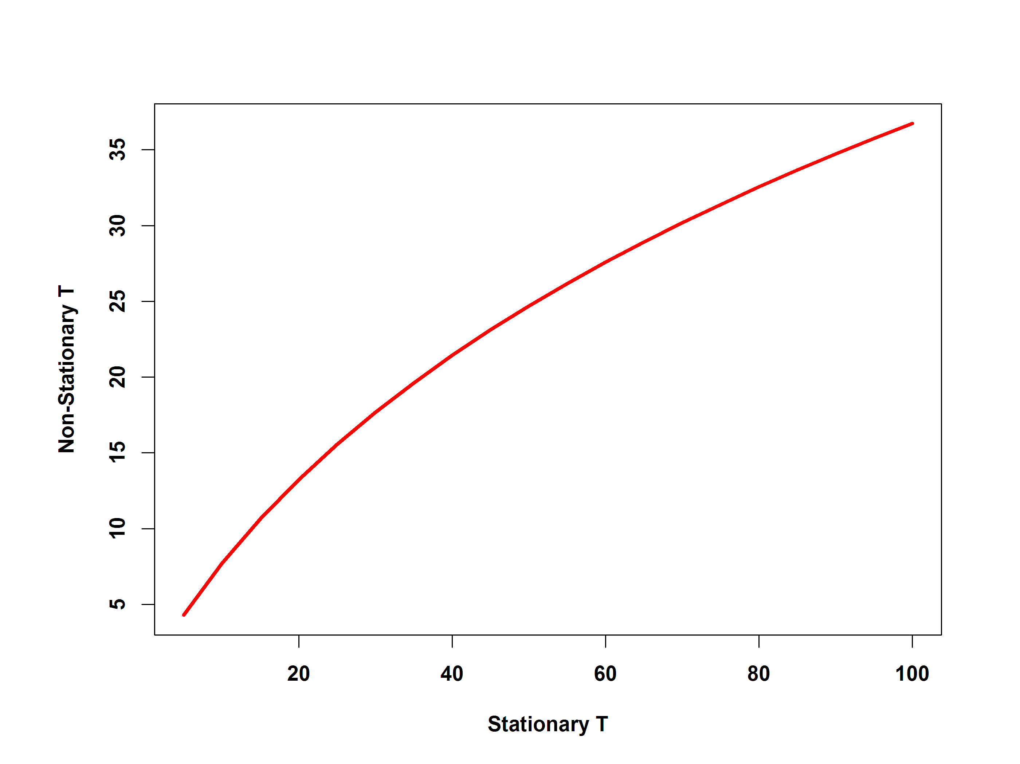

Nonstaionarity – A new paradigm for design
p_{x}
p₀
p₃
p₂
z_{q0}
p₁
Key West
Initial design
flood
. . .
q₁
q₂
q₃
q_{x} =(1-p_{x})
q₀ =1-p₀
time (years)
1
2
3
x

Slide 6
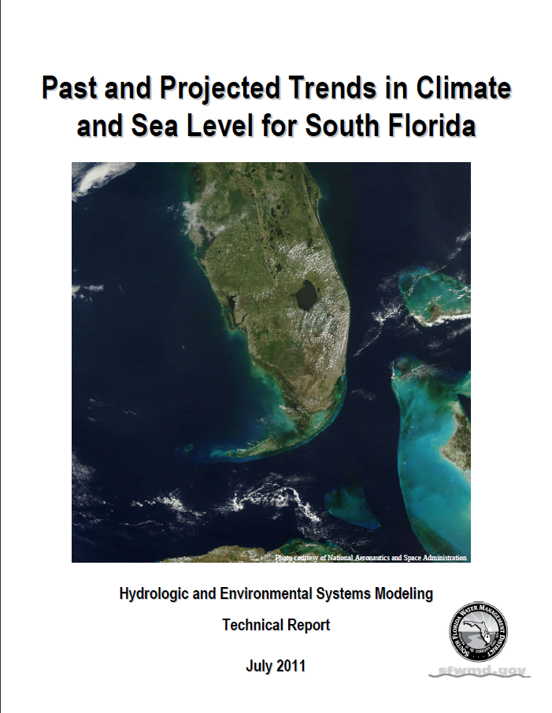
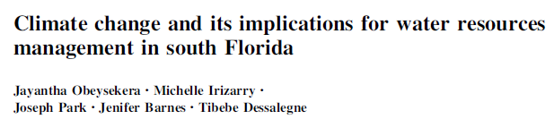

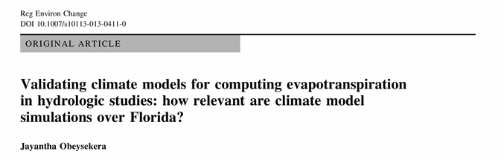
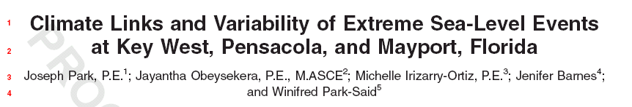
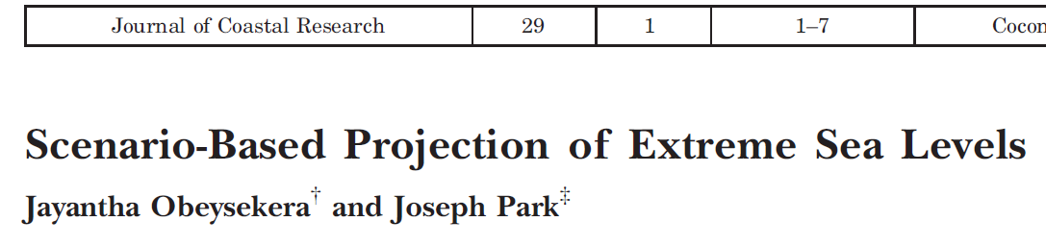
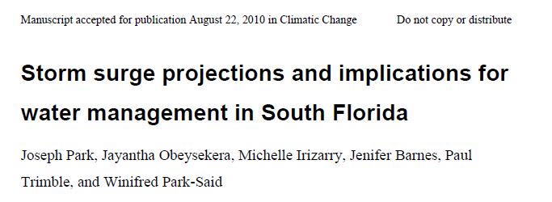
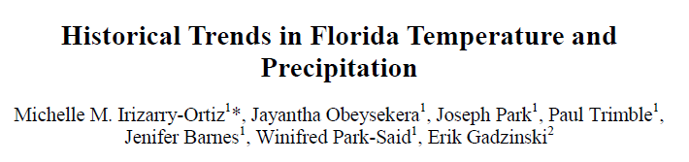
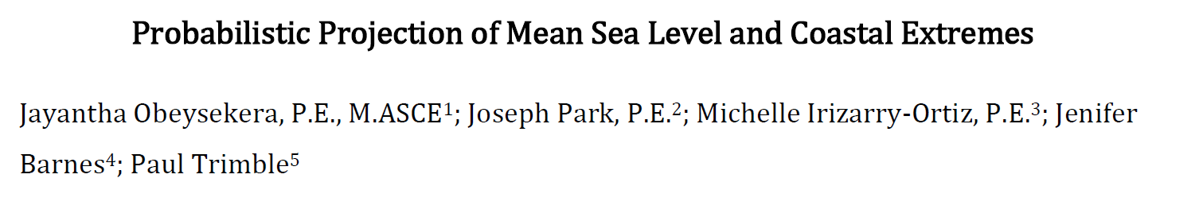
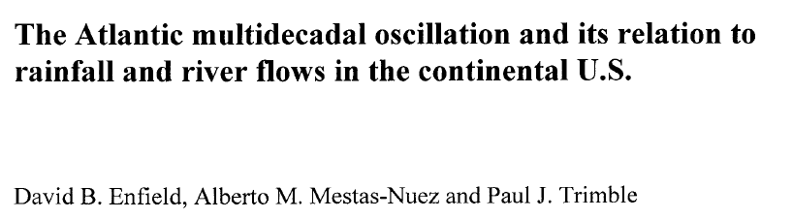
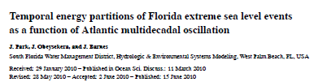
Research publications

Slide 7
Potential Impacts on Water Resources Management in South Florida
Climate Change Drivers
Water Management
Impacts
Natural Cycles
Inter-annual
(e.g. El Nino and La Nina) to
Multi-decadal
(e.g. AMO*)
Solar, Volcanos
Quartet of change:
Stressors
Direct landscape impacts (e.g. storm surge)
Water Supply
(e.g., saltwater intrusion)
Flood Control
(e.g. urban flooding)
Natural Systems
(e.g. ecosystem impacts, both coastal and interior)
Rising Seas
Temperature
Rainfall (both average & extremes)
Tropical Storms & Hurricanes
Human Induced
Land use changes
Greenhouse gases
*Atlantic Multi-decadal Oscillation of temperature in the Atlantic Ocean

Slide 8
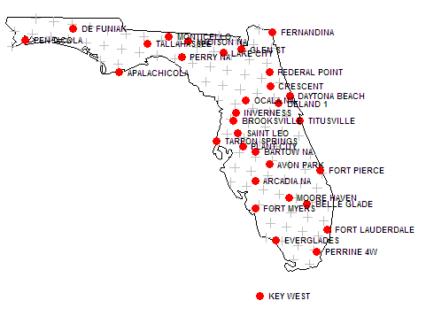
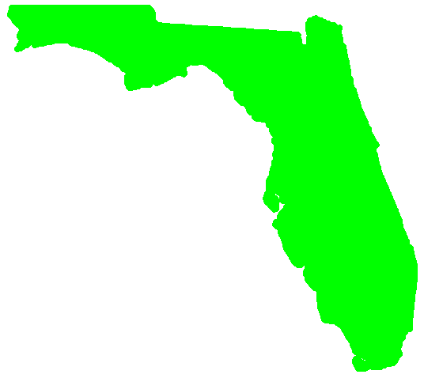
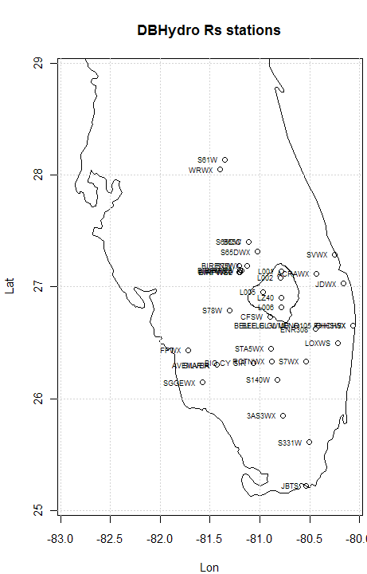
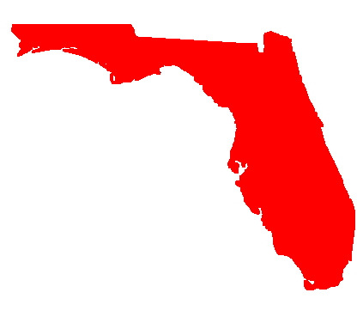
Validation Data
COAPS
FAWN
192,366 pixels
PRISM
USGS
141,332 pixels
USGS map
UCF - extremes
SFWMD

Slide 9
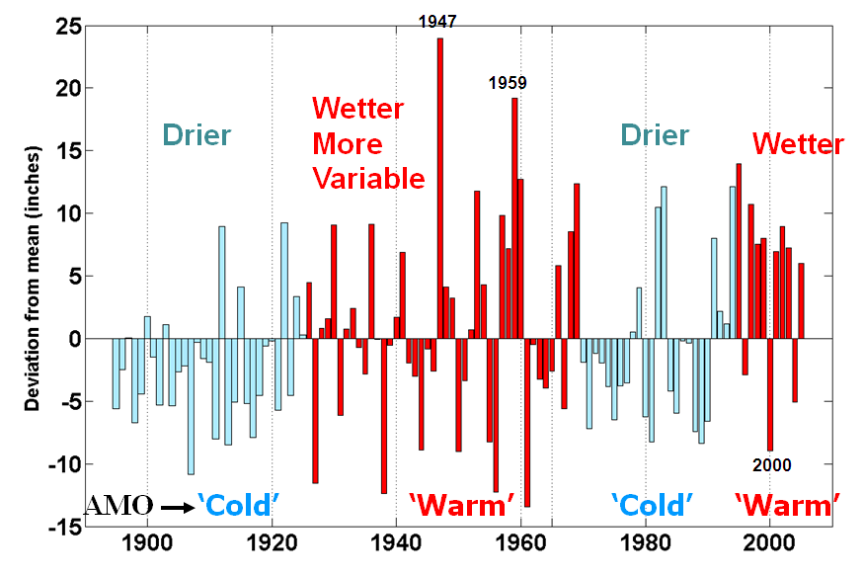
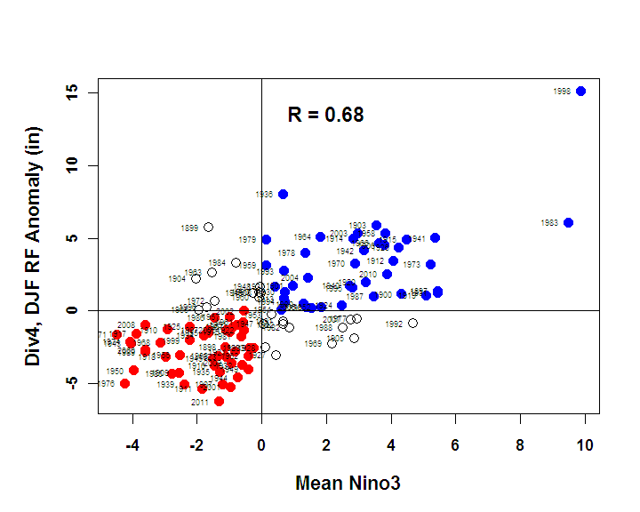
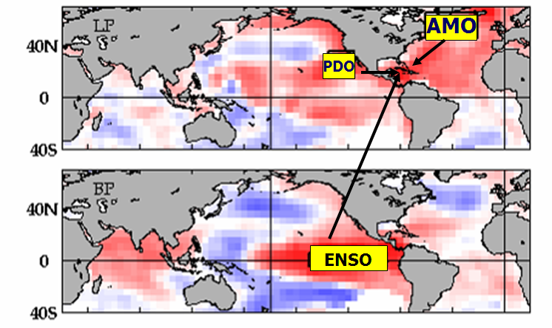
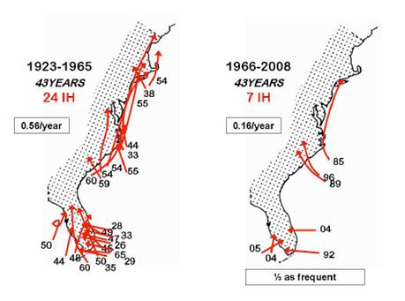
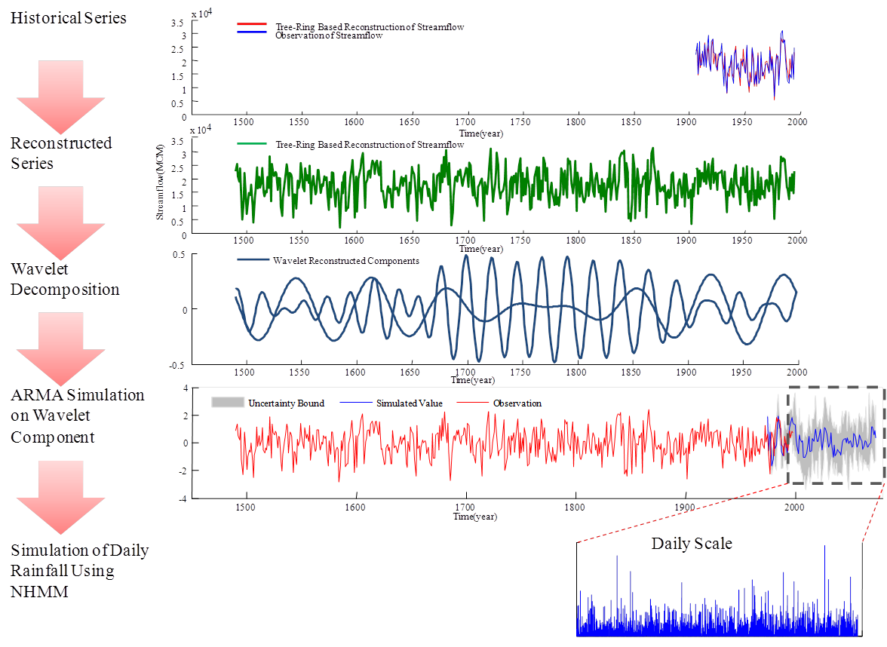
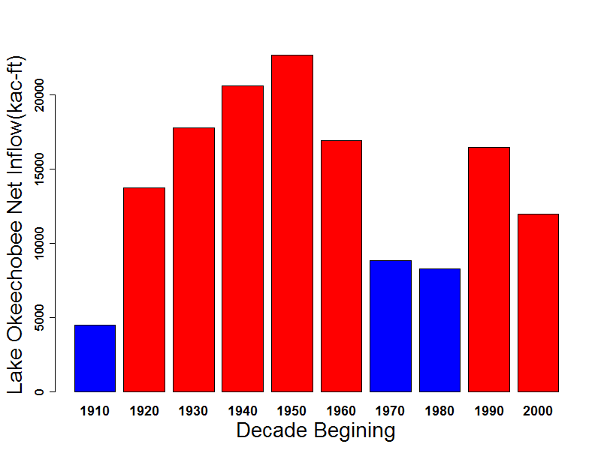
Natural Variability (Teleconnections)
Rainfall patterns
Rainfall vs. El Nino & La Nina
Tropical storm patterns
Kwon, Lall, and Obeysekera (2008)
Lake Okeechobee
Inflow

Slide 10
South Florida Water Management Model
Integrated surface water groundwater model
Regional-scale 2 mi x 2mi grid, daily time step
Major components of hydrologic cycle
Overland and groundwater flow, seepage
Operations of C&SF system
Water shortage policies
Agricultural demands simulated
Provides input and boundary conditions for other models

Slide 11
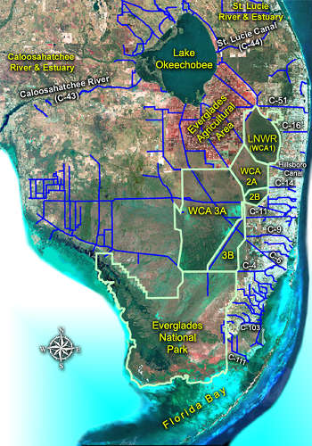
Regional Modeling Approach
SFWMM Model
Scenario
Model Output
Daily time
series of
water levels,
flows
Demands not
met
Climatic Input
  Rainfall
  ET
Boundary Conditions
• Land Use/Land Cover
• Water Demands
• Operating Criteria
Performance
Measures
(Ag, Env, Urban)

Slide 12
Using Climate Change Information
General Circulation Models
(GCMs)
Observed Climate Data
Simulation of Late 20th Century
21st Century Climate Projections
Downscale (Statistical & Dynamical) global information to regional information
Is there evidence that climate is changing in Florida?
How well are south Florida’s climate and teleconnections represented by climate models?
How do climate projections affect water resources management?

Slide 13
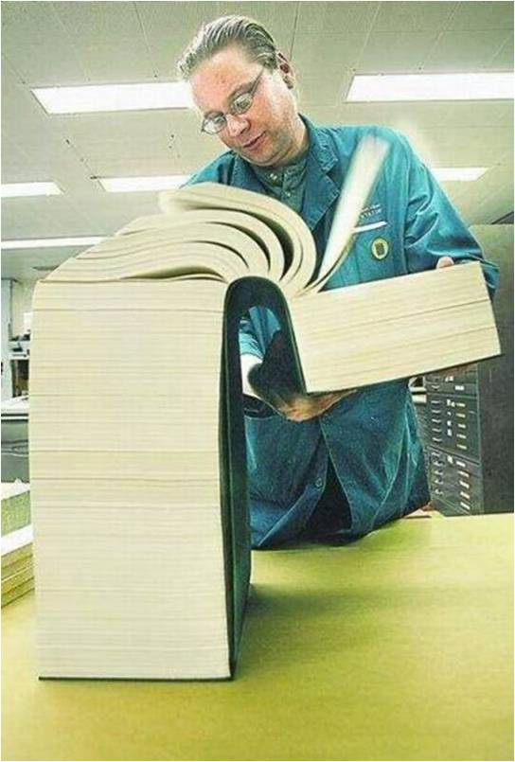

Book of Climate Output
What exactly we
find for Florida?

Slide 14
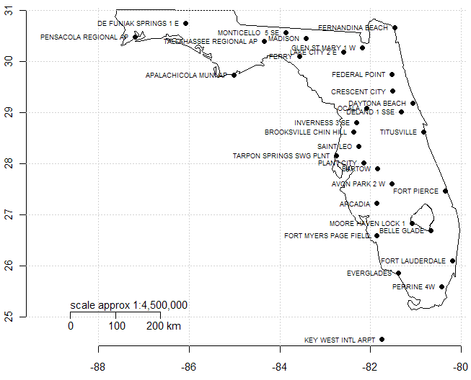

Historical Trends in Florida
Temperature and Precipitation
Variable | Averages | Extremes (by season)
Daily temperature | Average temperature Number of hot days | Number of days of extreme values (above 2-year return period) Maximum and minimum seasonal values Number of extreme events of duration 2, 3, 5, and 7 days
Precipitation | Total precipitation Number of wet days | Number of days of extreme values (above 2-yr return period) Highest seasonal value Number of heavy precipitation events of duration 2, 3, 5, and 7 days
Notes:
Stations with longest & most complete data records

Slide 15
Florida - Main Observations
↑ number of wet days during the dry season – POR
↓ May precipitation throughout the state – POR and especially post-1950. May be linked to changes in start of the wet season.
Urban heat island effect – urban (and drained) areas
  ↑ Tave and ↑ number of dog days for wet (warm) season especially post-1950
  Decrease in DTR (↑ Tmin > ↑ Tmax)
  ↑ Annual maximum of Tave and Tmin for all seasons in POR and especially post-1950

Slide 16
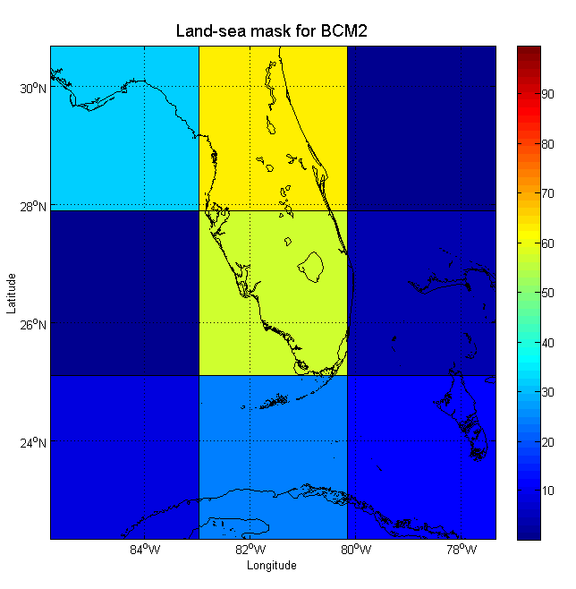
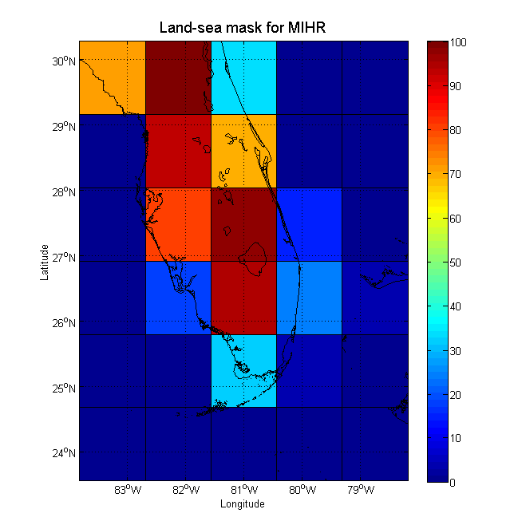
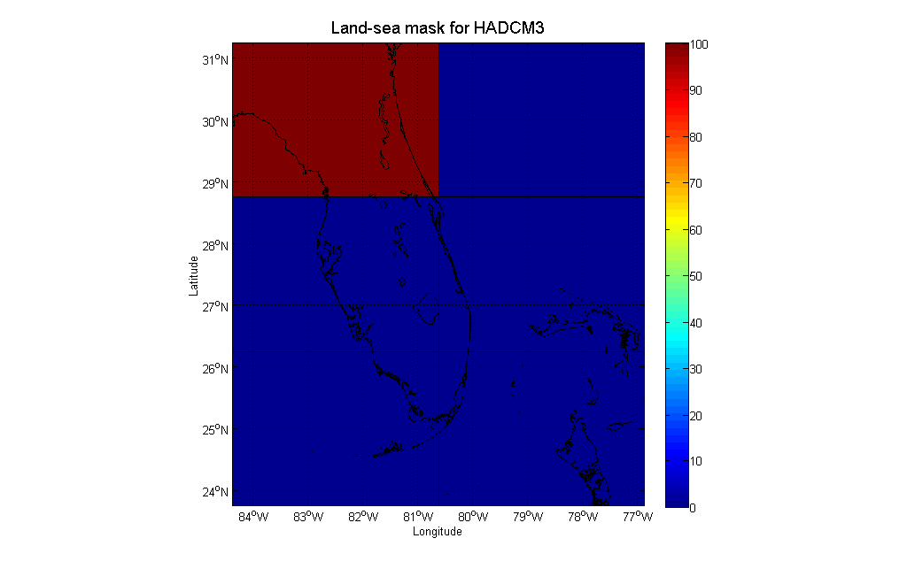
GCM Resolution in Florida
Uncertainties in GCM predictions due to:
  Poor resolution – South Florida not even modeled in some GCMs; greater errors at smaller scales
  From IPCC AR4-WG1, Ch. 8 - Simulation of tropical precipitation, ENSO, clouds and their response to climate change, etc.
Notes:
Good results at continental scales, but greater errors at smaller scales
Higher resolution does not necessarily mean more accurate simulations

Slide 17
Climate Projection Uncertainties
Internal Variability | General Circulation Model |  | Downscaling |  | Ice Sheet Dynamics | Scenarios
 |  | GCM (IPCC, 2007) | Statistical Dynamical |  |  | B1 | A1T | B2 | A1B | A2 | A1FI
 |  |  |  |  |  | 1.1-2.9 (○C) | 1.4-3.8 (○C) | 1.4-3.8 (○C) | 1.7-4.4 (○C) | 2.0-5.4 (○C) | 2.4-6.4 (○C)
 |  |  |  |  |  | 0.18-0.38 (m) | 0.20-0.45 (m) | 0.20-0.43 (m) | 0.21-0.48 (m) | 0.23-0.51 (m) | 0.26- 0.59 (m)
 |  | BCM2 | Constructed Analogues (CA) Bias Correction and Spatial Downscaling (BCSD) Weather Generators | Regional Climate Models (RCMs) |  | Climate Change Implications in Water Resources Investigations: Scenario based approaches Use all models Model Culling?
 |  | CGHR
 |  | CGMR
 |  | CNCM3
 |  | CSMK3
 |  | ECHOG
 |  | FGOALS
 |  | GFCM20
 |  | GFCM21
 |  | GIAOM
 |  | INCM3
 |  | IPCM4
 |  | MIHR
 |  | MIMR
 |  | MPEH5
 |  | NCCCSM
 |  | NCPCM
Scenario
Uncertainty
Natural Variability
Model Uncertainty

Slide 18
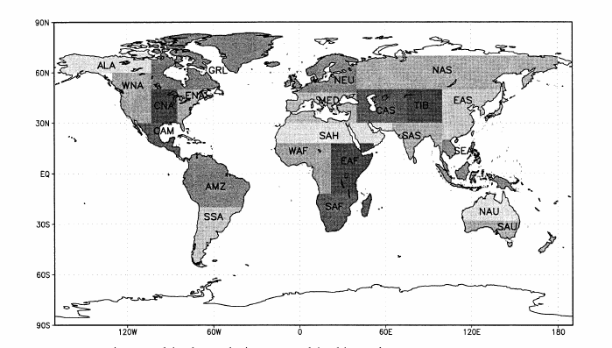
GCM Projections – Bayesian Approach (Tebaldi et al., 2008)
A Bayesian approach
Reward models with respect to BIAS (w.r.t. current climate) and CONVERGENCE (consensus on future projections)
23 Models, SRES scenarios A2(high), A1B (midrange), B1(low)
Posterior distribution of precipitation & temperature for each season & future decades
at http://rcpm.ucar.edu
MODEL
Likelihood:
Observed: X₀ ~ N[μ, −λ₀⁻¹]
GCM (current): X_{i} ~ N[μ, −λ_{i}⁻¹]
GCM(future): Y_{i} ~ N[ν, −(θλ_{i})⁻¹]
Priors:
μ, ν ~ U(-∞,+ ∞ )
λ_{i} ~ Γ (a,b), θ_{i} ~ Γ (c,d)

Slide 19
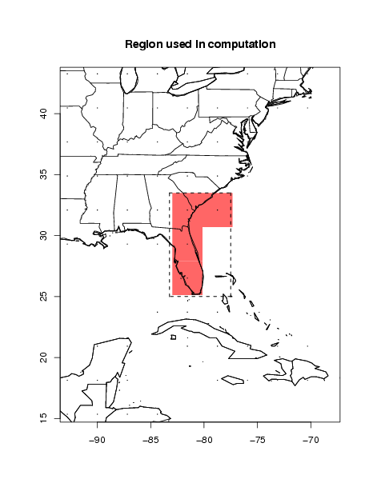
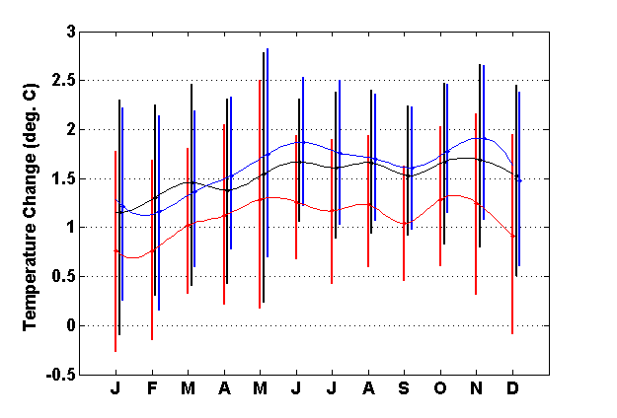
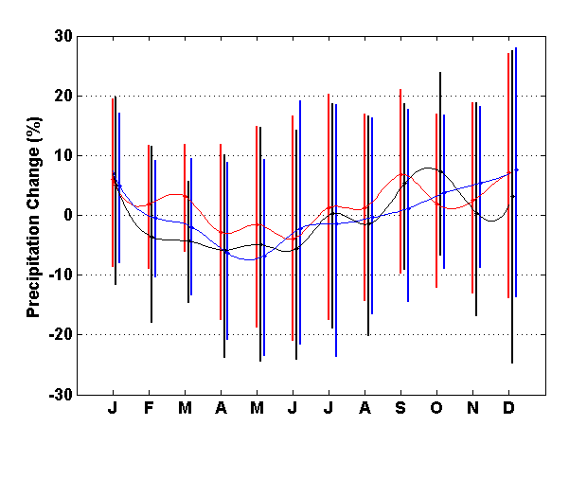
Projected Temperature Change from AOGCMs (for 2050) – Posterior Distribution
The vertical bars correspond to the percentiles, 5% and 95% of the posterior
distributions of temperature change for b1,a1b, and a2 scenarios (red, black and blue)

Slide 20
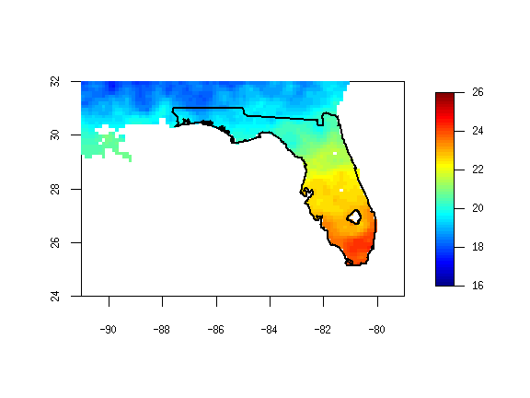
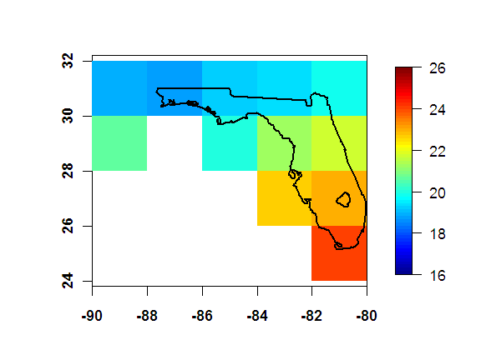
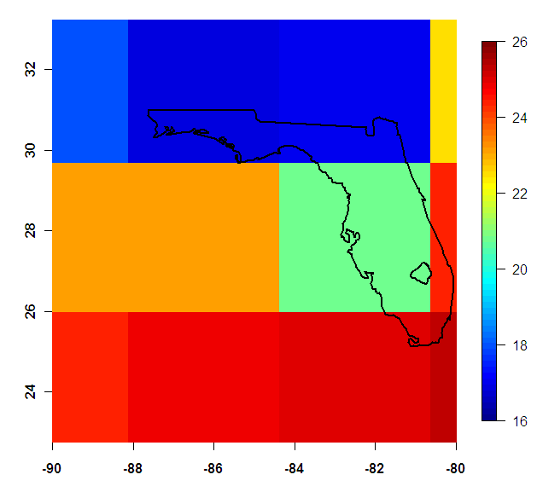
Statistical Downscaling – Example (Bias Correction-Spatial Disaggregation)
Gridded Observations 1/8 º
Observations 2º
GCM 3.5º
deg C
SD
BC
CDF-Obs
Bias-Corrected
CDF-Model
Model
time
percentile

Slide 21
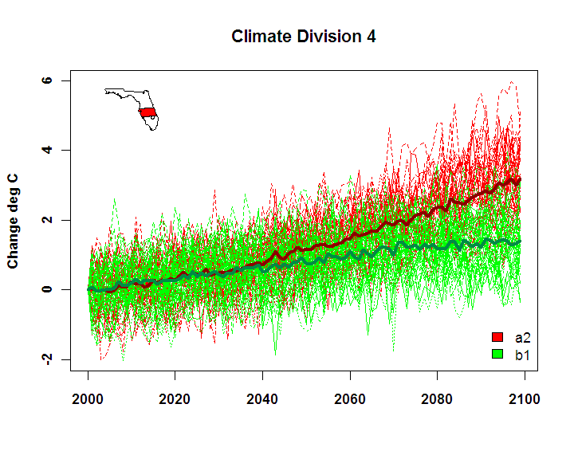
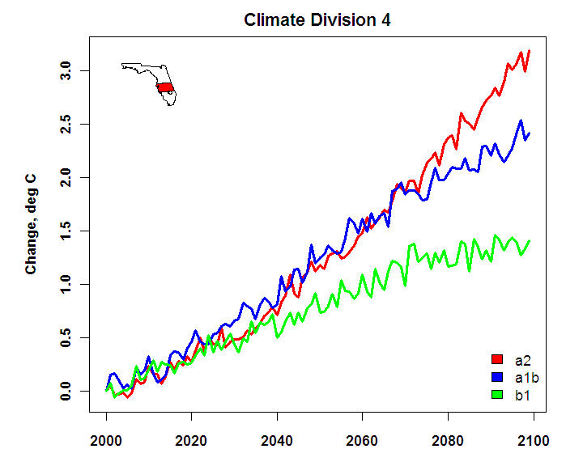
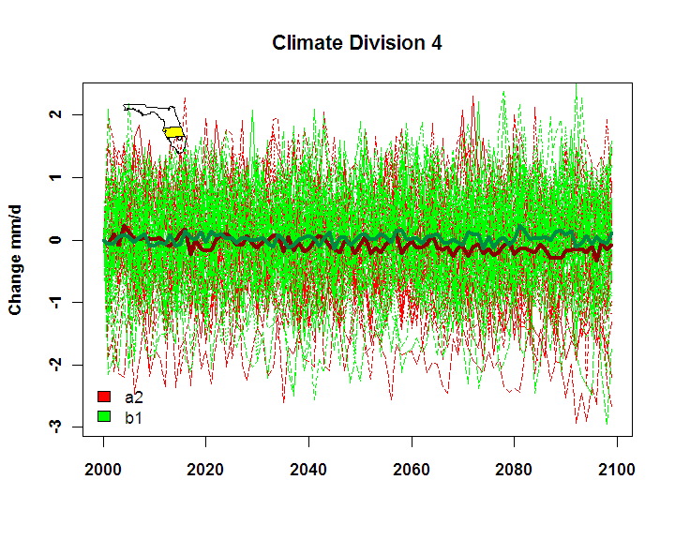
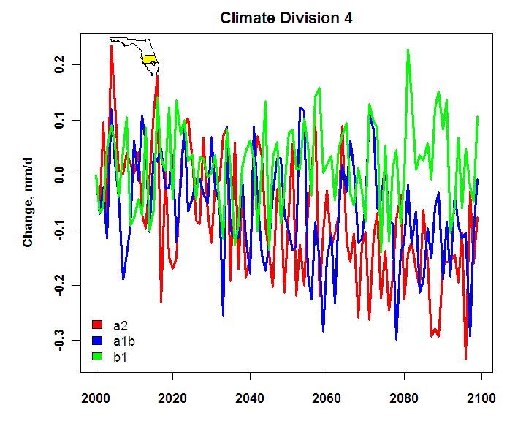
Future Projections – Temperature & Precipitation
ensemble mean
all models
Tº
P

Slide 22
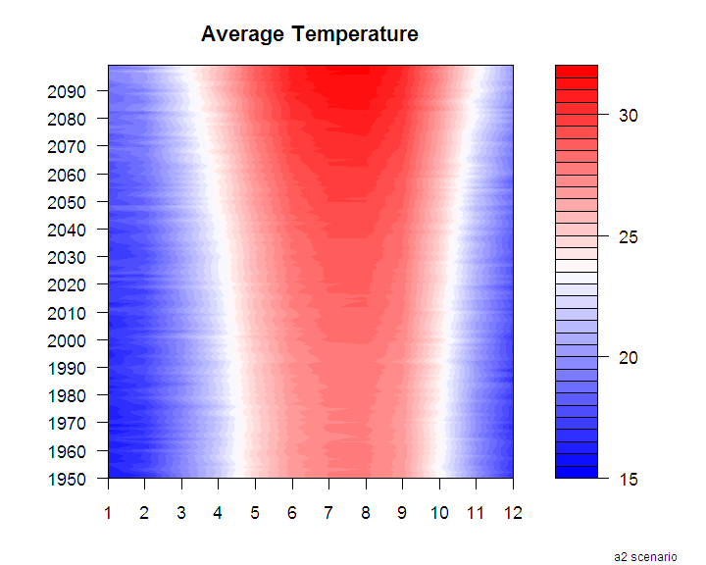
Change: Magnitude & Seasonality

Slide 23
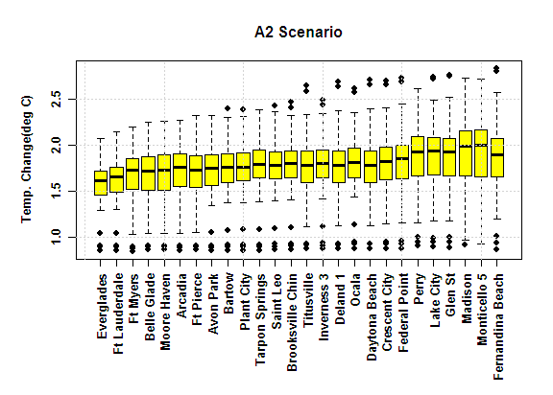
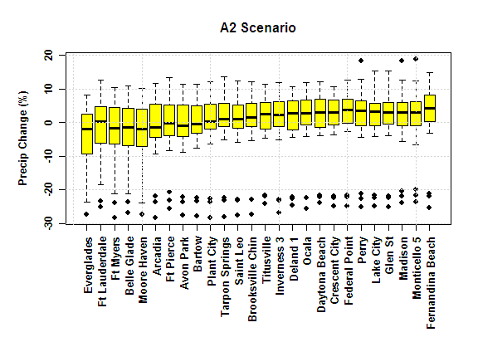
Spatial Trends
Temperature
Precipitation

Slide 24


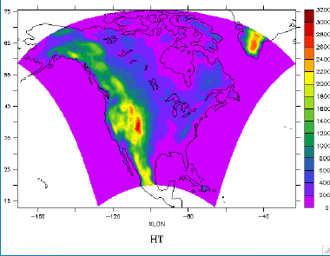
Dynamical Downscaling
North American Regional Climate Change Assessment Program
Acknowledgement:
NARCCAP is funded by the National Science Foundation (NSF), the U.S. Department of Energy (DoE), the National Oceanic and Atmospheric Administration (NOAA), and the U.S. Environmental Protection Agency Office of Research and Development (EPA)."

Slide 25
NARCCAP Scenario & Model Suite
A2 Emissions Scenario
GFDL
CGCM3
HADCM3
link to European
Prudence
CCSM
GFDL
Time slice
50 km
CAM3
Time slice
50km
1971-2000 current
Provide boundary conditions
2040-2070 future
MM5
Iowa State/
PNNL
RegCM3
UC Santa Cruz
ICTP
CRCM
Quebec,
Ouranos
HADRM3
Hadley Centre
RSM
Scripps
WRF
NCAR/
PNNL
Notes:
Interesting problem to determine expected relationship between time slice experiments and AOGCM runs and with RCMs using the same
AOGCM boundary

Slide 26
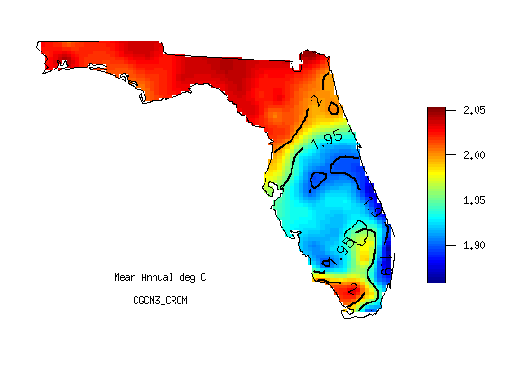
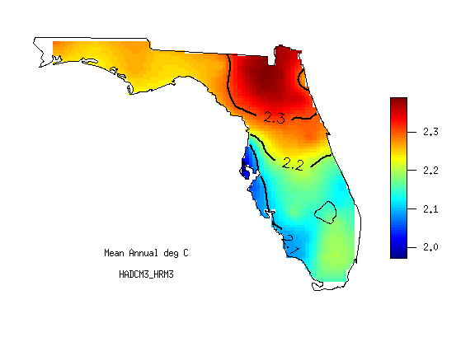
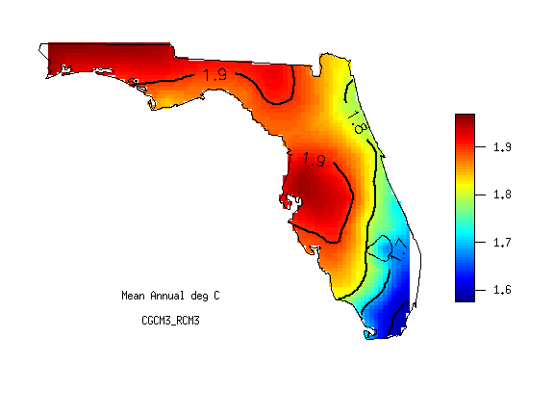
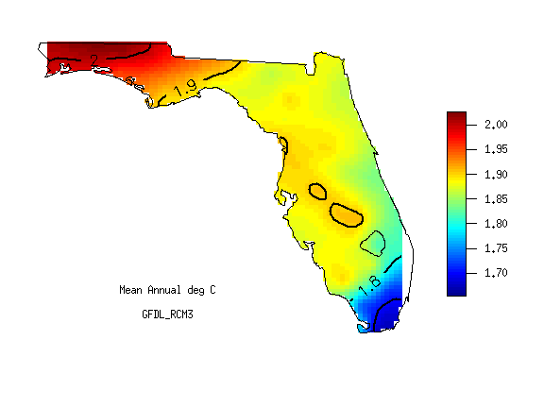
Change
Temperature
NARCCAP

Slide 27
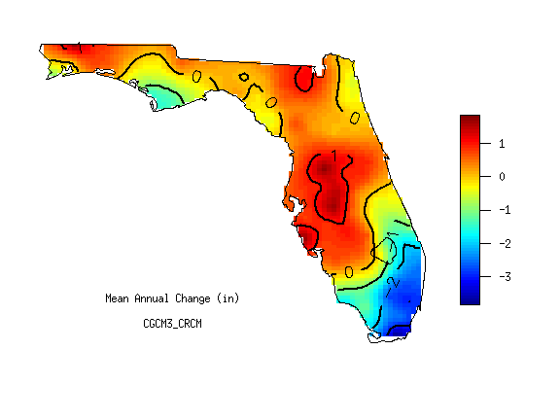
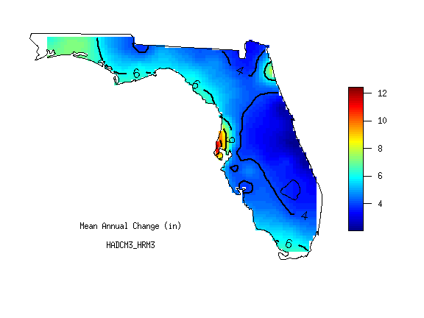


Change
Precipitation
NARCCAP

Slide 28






Changes in duration of “dog days” & “freezing temperatures”
BCCA
Dog days – Mean Number of days average above 80º F
Historical
CGCM3-CRCM
HADCM3-HRM3
Change from
1970-1999
to 2040-2069
Change from
1970-1999
to 2040-2069
Absolute Value
Freezing – Mean Number of days minimum below 32º F
Change from
1970-1999
to 2040-2069
Change from
1970-1999
to 2040-2069
Absolute Value

Slide 29

Can RCM be used to compute future ET?

Slide 30


Model skill: Precipitation Extremes (Rainfall Depth – Duration)
Observed

Slide 31


Sea Level Rise

Slide 32


Rising Seas – Historical Data
Wilmington
Charleston
Pensacola
Fort Pulaski
Mayport
Relative Sea Level (height above a local datum) depends on:
  Global Mean Sea Level
  Regional Variability
  Vertical Land Movement (uplift/subsidence)
St. Petersburg
Key West

Slide 33



Unified SE FL Sea Level Rise Projection

Slide 34

Projected range of sea level rise (National Climate Assessment, 2013)
Draft report: http://ncadac.globalchange.gov
Notes:
Estimated, observed and possible amounts of global sea level rise from 1800 to 2100. Proxy estimates (Kemp et al. 2012) (for example, based on sediment records) are shown in red (pink band shows uncertainty), tide gauge data in blue (Church and White 2011a), and satellite observations are shown in green (Nerem et al. 2010). The future scenarios range from 0.66 feet to 6.6 feet in 2100 (Parris et al. 2012). Higher or lower amounts of sea level rise are considered implausible, as represented by the gray shading. The orange line shows the currently projected range of sea level rise of 1 to 4 feet by 2100, which falls within the larger risk-based scenario range. The large projected range reflects uncertainty about how glaciers and ice sheets will react to the warming ocean, the warming atmosphere, and changing winds and currents. As seen in the observations, there are year-to-year variations in the trend. (Figure source: Josh Willis, NASA Jet Propulsion Laboratory). Figure 2.26 from Ch2: Our Changing Planet.

Slide 35
Summary of Projections for 2060
Variable | Global Models | Statistically Downscaled Data | Dynamically Downscaled Data
Average Temperature | 1 to 1.5ºC | 1 to 2ºC | 1.8 to 2.1ºC
Precipitation | -10% to +10% | -5% to +5% | -3 to 2 inches
Sea Level Rise | 1.5 feet

Slide 36

Caveates: Spatio-Temporat Rainfall Dataset
Daily Rainfall (1965-2005)
Spatially interpolated to create a spatial dataset for each day
Future Rainfall Scenarios?
  Simplified “Delta Method”

Slide 37


Caveats: Reference Evapotranspiration (RET), Demands, Boundary Inflows
Demands (Agricultural areas):
  Ran AFSIRS using rainfall and ET scenarios
Boundary Inflows
  Rainfall-Runoff relationships
Notes:
Previous attempts at estimating RET for hydrologic modeling have been based on simpler methods or more complex methods relying heavily on gap-filling techniques.
Simple Method developed from lysimeter studies on ENR308 constructed wetland – cattails, mixed marsh, open water
Used since Rs captures 70% of ET variability

Slide 38
Modeling Scenarios
2010 Baseline (demands and landuse corresponding to 2010 simulated with the 1965-2005 rainfall & ET (BASE)
2010 Baseline with 10% decrease in rainfall (decRF)
2010 Baseline with 10% increase in rainfall (incRF)
2010 Baseline with 1.5° Celsius increase and 1.5 foot sea level rise with increased coastal canal levels (incET)
2010 Baseline with 10% decrease in rainfall, 1.5° Celsius increase and 1.5 foot sea level rise with increased coastal canal levels (decRFincET)
2010 Baseline with 10% decrease in rainfall, 1.5° Celsius increase and 1.5 foot sea level rise with no increased coastal canal levels (decRFincETnoC)
2010 Baseline with 10% increase in rainfall, 1.5° Celsius increase and 1.5 foot sea level rise with increased coastal canal levels (incRFincET)

Slide 39









Hydrologic Performance Measures

Slide 40

DecRFincET versus IncRFincET

Slide 41
Summary
Resolution of GCMs is not adequate to capture hydro-meteorology of Florida peninsula
Skills of models for regional climate information may not be adequate, yet. More work is need to verify and improve the methods/models.
Need to work together on a “unified set of climate scenarios” for Florida.
Regional modeling Scenario runs made using a very simplified “delta method” may be useful for engaging professionals in various disciplines

Slide 42


Slide 43


Slide 44



Slide 45


Slide 46


Slide 47

Questions?

Slide 48

Potential ET change

Slide 49
Percent Change in Demand and Runoff (K ac-ft)
Type | BASE | decRF | incRF | incET | decRFincET | decRF incETnoC | incRF incET
Palm Beach County Irrigation | 209 | 3 | -6 | -2 | 1 | 1 | -8
Broward County Irrigation | 161 | 3 | -6 | 2 | 5 | 5 | -5
Miami-Dade County Irrigation | 231 | 4 | -5 | 5 | 9 | 9 | -1
EAA | 309 | 20 | -10 | 25 | 61 | 60 | 6
C-43 Demand | 107 | 15 | -14 | 14 | 31 | 31 | -1
C-43 Runoff | 713 | -27 | 28 | -11 | -36 | -36 | 17
C-44 Demand | 24 | 21 | -16 | 21 | 47 | 47 | 2
C-44 Runoff | 166 | -26 | 28 | -12 | -36 | -36 | 15

Slide 50

Changes to boundary flows (Kissimmee Basin Example)

Slide 51


Geographical Subregions and Transects

Slide 52
Percent Change in Lake Okeechobee Inflows

Slide 53
Percent Change in Lake Okeechobee Outflows

Slide 54


Slide 55


Slide 56


Slide 57

Transect Flows (% change)
Scenario | 1 | 2 | 4 | 5 | 6 | 7 | 8 | 10 | 12 | 15 | 16
Base (total, K ac-ft) | 74 | 299 | 92 | 245 | 68 | 477 | 507 | 77 | 824 | 168 | -153
decRF (%delta) | -18 | -37 | -26 | -27 | -38 | -36 | -28 | -35 | -40 | -54 | -27
incRF (%delta) | 15 | 40 | 10 | 25 | 43 | 36 | 14 | 5 | 30 | 15 | 19
incET (%delta) | -9 | -19 | -12 | -17 | -22 | -22 | -15 | -13 | -22 | -27 | -13
decRFincET (%delta) | -31 | -56 | -49 | -44 | -57 | -56 | -56 | -51 | -67 | -83 | -56
decRFincETnoC (%delta) | -31 | -56 | -49 | -44 | -57 | -56 | -54 | -51 | -65 | -81 | -56
incRFincET (%delta) | 4 | 19 | 4 | 11 | 19 | 17 | 6 | 10 | 13 | 12 | 8

Slide 58

Transect Flows (cont.)
Scenario | 17 | 18 | 19 | 20 | 21 | 22 | 23 | 23a | 23b | 23c | 27
Base (total) | 692 | 131 | -117 | 7 | 675 | 133 | 154 | 19 | 67 | 68 | 730
decRF (%delta) | -55 | -7 | -24 | 329 | -51 | -63 | -44 | -42 | -46 | -43 | -53
incRF (%delta) | 73 | -7 | 19 | -514 | 62 | 96 | 51 | 58 | 55 | 46 | 65
incET (%delta) | -33 | -8 | -15 | 186 | -28 | -39 | -21 | -116 | -16 | 0 | -32
decRFincET (%delta) | -74 | -63 | -43 | 243 | -69 | -82 | -64 | -142 | -61 | -46 | -67
decRFincETnoC (%delta) | -73 | -23 | -40 | 286 | -68 | -80 | -67 | -142 | -61 | -51 | -72
incRFincET (%delta) | 31 | -7 | 8 | -129 | 30 | 40 | 25 | -89 | 37 | 44 | 27

Slide 59


Slide 60


Slide 61


Slide 62


Slide 63


Slide 64


Slide 65


Slide 66


Slide 67




Slide 68


Slide 69


Slide 70


Slide 71

Rainfall Deviations from Mean of 133 cm
Orlando
cm
Ft. Pierce
West
Palm
Beach
Monthly Distribution
Naples
Wet
Mean Annual
Rain (cm)
cm
Dry
Miami
100
120
140
160

Slide 72
Return Period – nonstationary case
Return Period is defined as the “expected time for the first exceedance” (expected waiting time)
Coley (2013) provides a nice simplification:

Slide 73

Return Period Change Under Non-Stationarity
Key West
Adak

Slide 74
Performance Measure Sets
Available in
BASE, incRF, incET, incRFincET
BASE, incRFincET, decRFincET, decRFincETnoC
BASE, decRFincET, decRFincET,decRFincETnoC
ftp://ftp.sfwmd.gov/pub/jabarne/climate/

Slide 75
Simulation of Daily Rainfall with Inter-annual & Multi-Decadal Climate Cycles (Hyun-Han Kwon, Upmanu Lall, and Jayantha Obeysekera (2008)

Slide 76



Current Water Management
In Urbanized Areas
Soil storage
Water Table
Primary Canal
Swale

Slide 77
Increased Canal Levels
Impacts Flood Protection
Soil storage
Water Table
Primary Canal
Swale
* Increasing Canal Levels to counter saltwater intrusion may impact flood protection due to increased groundwater levels

