Slide 1
Scenario Planning and Geovisualization
NSF Water, Sustainability and Climate
Project Kick Off Meeting
Dr. Michael Flaxman
March 3, 2013

Slide 2
Topics
Scenario Concepts and Organization
Scenario Generation Methods
Geovisualization Options & Prospects

Slide 3



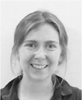



MIT Research Team
Dr. Juan Vargas
Christopher Horne
Stephen Lloyd
Linda Ciesielski
Gates Gooding
Vanessa Ng
Holly Moeller

Slide 4

MIT Scenarios and Similar Projects
• 5 Year Research initiative developed while faculty at MIT
initially sponsored by FWS and USGS
Has spawned additional related scenario projects:
Peninsular Florida LCC Conservation Scenarios (FWS)
Florida Beaches HCP Scenarios (FWC)
Keys Marine Adaptation Planning (FWC)
Left MIT in 2012 to found Geodesign Technologies
San Francisco-based scenario planning firm
Notes:
4

Slide 5
MIT Everglades Project Goals
• Simulate a range of possible futures, with variations in
climate
population growth /pattern
and planning policies
Identify potential impacts of these scenarios on “trust resources”
  Species
  Habitats
  Refuges and landscapes
Notes:
5

Slide 6
Classic “Wicked” Problem
  Missing broad social consensus
    but science, professional due diligence and legislation require addressing the issues
  Levels of uncertainty make conventional risk assessment techniques problematic
    For example, IPCC scenarios have no probabilities assigned
  Involves a deeply coupled human-natural system.
    Assumptions about human behavior are significant in systems operation, and affected by natural events
    Physical designs affect policies and vice versa
  Potentially effects many systems in parallel
    Humans – not just species - will move in response to climate change
    Water demand, recreation, transportation, energy, all will adapt simultaneously

Slide 7
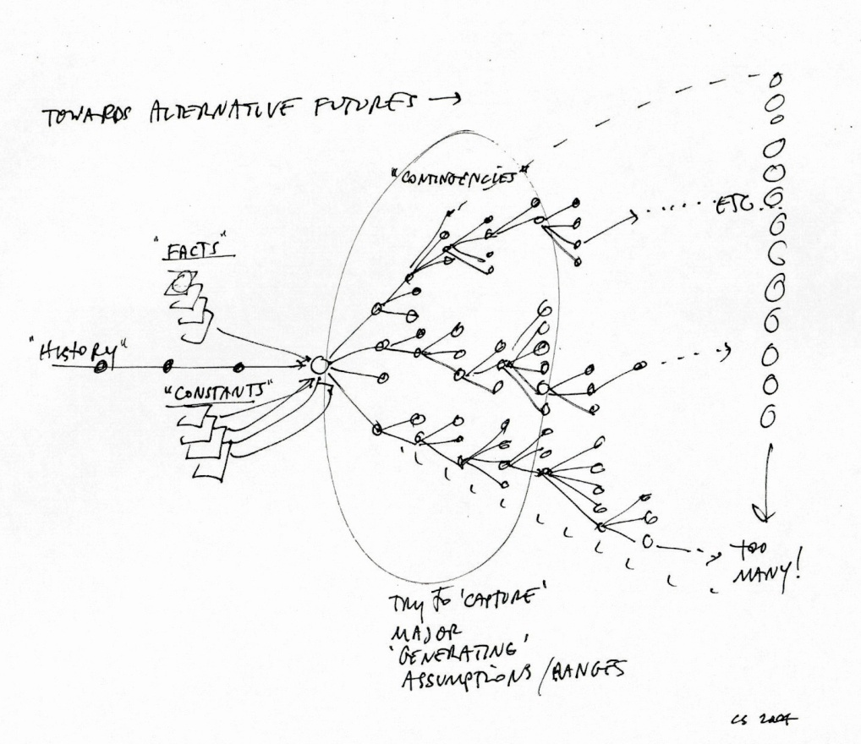
Characteristics of Desirable Solutions
Technical/Scientific
  Generating solid information at relevant scales
  Integrating across science project/disciplines
  Managing propagation of uncertainty
Planning Process/Institutional Aspects
  Accounting for dynamic spatial processes with significant uncertainties
  Integrating fast-changing science

Slide 8
Approach
  Stakeholder-based participatory planning
    Get people responsible for making decisions involved up front and throughout
  Scenario-based simulation modeling
    Make uncertainties explicit and tangible
    Package multiple variables to avoid combinatorial explosion
  Evaluate Conservation Consequences
    Model and evaluate different conservation strategies in scale and with realistic budgets
    Look for “resilient” strategies (plans which work across a range of conditions)

Slide 9
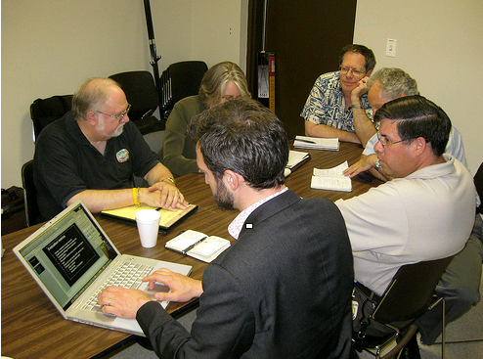
Essential Components of
“Alternative Futures” Planning
  Stakeholder Process
  Scenarios
  Process Models
  Impact Assessments

Slide 10
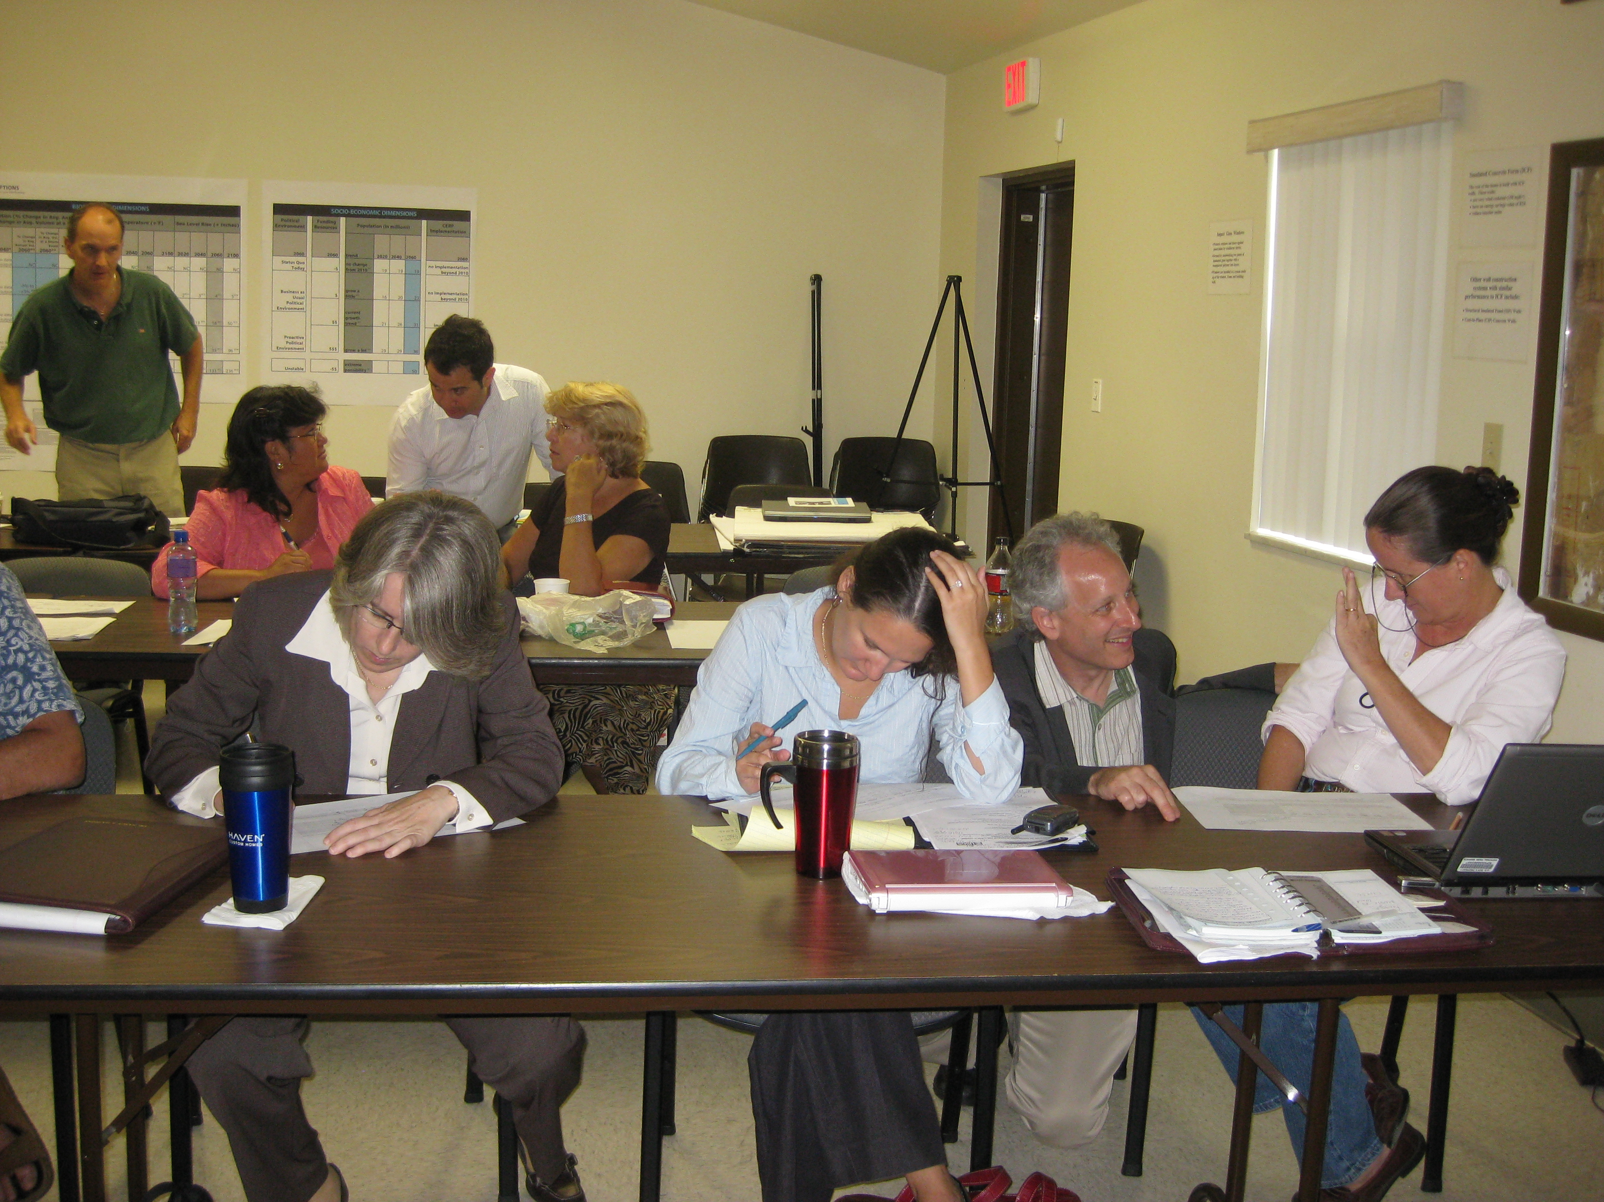
Stakeholder-Based Processes
  Want a broad-based, representative group of those tasked with implementation + those with substantive knowledge to contribute
  Provide expert review and help ensure management relevance
  This requires significant “contact hours” and long term commitment
10

Slide 11
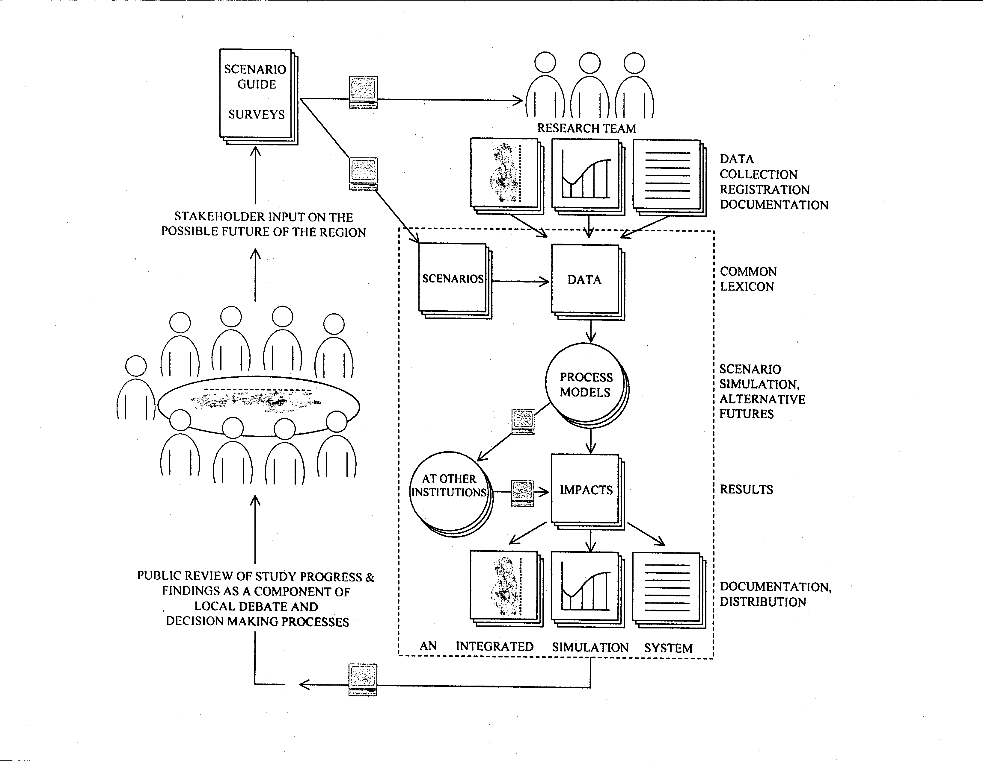

Slide 12
What Do We Mean By “Scenarios”?
Bundles of consistent assumptions, facts, projections and possible policies
Vary along multiple dimensions, not just one (i.e. climate + population)
Require expertise and judgment to construct usefully
Spatially rendered into visual and computable forms
12

Slide 13
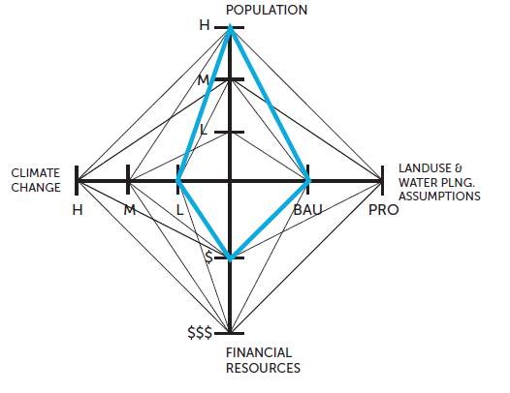
Scenario Dimensions
Which aspects of change are considered?
Climate Change
Population Projections
Financial Resources
Planning Assumptions
Notes:
13

Slide 14
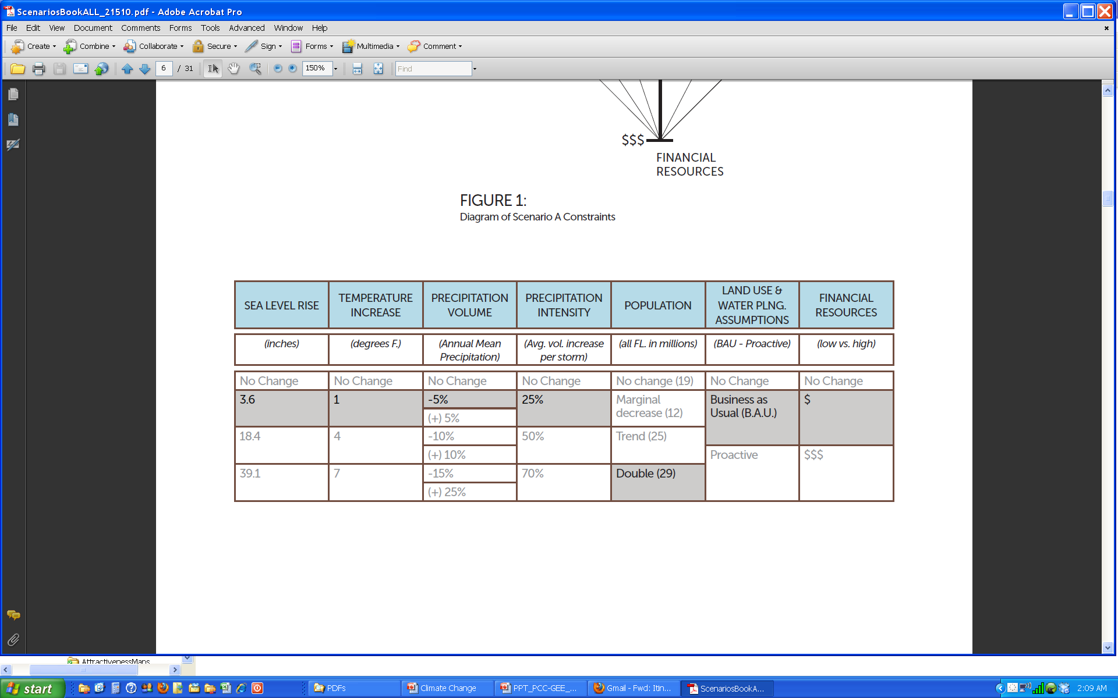
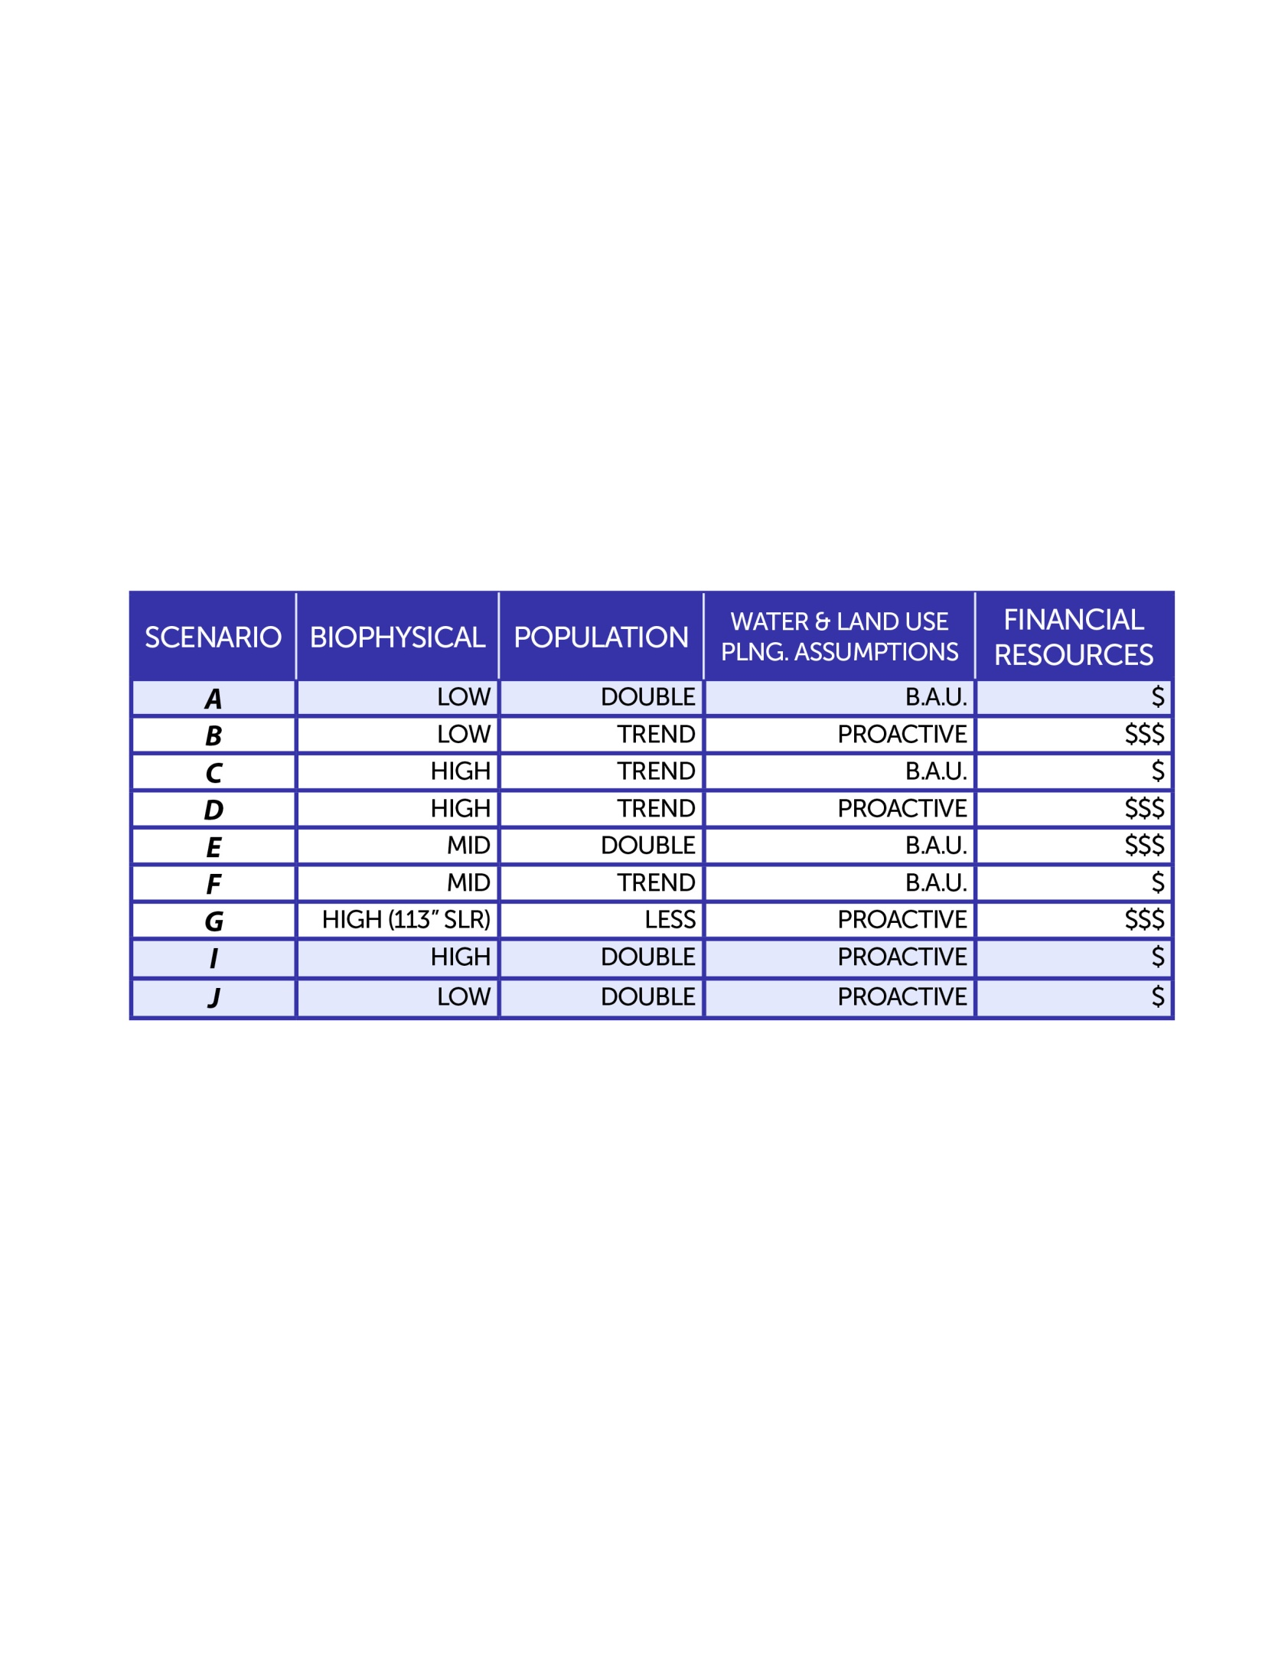
Scenario Parameters & Bundling
Which specific values are used for each dimension, and how are they grouped?
14

Slide 15

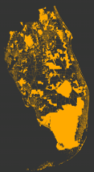




“AttCon” Simulation Process
DEMAND
ATTRACTIVENESS
Residential
Conservation
Agriculture
Residential
Conservation
Agriculture
ALTERNATIVE FUTURES (2020 -2040 -2060)
15
Notes:
15

Slide 16
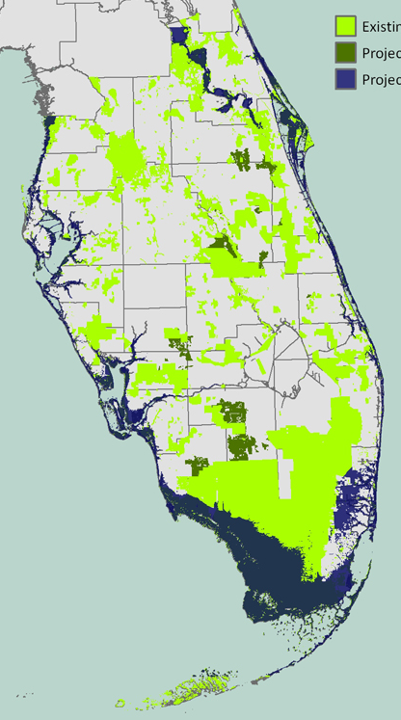
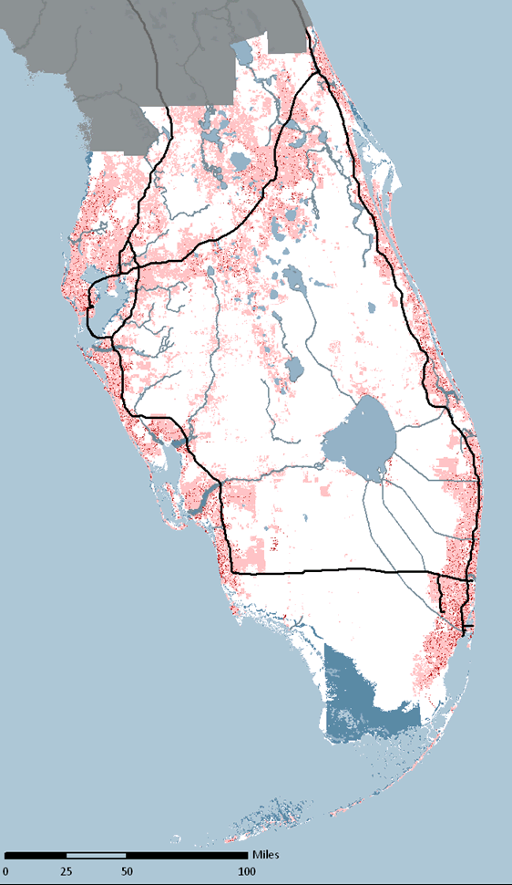
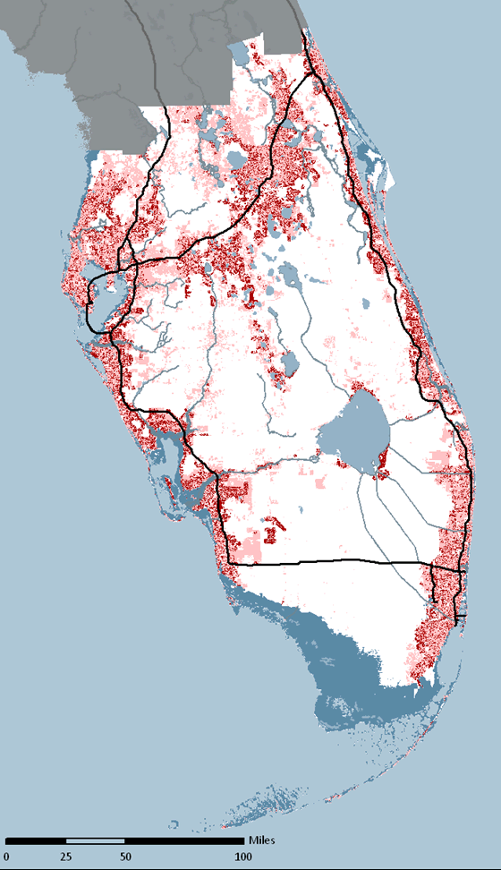
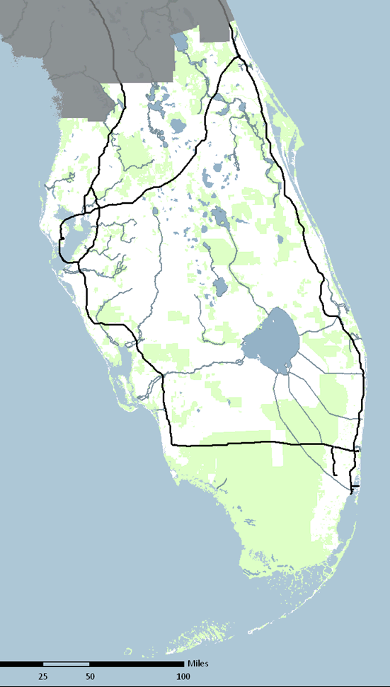
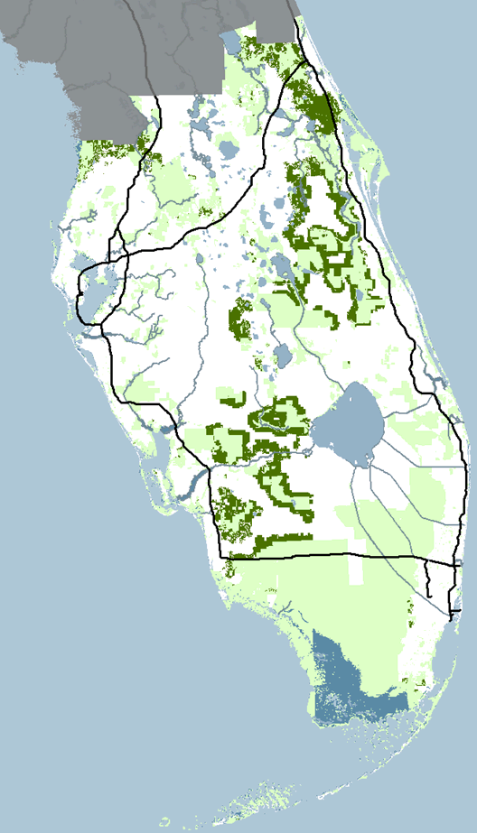
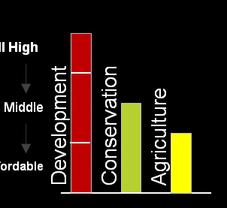
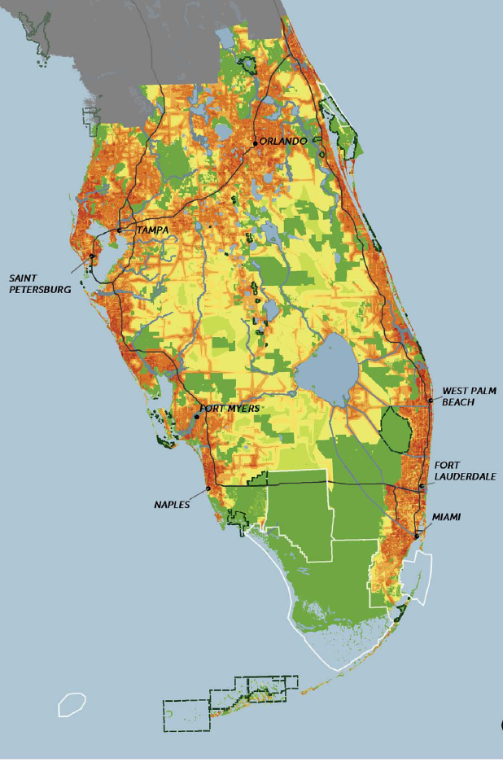
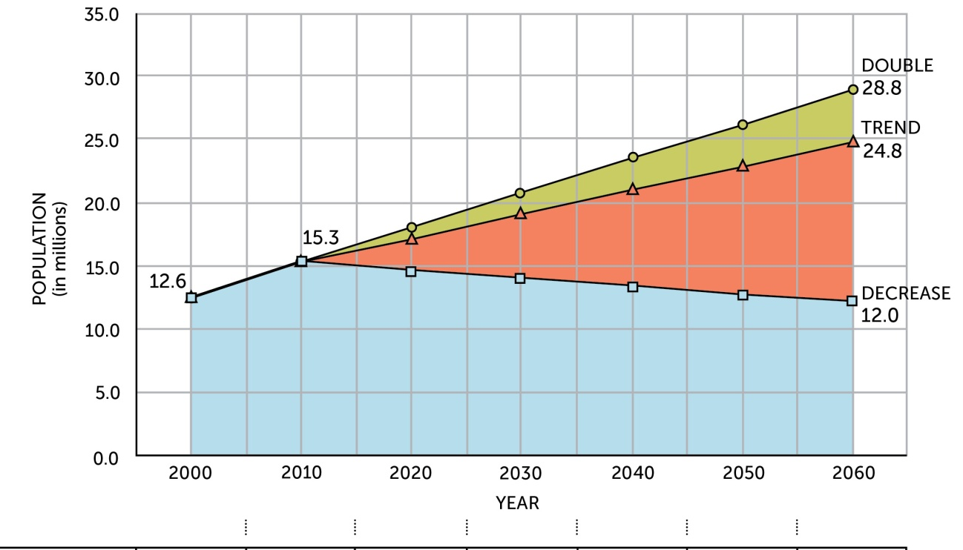
ANIMATION - PROCESS OF GEOSPATIAL SEQUENCED-ALLOCATION
Development, conservation and agriculture
2014
YEAR
2019
2010
2011
2012
2013
2015
2016
2017
2018
2020
All High
Middle
Conservation
Development
Conservation
Development
Agriculture
Agriculture
Affordable
2
1
3
4
5
6
7
8
9
0

Slide 17
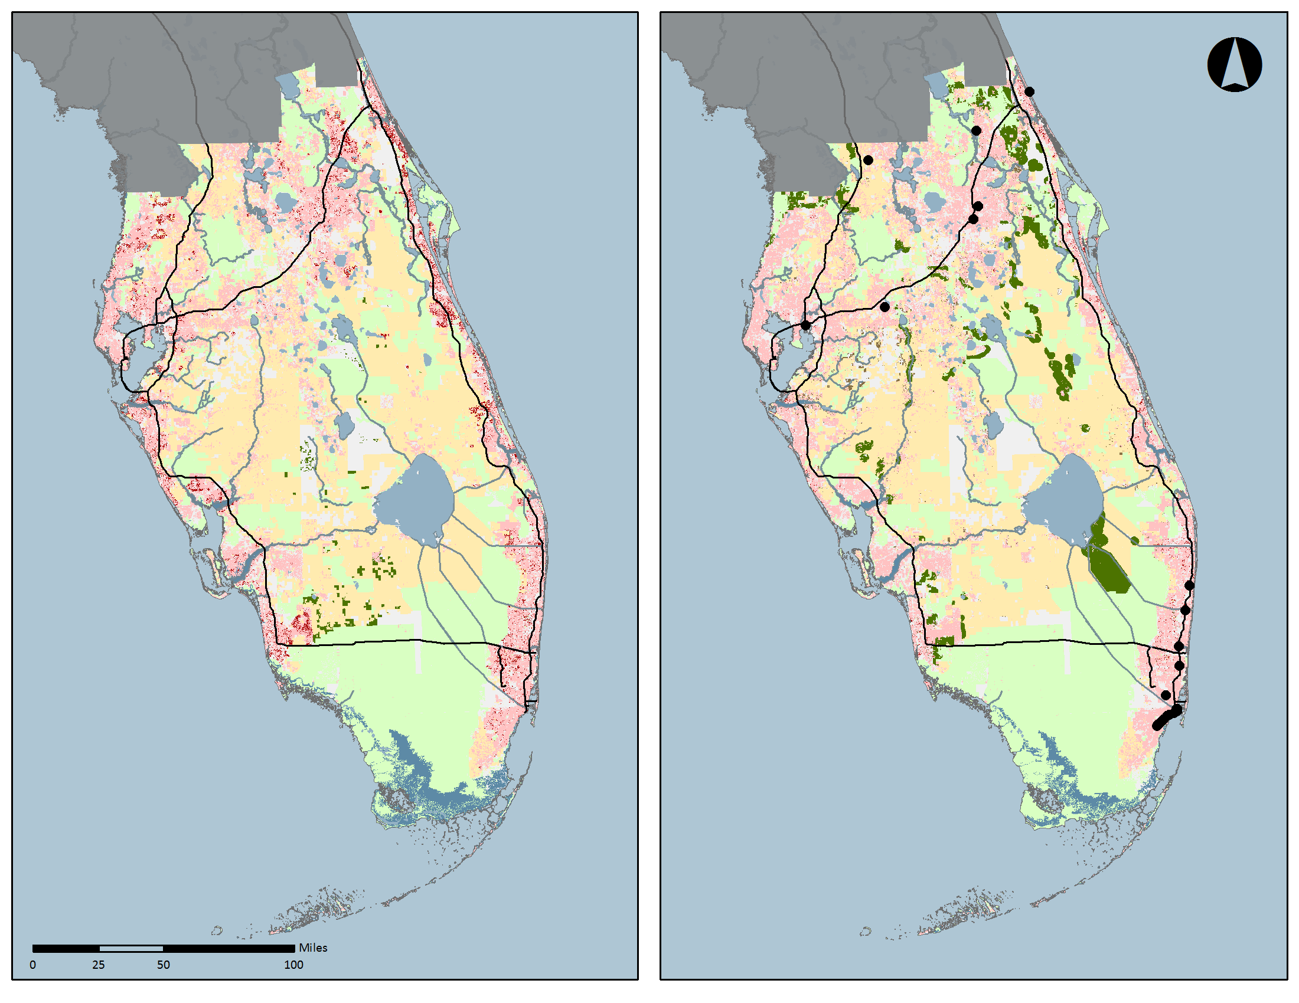
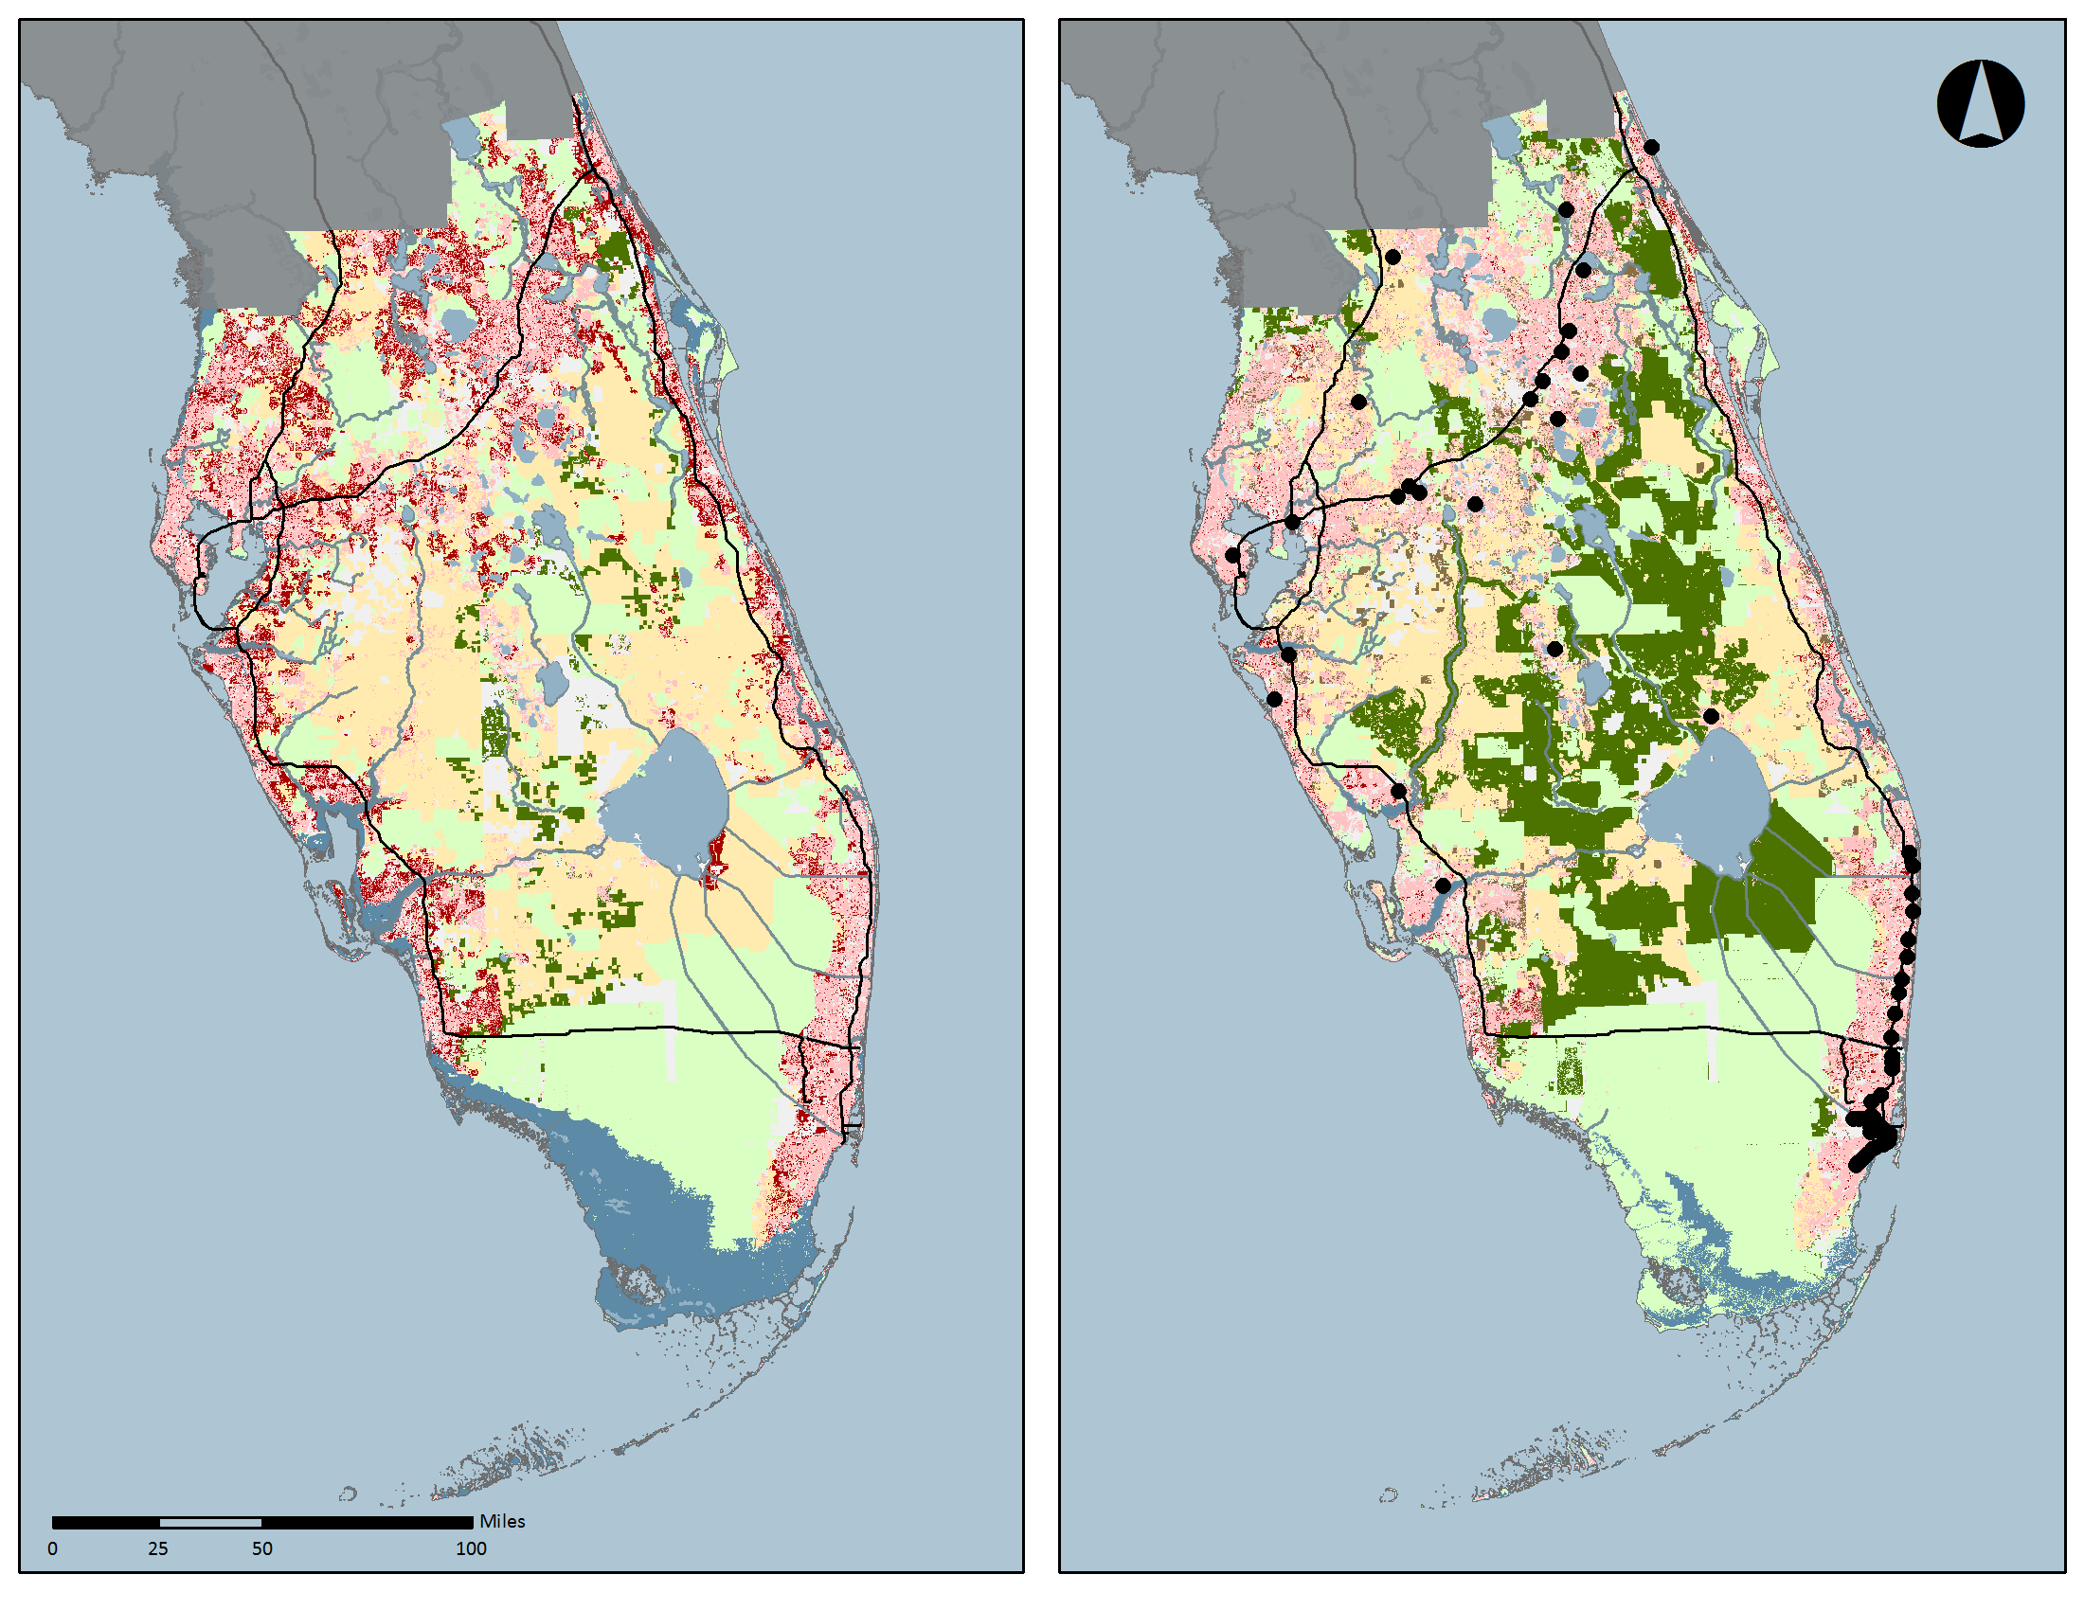
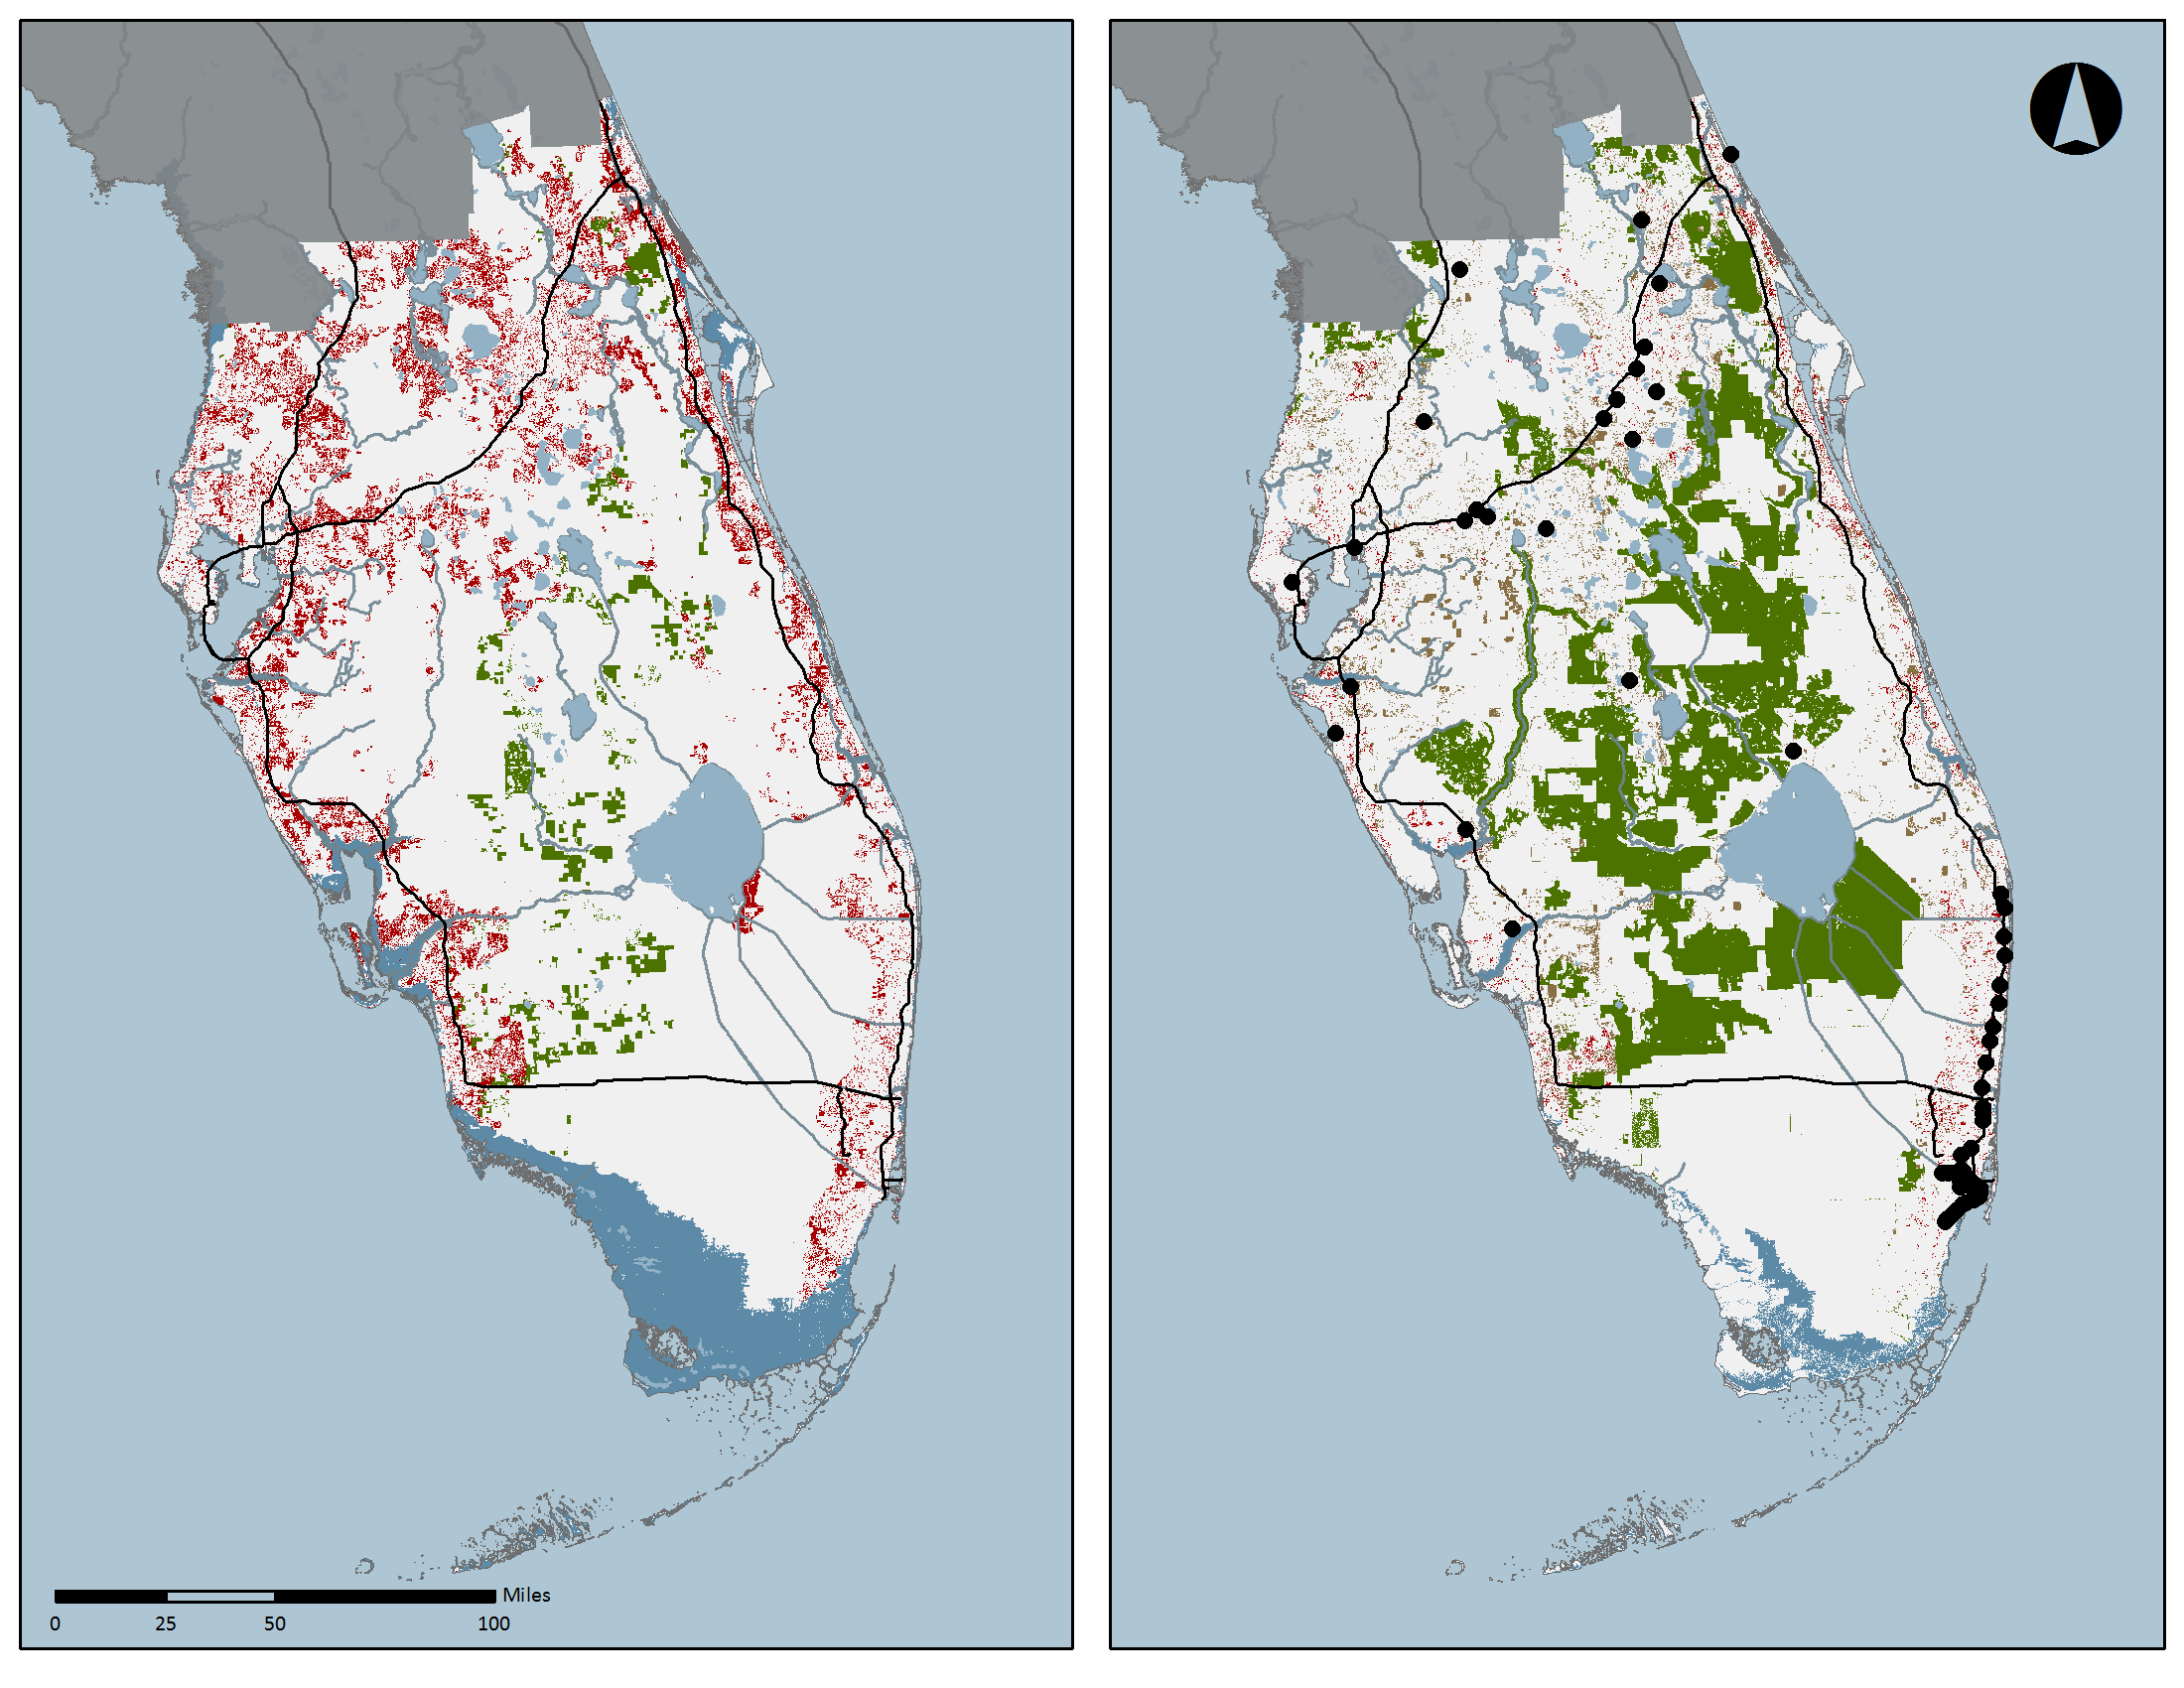
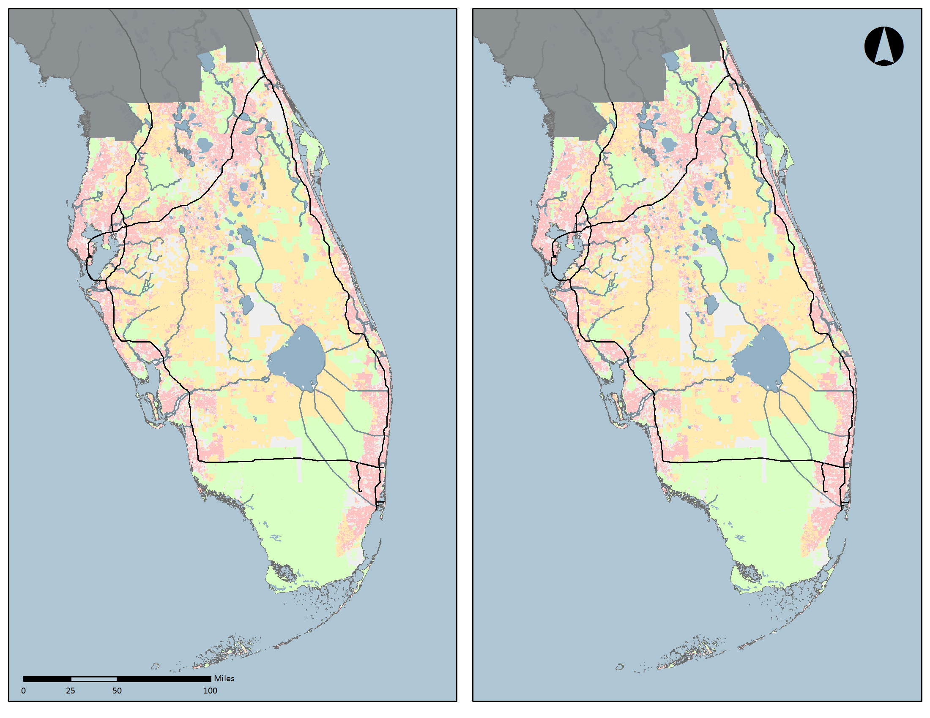
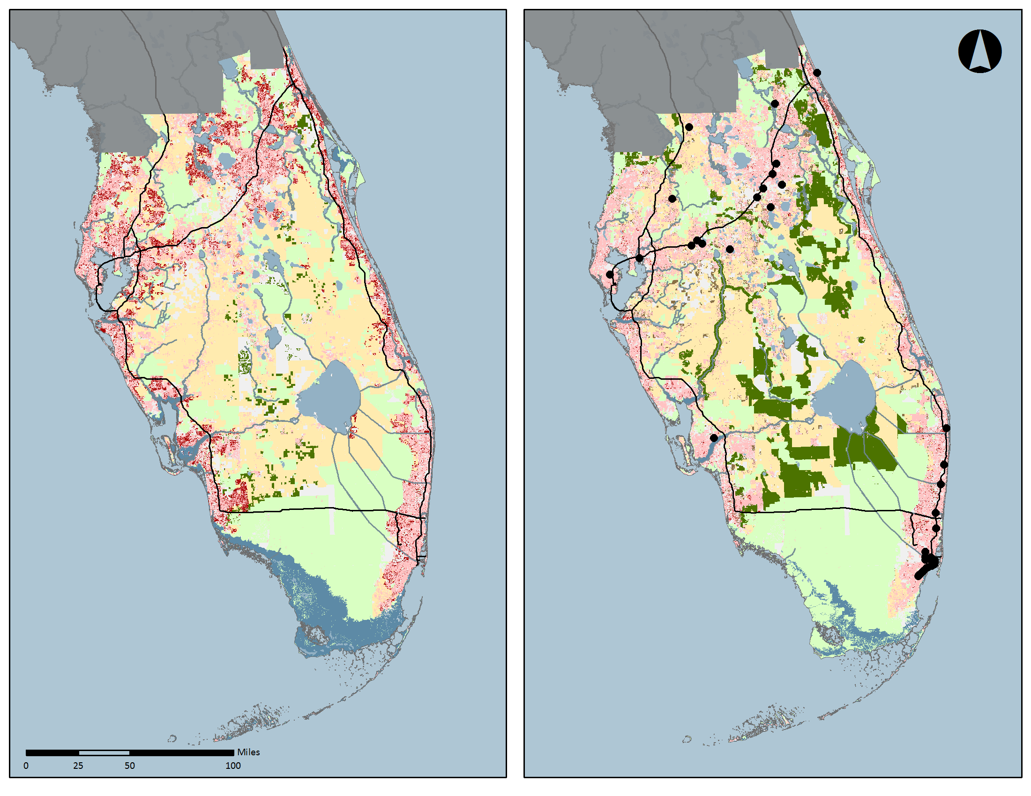



Scenario C
Scenario B
Year: 2010
Year: 2020
Year: 2060
Year: 2060
Only new
area
allocated
Year: 2040
Percent of
Study Region Area
Percent of
Study Region Area
other
other
High Sea Level Rise – Low Financial Resources
Business as Usual – Double Population
Low Sea Level Rise – High Financial Resources
Proactive – Trend Population
17

Slide 18
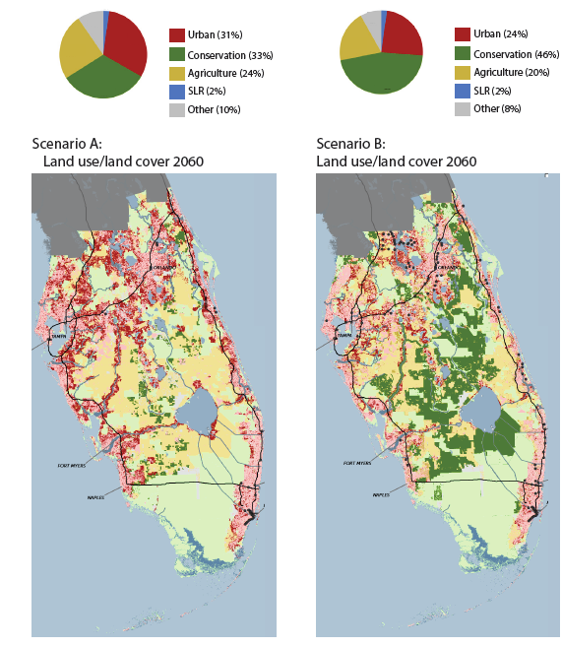
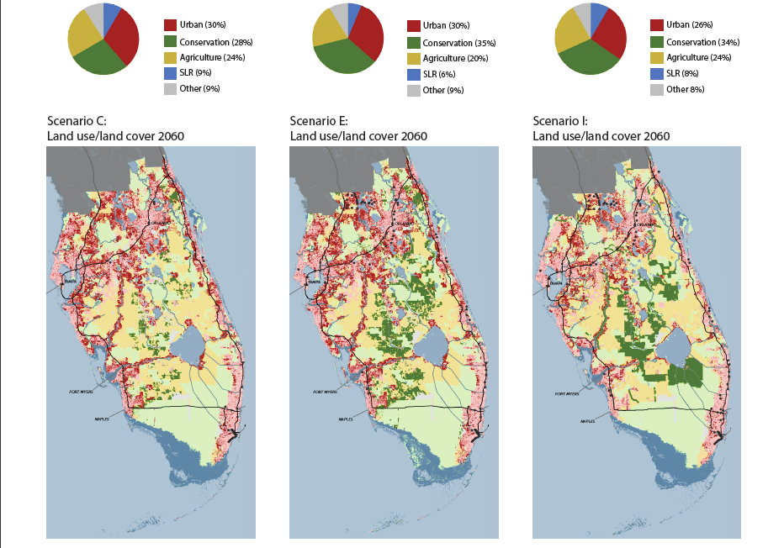
SCENARIO A SCENARIO B SCENARIO C SCENARIO E SCENARIO I

Slide 19
PFLCC Scenarios
Focus on potential private voluntary conservation. Use latest tidally-corrected LIDAR for SLR (still bathtub model). Use 2010 census

Slide 20
Geovisualization

Slide 21
Motivating Issues
Maps themselves are good geovisualization techniques
However…
  Relatively Abstract, especially for law audiences
  Especially hard to judge “new concepts” in map form
Full 3d/4d immersive representations possible
  But generally still hard, expensive, hand-built

Slide 22
The Challenge
Literature shows that you don’t need “photorealistic” renderings for comprehension (Lange 2001, Bishop 2006)
But do need at least cartoonish or “evocative” views
  i.e. users can understand objects without a key or legend
Need to drive this at scale for hundreds to millions of objects
  So need efficient methods to generate

Slide 23
Geovisualization Methods
Manually creating thousands of 3D models is infeasible
  (except with Hollywood talent and budgets)
For science visualization use, best to generate 3D objects procedurally
Or obtain large libraries of 3D objects
Use maps+ rules to place objects
Use normal 3D rendering

Slide 24
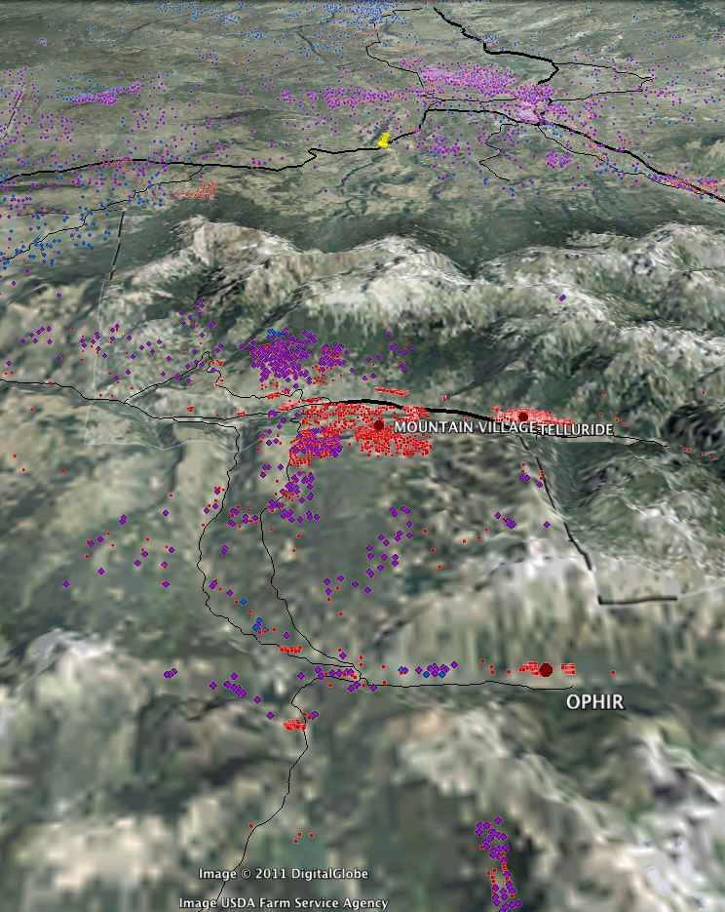
Simplest Technique: 2.5D Drape
Works well for
  orthophotos
  over dramatic terrain
  at intermediate to long distances
  Where viewer doesn’t notice lack of parallax
  “Off the shelf” technology (Google Earth, etc.)

Slide 25
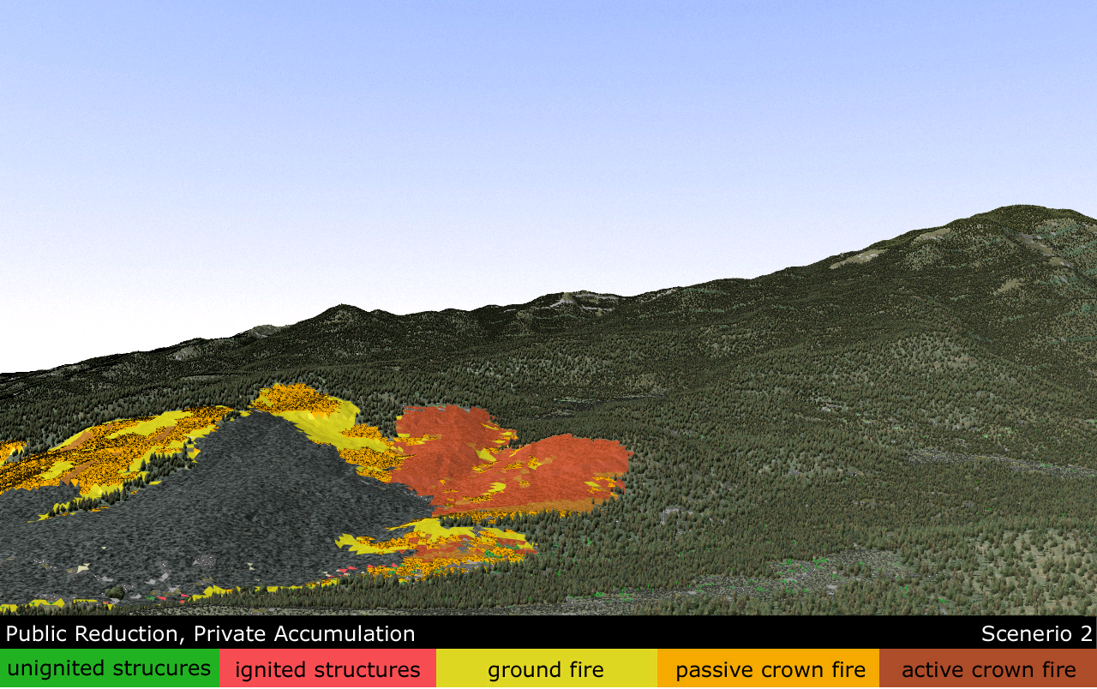
Dynamic GIS Model Output Rendered with “Billboard” Technique

Slide 26
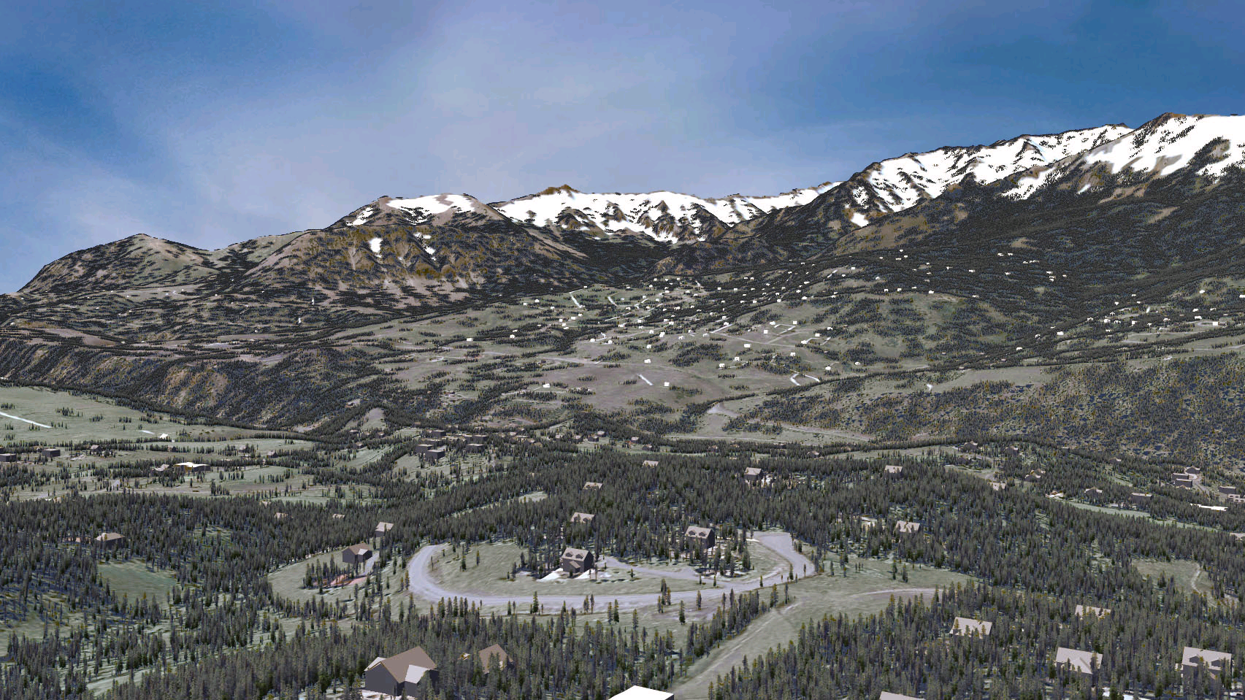
3D Library Objects
Procedurally-Placed

Slide 27
Scenarios as a Starting Point
Scenario-based hydrologic simulations do not typically represent the adaptive behaviors … provide direct information about Pareto-optimal solutions ( from our proposal)
So: we have available a set of “alternative futures” which can in whole or parts clearly be used as *inputs* to our study
They are by design computable, and visualizable

Slide 28
Thank you!
http://geodesigntech.com

