Slide 1


National Science Foundation Water, Sustainability, and Climate Project for South Florida:
Hydro-economics and Ecosystems
Mike Sukop
Earth and Environment
South Florida Hydrologic Society
February 6, 2013
Notes:
1

Slide 2
Overview
NSF’s Water, Sustainability, and Climate (WSC) Program
  Motivation, goals, and funding sources
  Three Categories
WSC 1 Project
  Field tracer experiment
  Ecosystem services, especially carbon and fisheries
WSC 2 Project
  Much broader area and scope

Slide 3
NSF WSC Program
Urgent challenge to ensure adequate supply and quality of water
  Growing human needs
  Climate variability and change
Goal: “… understand and predict the interactions between the water system and climate change, land use (including agriculture, managed forest and rangeland systems), the built environment, and ecosystem function and services through place-based research and integrative models”
National Science Foundation (NSF) and the United States Department of Agriculture National Institute of Food and Agriculture (USDA/NIFA) identify and fund the most meritorious and highest-impact projects that support their respective missions, while eliminating duplication of effort and fostering collaboration between agencies and the investigators they support

Slide 4
NSF WSC Program
“Successful proposals are expected to study water systems in their entirety and to enable a new interdisciplinary paradigm in water research.”
“Proposals that do not broadly integrate across the biological sciences, geosciences, engineering, and social sciences may be returned without review.”

Slide 5
NSF WSC Program
Award Categories
  Category 1 Awards
    Small exploratory or incubation grants to develop teams, identify sites, hold workshops and develop plans for establishment or operation of a study site or modeling effort (4-10, $150,000)
  Category 2 Awards
    Place-based observational and modeling studies, up to 5 years in duration and for a maximum of $5 million for each award (2-4)
  Category 3 Awards
    Synthesis, modeling and integration grants that will use existing data to integrate and synthesize across watershed and groundwater sites (6-12, $1.5 M)

Slide 6


WSC-Category 1: Linking freshwater inputs to ecosystem functioning and services provided by a large mangrove estuary
Mike Sukop
Earth and Environment
Bill Anderson/FIU
Mahadev Bhat/FIU
Vic Engel/NPS
Jose Fuentes/PSU
David Ho/UHI
Rudolf Jaffe/FIU
Pallab Mozumder/FIU
Jennifer Rehage/FIU
Notes:
1

Slide 7
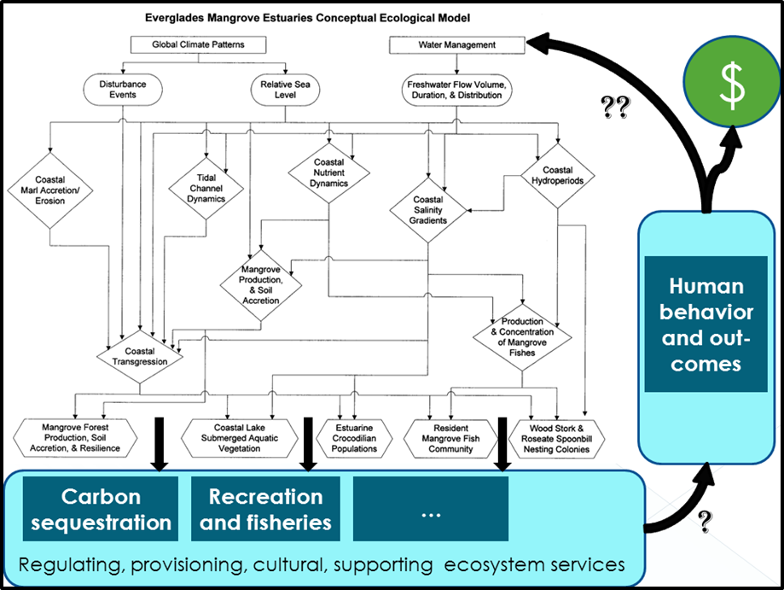
Overview: Traditional vs. WSC

Slide 8
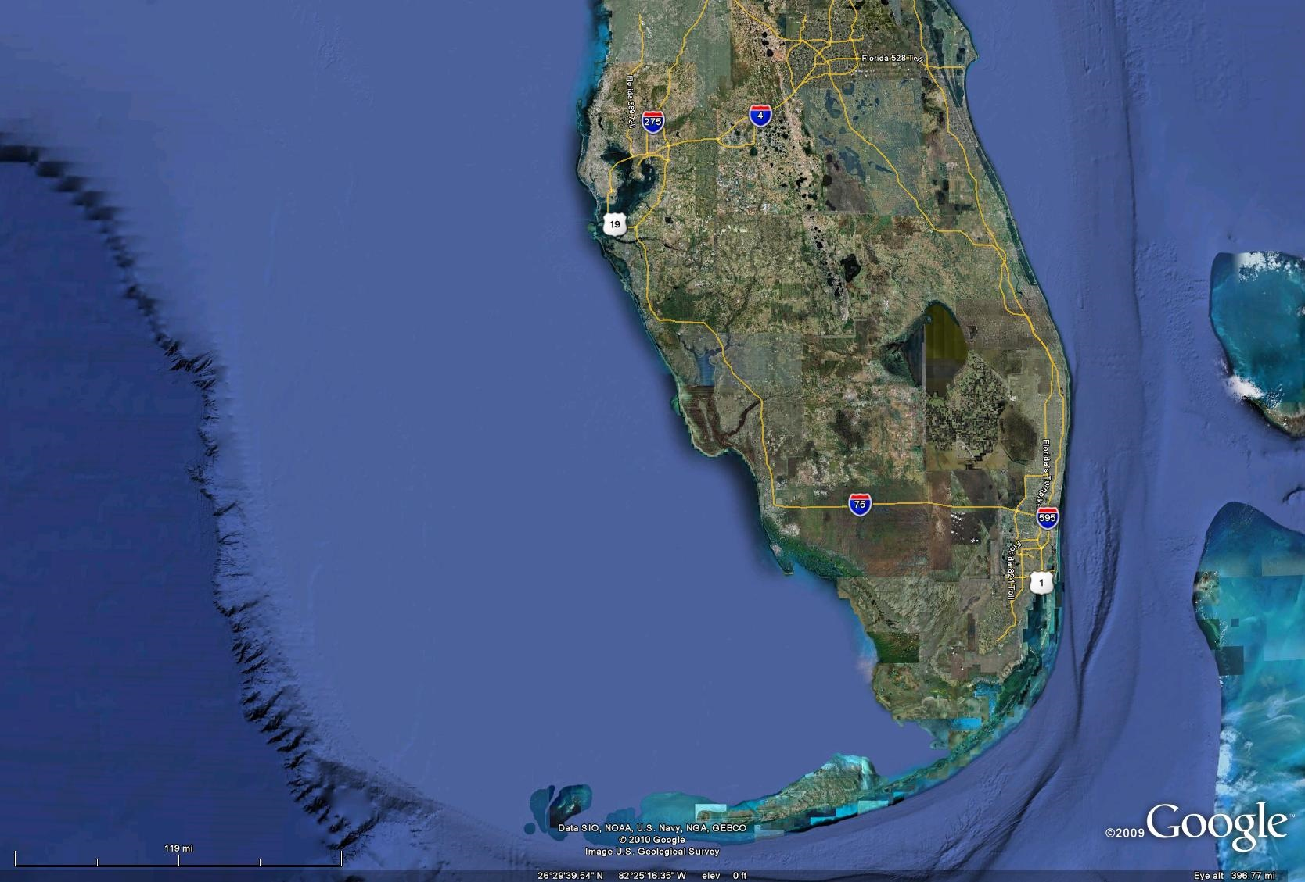
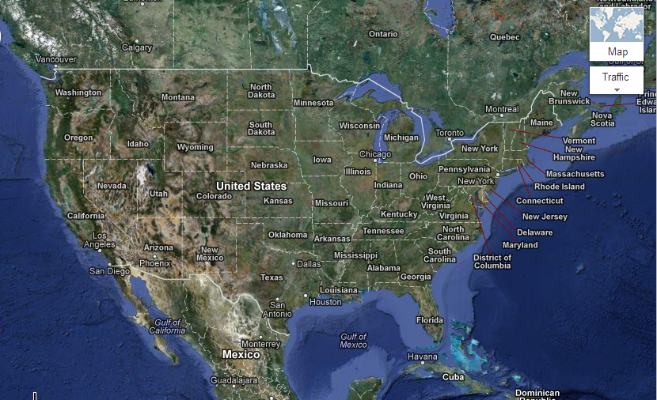
South Florida Hydrology
Lake Okeechobee
Everglades/Urban boundary
5.5 million
people
Everglades National Park
100 miles
160 km

Slide 9
Main Project Activities
Field trip to remote Shark River, principal drainage of Everglades National Park (ENP)
  Together with adjacent Harney River, was primary drainage of the “River of Grass” that flowed from Lake Okeechobee prior to human intervention in south Florida hydrologic system
Workshop:
  ~50 individuals (economists, water managers, CERP representatives, and ecosystem, atmospheric, anthropologic, and hydrologic scientists.
  Presentations on economic valuation strategies, hydrology, mangrove ecology, carbon cycling, and fisheries

Slide 10
Workshop Outcomes
Local regulatory community introduced to idea of social-ecological systems and of considering value of ecosystem services in water management decisions
Ecosystem services related to carbon sequestration and fisheries support provided by Everglades mangrove zone and potential approaches for quantifying monetary/non-monetary value of these services
US Army Corps demonstrated how monetized ecosystem services can be entered into traditional cost-benefit analyses
Recommendations to extend spatial extent of analysis to include population centers on Florida’s east coast and quantify value of ecosystem services derived from land use and water management policies in region

Slide 11
Carbon Storage Ecosystem Service and Valuation
WSC 1

Slide 12
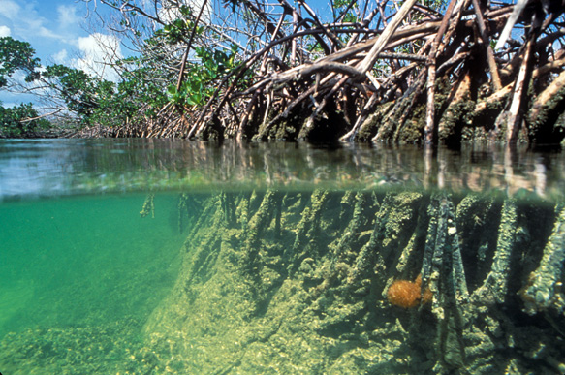
An Economic Analysis of Carbon Sequestration and Storage by the Mangrove Forests in Everglades National Park, Florida
Meenakshi Jerath
Major Advisor: Dr. Mahadev G. Bhat
Committee Members: Dr. Michael Sukop
Dr. Pallab Mozumder
Dr. Jennifer Rehage
Florida International University

Slide 13
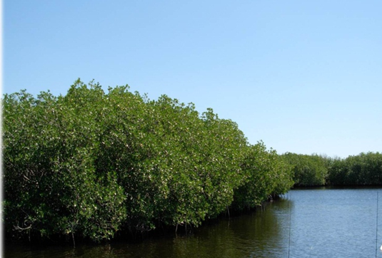
Introduction
Mangroves and ecosystem services
Mangroves and Blue Carbon (coastal vegetation)
Carbon sequestration and storage
  Reduces global warming, mitigates climate change effects
Global threats
  deforestation, global warming
Economic valuation of carbon sequestration and storage
  Challenges: quantification of carbon, valuation methodology

Slide 14
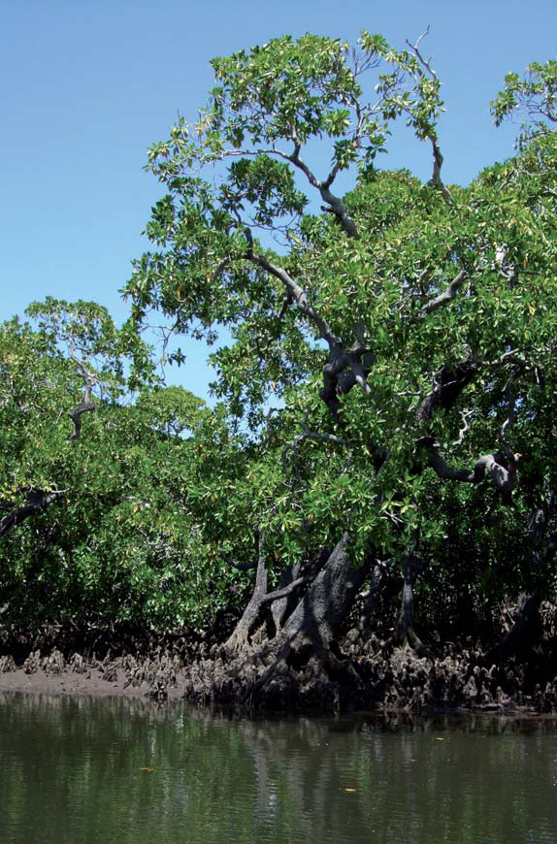
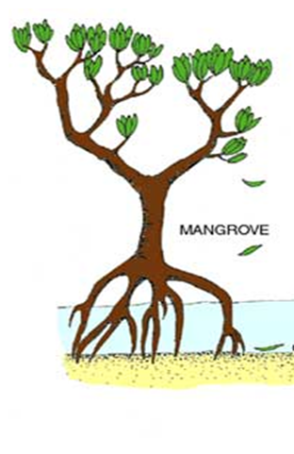
CO₂
Blue Carbon in Mangroves
Photosynthesis
Aboveground biomass
Leaves
Stem
Wood
Direct herbivory
Adjacent environments
Atmosphere
Belowground biomass
Fine & coarse roots
Soil carbon
Diagram source: derm.qld.gov.au. Picture: IUCN report, 2009

Slide 15
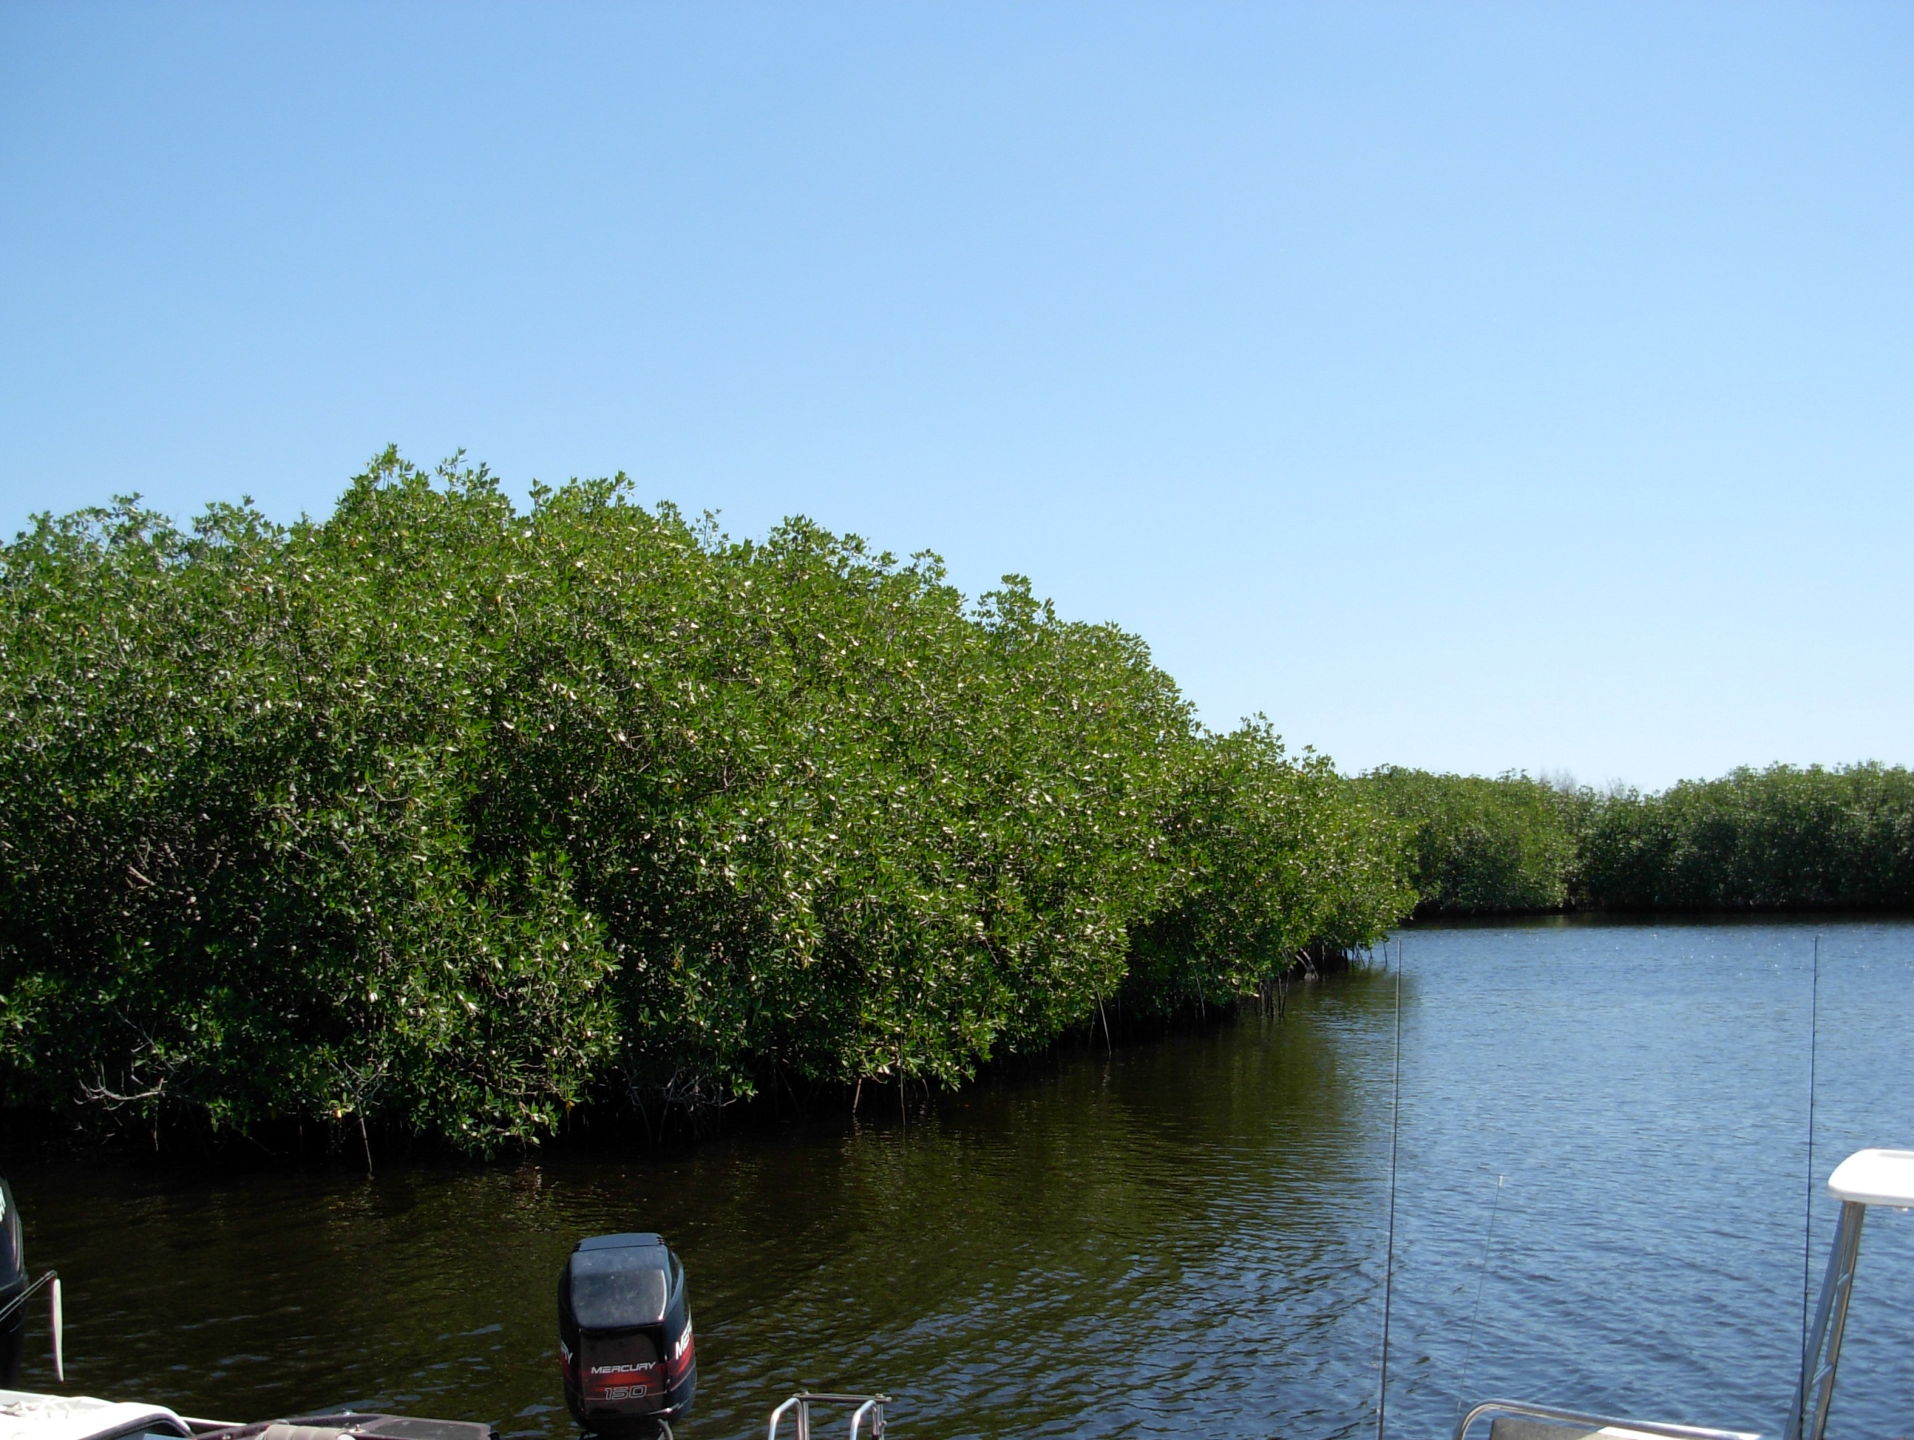
.
Mangrove Forests of Everglades National Park (ENP)

Slide 16

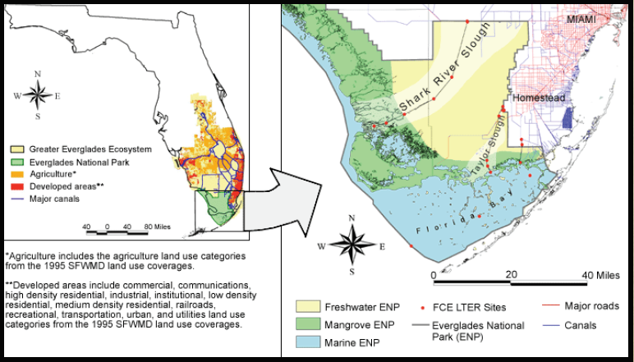
Mangrove forests of Everglades National Park
Total area 144,447 ha
Map source: FCE LTER

Slide 17
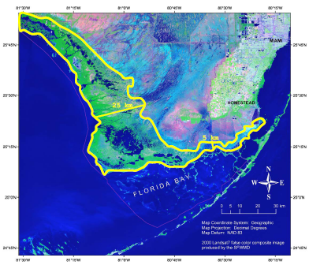
Mangrove Forests of ENP
Unique!
  Subtropical
  Carbonate platform
  Oligotrophic
    P limiting nutrient
    “Upside down estuary”
  (Childers et al. 2006)
  High productivity
  Not threatened by direct human impact
  (unlike other mangrove forests)
Upper Everglades
GULF OF MEXICO
Rivera-Monroy et al.(FCE LTER)

Slide 18
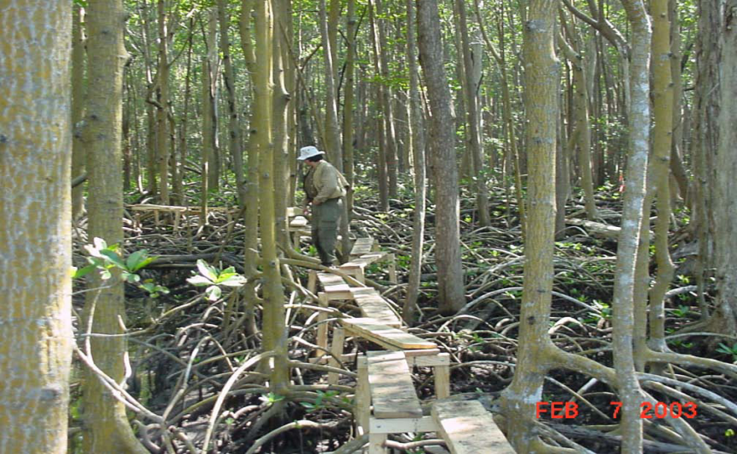
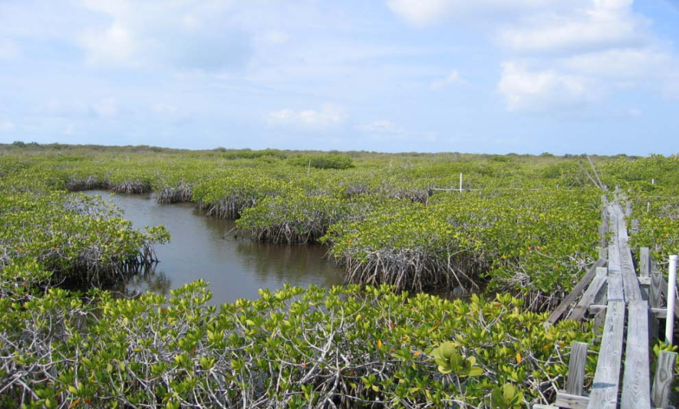
Shark River Slough
Riverine, fringing
Tide dominates duration and depth of flooding
  Marine P available
High aboveground productivity
Taylor River Slough
Scrub
Permanently flooded
  P-limited
3.8x higher biomass allocation to roots
Photos: FCE LTER
Castaneda-Moya et al., (2011)

Slide 19
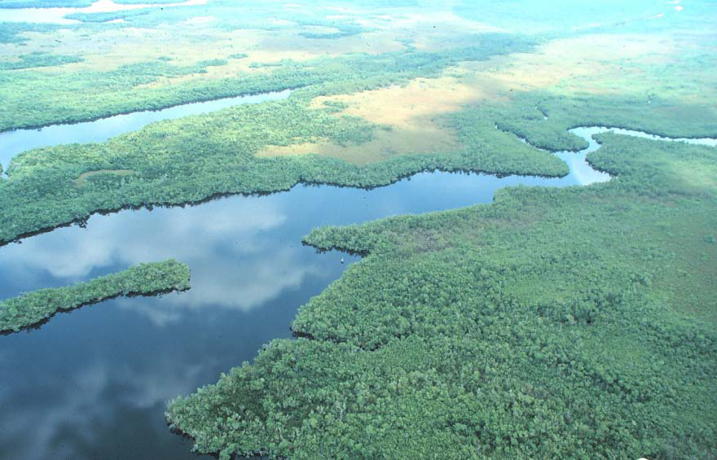
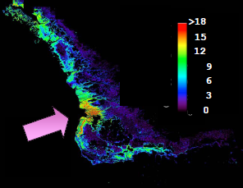
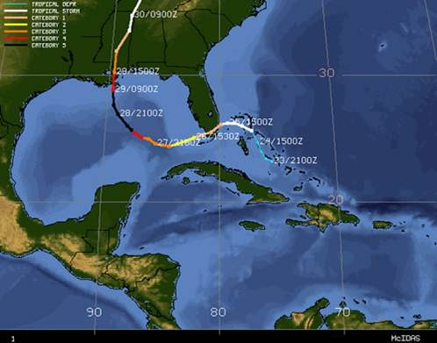
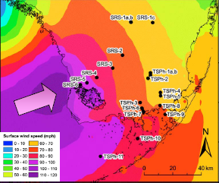
ENP Mangroves
Pulses
Presses
Water management
Sea level rise
FCE-LTER
Urban development
Simard et al. (2006)
Varying spatial and temporal scales
(Photograph: FCE LTER)

Slide 20
Research Objectives

Slide 21
Specific Objectives
Quantify total carbon
          (aboveground and belowground)
Identify appropriate methods of economic valuation
Estimate incremental value of carbon sequestration and storage with respect to sea level rise

Slide 22
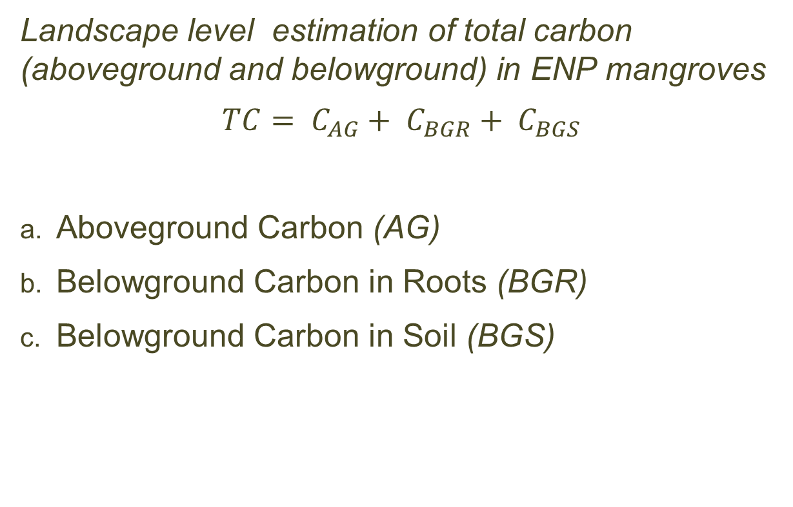
  Estimation of Total Carbon present in mangrove forests of Everglades National Park
Landscape level estimation of total carbon (aboveground and belowground) in ENP mangroves
$$TC= C_{AG}+ C_{BGR}+ C_{BGS}$$
Aboveground Carbon (AG)
Belowground Carbon in Roots (BGR)
Belowground Carbon in Soil (BGS)

Slide 23
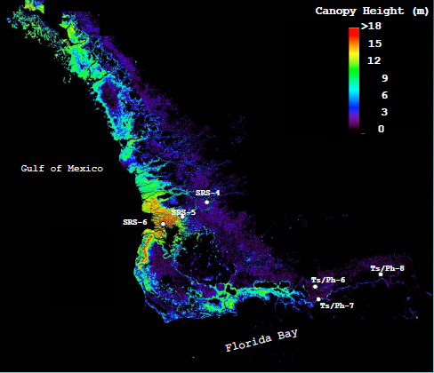
Aboveground Carbon in Mangrove Forests of ENP
Mean tree height
(Simard et al., 2006)
Standing Biomass distribution
(Rivera-Monroy et al., 2011)
Carbon Conversion factor = 0.44 (Ewe et al., 2006)

Slide 24
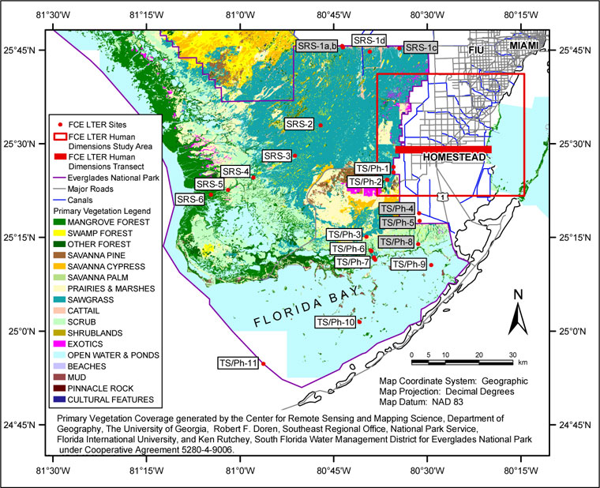
Belowground Carbon in fine roots of ENP mangroves

Slide 25
Aboveground and belowground biomass
FCE LTER Study Site | Aboveground Biomass (Mg/ha) | Belowground Root Biomass (Mg/ha) (Roots < 20 mm) (0-90 cm) | Average Tree height | Aboveground Carbon (Mg/ha) | Belowground (Root) Carbon (Mg/ha) | Aboveground: Belowground Carbon
SRS-4 | 97.72ª | 31.98^{b} | 6 | 43.00 | 14.1 | 3.1
SRS-5 | 108.79ª | 43.89^{b} | 8 | 47.87 | 19.3 | 2.5
SRS-6 | 152.07ª | 25.32^{b} | 13 | 66.91 | 11.1 | 6.0
TS/Ph-6 | 12.5ª | 24.04^{b} | 2 | 5.50 | 10.6 | 0.5
TS/Ph-7 | 12.5ª | 46.73^{b} | 2 | 5.50 | 20.6 | 0.3
TS/Ph-8 | 4.47ª | 43.58^{b} | 3 | 1.97 | 19.2 | 0.1
a: Chen & Twilley (1999b); Coronado-Molina et al. (2004); b: Castañeda-Moya et al. (2011)

Slide 26
Selection and development of carbon prices
Analysis of Valuation Methodologies
Damage Cost – Social Cost of Carbon (SCC)
Damage Avoided – Marginal Abatement Costs (MAC)
Market Price Method

Slide 27
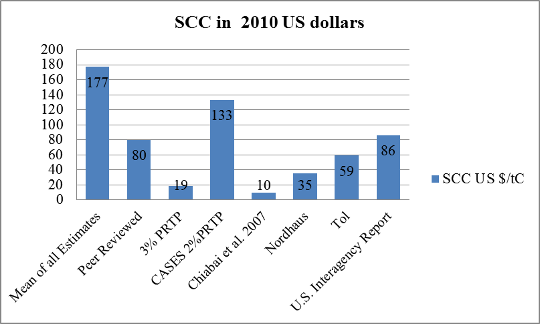
Social Costs of Carbon
Estimate of damages from incremental increase in carbon emissions in a given year. Intended to include changes in net agricultural productivity, human health, property damages from increased flood risk, and the value of ecosystem services due to climate change
Technical Support Document: Social Cost of Carbon for Regulatory Impact Analysis Under Executive Order 12866. Interagency Working Group on Social Cost of Carbon, United States Government
PRTP: Pure Rate of time Preference
Notes:
'All estimates' of SCC is the mean of the estimates of all published authors (311), peer reviewed as well as grey literature. So they tend to be higher. Among the peer reviewed ones, the SCC value goes down. The differences in the rates is mainly because of the discount rates used or the rate of time preference used. The peer reviewed authors generally use conservative rates for the discount etc.

Slide 28
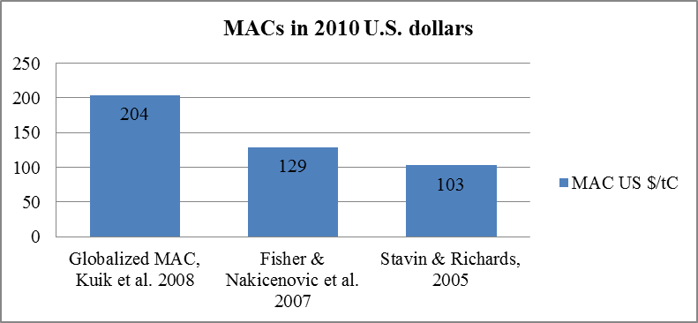
Marginal Abatement Costs (MACs)
Marginal abatement cost curve is a set of options available to an economy to reduce pollution. Tool in understanding emissions trading, driving forecasts of carbon allowance prices, prioritizing investment opportunities, and shaping policy discussions. MAC curves cover emissions reduction opportunities in power, industry, waste, buildings, transport, agriculture, and forestry
http://en.wikipedia.org/wiki/Marginal_abatement_cost

Slide 29
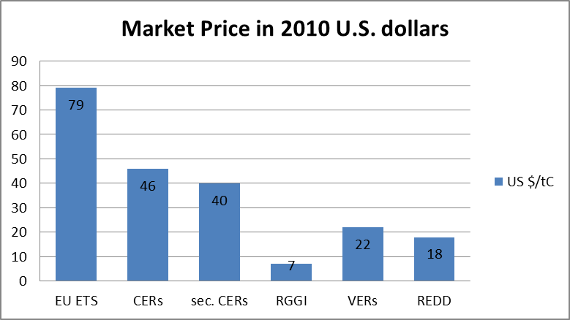
Market Prices
Certified Emission Reductions
Secondary CERs
Reducing Emissions from Deforestation and Degradation
Voluntary Emissions Reductions
Regional Greenhouse Gas Initiative

Slide 30
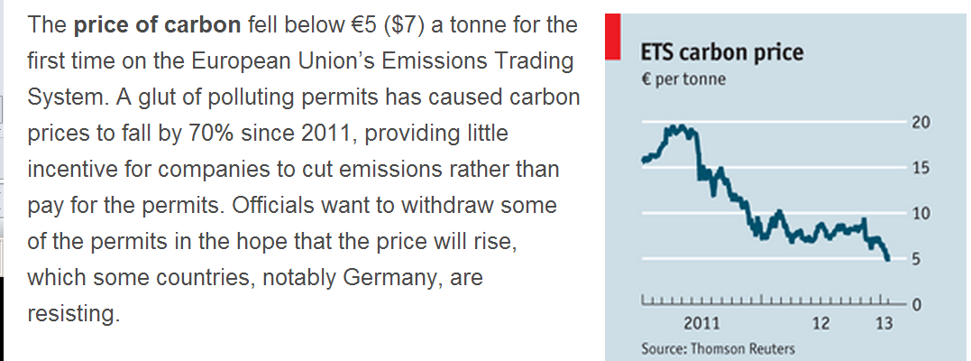
Change in Economic Value of Carbon Stock in ENP Mangroves under different Sea Level Rise Scenarios
The Economist, Jan 26th 2013 |From the print edition

Slide 31
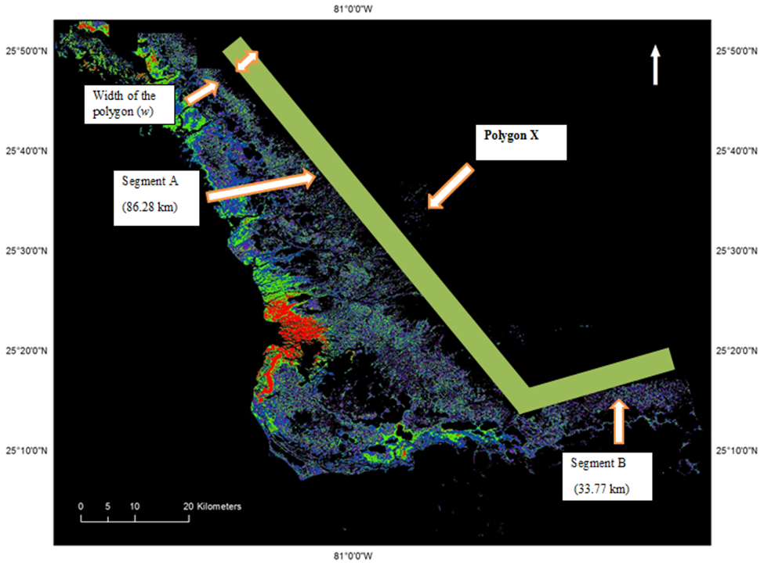
Mangrove Forests of Everglades National Park with projected zone of mangrove transgression
Global rate of mangrove carbon sequestration = 2.1 Mg C ha⁻¹ year⁻¹ (Chmura et al., 2003)

Slide 32
Landward Migration of ENP Mangroves under Selected Sea Level Rise Scenarios
Scenario | Projected sea level riseª | Extent of mangrove migration^{b} | Length of landward boundary of ENP Mangroves | South – North distance of migration
 | (m/ 100 years) | hectares | km | km
I | 0.20 | 50,000 | 120 | 4.17
II | 0.38 | 90,000 | 120 | 7.5
III | 0.56 | 150,000 | 120 | 12.5
a: Projected sea level rise using IPCC estimates from Engel, 2010; b: Estimates for habitat gain from Doyle, 2003, (USGS Fact Sheet, 2003).
.

Slide 33
Carbon Price Over Time
Prices per ton of carbon
C price | 2005 | 2010 | 2015 | 2020 | 2025 | 2055 | 2100 | 2105
RICE model | 0.00 | 0.07 | 0.39 | 2.21 | 12.40 | 64.11 | 41.55 | 27.68
RICE model, with RGGI^{b} price |  | 6.038^{c} |  |  |  |  | 48.17^{d}
SCCe (3%) ($/tCO₂) |  | 21.4 | 23.8 | 26.3 | 29.6
SCC^{f} estimate |  | 85.82 |  |  |  |  | 301.41
Regional Integrated model of Climate and the Economy
  a: all market prices sourced from Nordhaus, 2010; b: RGGI 2010 price is used as baseline for this run which follows the same price trend as in a;
  c & d are prices used to value C storage in ENP mangroves for 2010 and 2100 respectively using equation 3.5;
  e: all prices sourced from U.S. Interagency Report on SCC estimates, 2010; f: SCC estimates used for this study to value C storage in mangrove.

Slide 34
Results

Slide 35

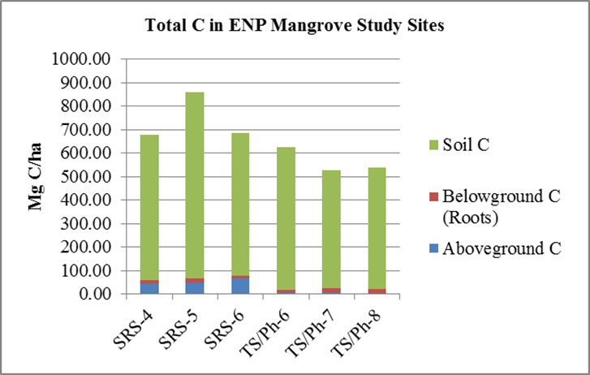
Carbon Storage in ENP Mangroves
Florida Coastal Everglades LTER Study Sites
Mg = Megagram (1 Megagram = 1 ton)
SRS: Shark River Slough
TS/Ph Taylor Slough /Panhandle

Slide 36
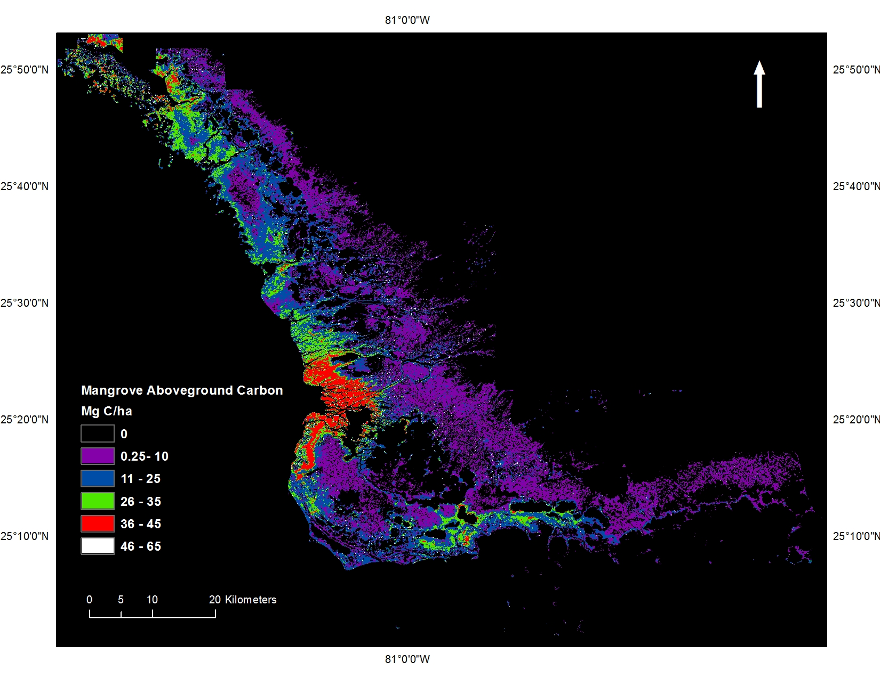
Aboveground Carbon in Standing Biomass of Mangrove forests in Everglades National Park
Gulf of Mexico
Shark River Slough
Florida Bay

Slide 37
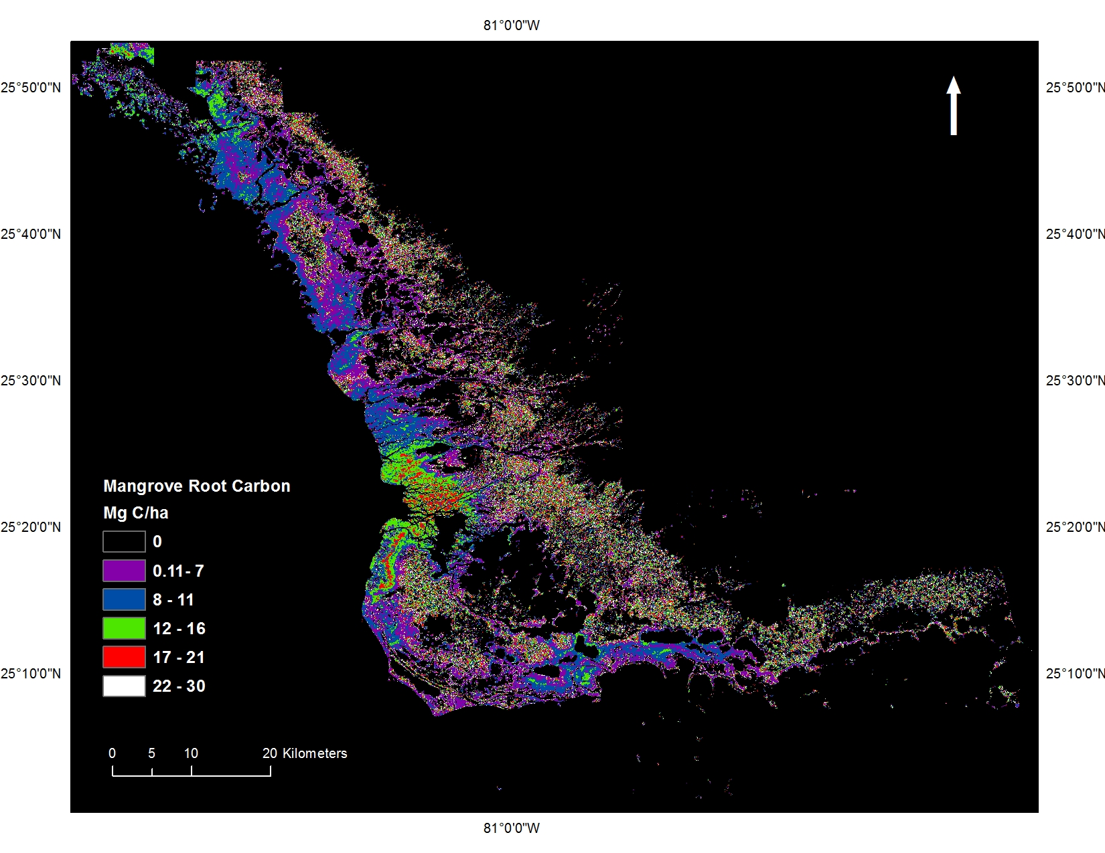
Carbon in Roots of Mangrove Forests in Everglades National Park
Shark River Slough
Gulf of Mexico
Taylor River Slough
Florida Bay

Slide 38
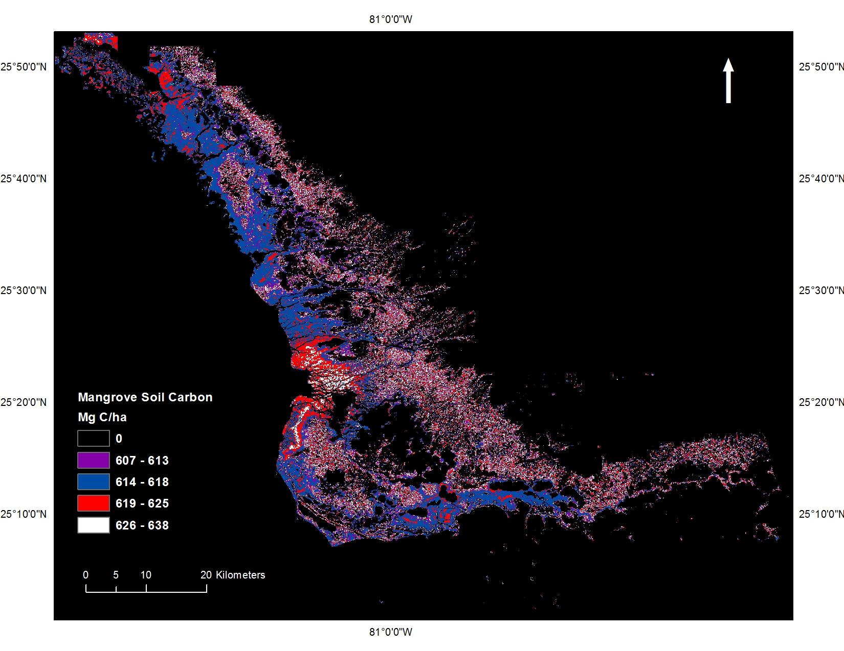
Carbon in Soil of the Mangrove Forests in Everglades National Park
Gulf of Mexico
Florida Bay

Slide 39
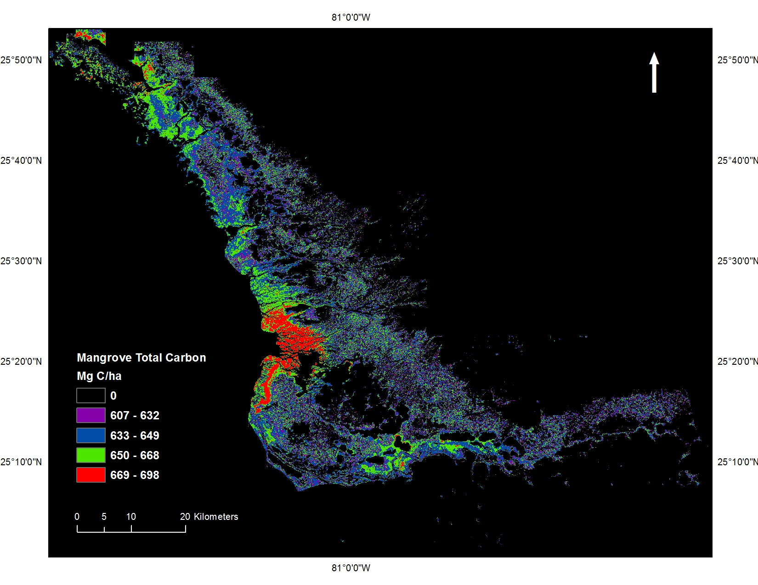
Total Carbon in Mangrove Forests in Everglades National Park, Florida
Gulf of Mexico
Florida Bay

Slide 40
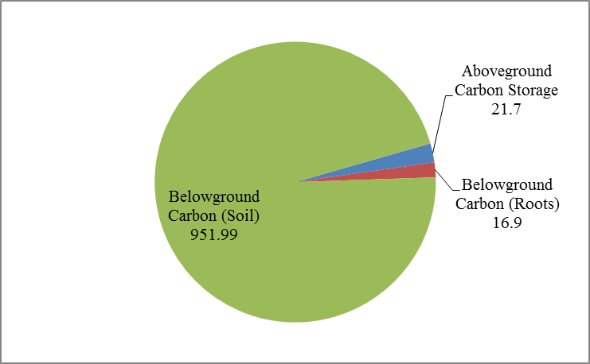
Carbon Storage (million Mg C) in different Forest Components of ENP Mangroves
(2%)
(1.7%)
(96%)
Total Carbon storage in ENP Mangroves: 990,724 million Mg C

Slide 41
Comparison of Carbon Stocks in Terrestrial Ecosystems and Mangroves
Ecosystem | Mean Estimate of C per hectare | Source
Tropical | 242 | Pan et al., 2011
Temperate | 155 | Pan et al., 2011
Boreal | 239 | Pan et al., 2011
Tropical Mangroves | 1023 | Donato et al., 2011
ENP Mangroves | 7144 | This study

Slide 42
Economic Valuation of C storage in ENP mangroves (max and min per hectare)
Valuation Methodology | Examples | Cost of Carbon ($/tC) | Total Value of C in ENP mangrove forests (million $) | Mean estimate (million $) | Value of ENP mangroves per ha ($/ha) | Mean estimate ($/ha)
Social Cost of Carbon | Peer Reviewed | 80 | 79,258 | 64,397 | 571,520 | 464,360
 | US Interagency Report | 86 | 85,202 |  | 614,384
 | Tol | 59 | 58,453 |  | 421,496
 | Nordhaus | 35 | 34,675 |  | 250,040
Marginal Abatement Costs | Globalized MAC | 233 | 202,108 | 131,767 | 1,457,376 | 950,152
 | IPCC, Fourth Assessment Report | 129 | 123,841 |  | 893,000
 | Cost of forest based sequestration | 103 | 69,351 |  | 500,080
Market Prices | EU ETS | 79 | 78,267 | 35,006 | 564,376 | 252,421
 | CERs | 46 | 45,573 |  | 328,624
 | secondary CERs | 40 | 39,629 |  | 285,760
 | RGGI | 7 | 6,935 |  | 50,008
 | VERs | 22 | 21,796 |  | 157,168
 | REDD^{l} | 18 | 17,833 |  | 128,592

Slide 43
Criteria for Valuation of ENP Mangroves
(Economic, Political, Social)
Context | Valuation Approach | Carbon Price (US$/tC)
Cost (impact) of mangrove degradation WTP of society to avoid future damage to mangroves Absence of C markets | Damage Cost/Social Cost of Carbon | 10 – 177
Cost of restoring mangroves Opportunity costs society will incur by Sequestration measures Use of less C intensive technology Carbon Permit Price | Damage Avoided/ Marginal Abatement Costs | 103 – 233
Individual WTP to conserve natural C sink | Market Price | 7 – 79
Note: The range of prices shown are based on the review by this study

Slide 44
Economic Valuation of Carbon Storage in ENP Mangroves
Valuation Methodology | Source | Cost of Carbon ($/tC) U.S. 2010 dollars | Value of ENP Mangroves ($/ha)
Market Price | RGGI, 2010 | 7 | 50,008
Social Cost of Carbon | U.S. Government Interagency Report, 2010 | 86 | 614,384

Slide 45
Change in Economic Value of Carbon Stock in ENP Mangroves under different Sea Level Rise Scenarios
 | Baseline Year | PROJECTED SCENARIOS
 | 2010 | SI, 2100 | SII, 2100 | SIII, 2100
Estimated Sea Level Rise (IPCC) (m) |  | 0.2 | 0.38 | 0.56
Total C Stock In ENP mangroves(Mg C or tC) | 990,724,732 | 995,819,332 | 1,000,269,232 | 1,006,632,232
Total Area of ENP mangroves (hectares) | 144,447 | 194,447 | 234,447 | 294,447
Market price ($/tC) (RGGI) | 7 | 48.17 | 48.17 | 48.17
Value of total C storage in ENP mangroves (billion $) Market price | 7 | 47.96 | 48.18 | 48.48
Social Cost of Carbon ($/tC) | 85.82 | 301.41 | 301.41 | 301.41
Value of total C storage in ENP mangroves (billion $) SCC | 85.02 | 300 | 301 | 303

Slide 46
Fisheries Ecosystem Services
WSC 1

Slide 47
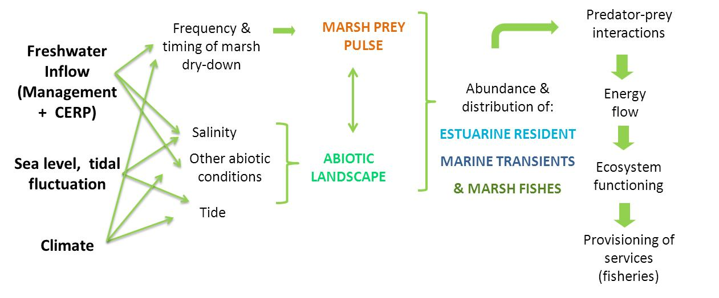
Conceptual framework of factors influencing abundance and distribution of fish
Notes:
Figure 3. Conceptual framework for the trophic and fisheries component, showing the factors influencing the abundance & distribution of fishes in ecotonal habitats in the southern Everglades, and implications across multiple ecological scales

Slide 48
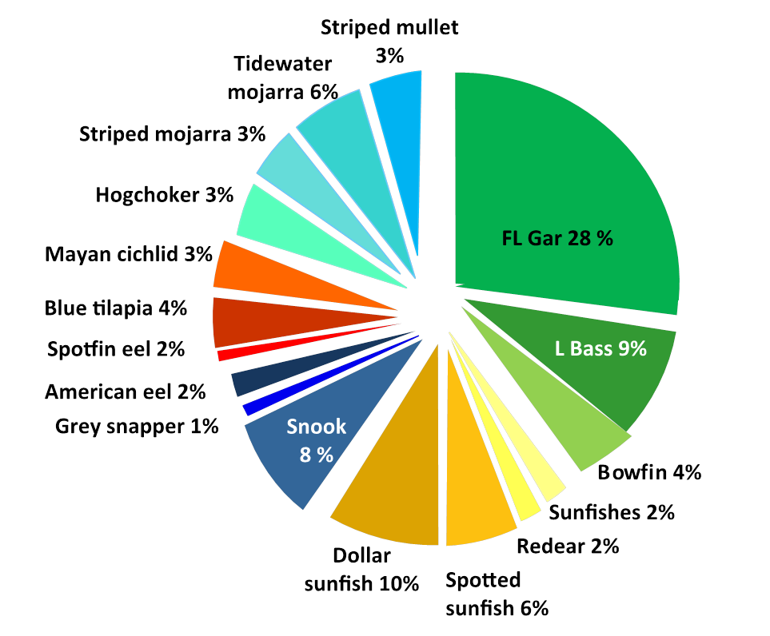
Community structure (2004-2010) for upper Shark River
Estuarine prey
Freshwater predators
Non-native
Key Recreational
Estuarine predators
Key Recreational
Freshwater prey
Notes:
Community structure (2004-2010) for the upper Shark River. Key recreational species are shown in white text. Functional groups are color-coded: freshwater predators (green), freshwater prey (yellow), estuarine predators (dark blue), nonnative taxa (orange-red), and estuarine prey (light blue).

Slide 49
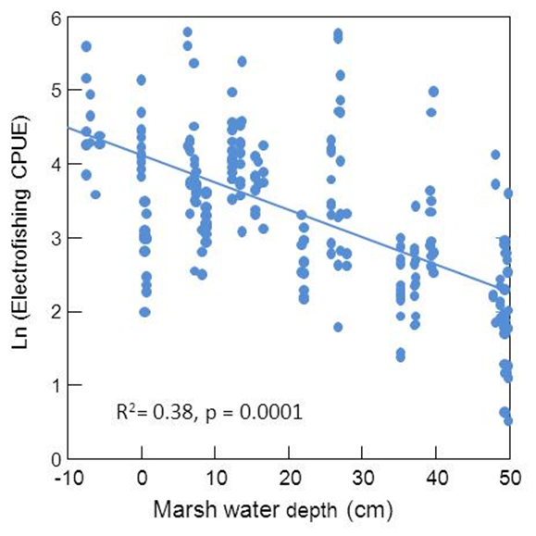
Fish Abundance for upper Shark River
Notes:
Fig 17. Relationship between fish abundance in the upper Shark River (all taxa combined) and marsh water depth upstream of the mangrove region

Slide 50
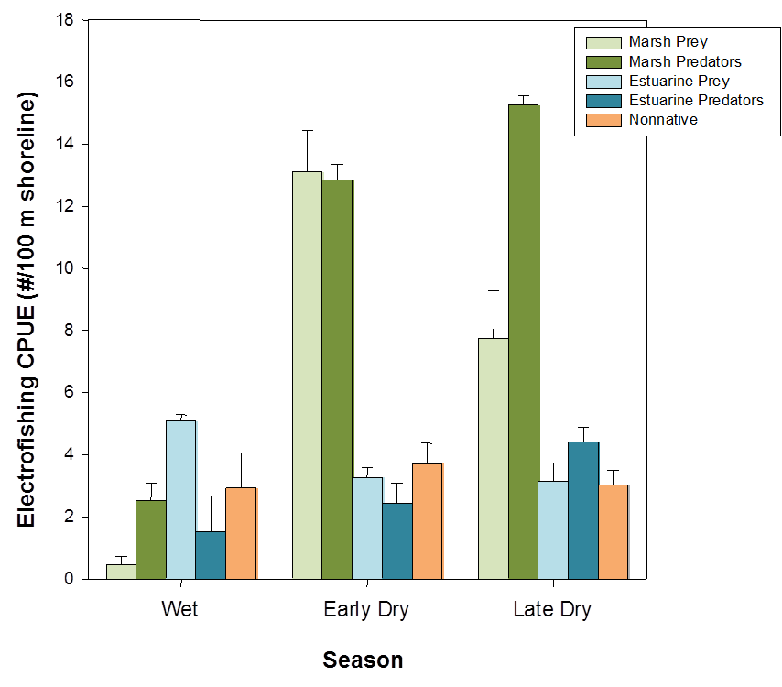
Seasonality in catch per unit effort (CPUE; 2004-2010) for upper Shark River
Notes:
Figure 18. Seasonality in catch per unit effort (CPUE; 2004-2010) shown by functional group: marsh fishes (both predators and prey), estuarine/marine prey and consumers, and nonnative taxa.

Slide 51








WSC Category 2:
Robust decision-making for south Florida water resources by ecosystem service valuation, hydro-economic optimization, and conflict resolution modeling
14 Institutions, 21 PIs, and 4 Collaborators
New researchers
Social/Behavioral/Economics
Robert Meyer, J. Czajkowski/U. Penn Wharton School
Kenny Broad, D. Letson, J. Bolson/UM Center for Environ. Sci. and Policy
J. Harrington/FSU Center for Economic Forecasting
M. Flaxman/MIT; R. Weisskoff/UM
P. Mozumder/FIU
Engineering/Modeling
David Watkins/MTU J. Obeysekera/SFWMD
J. Hughes/USGS
Climate/Ecosystem Science
Michael Mann/PSU C. Martinez/UF
J. Smoak/USF J. Ault/UM
R. Hinkle/ UCF J. Barr/NPS
Notes:
1

Slide 52
Big Picture Issues
High-value wetland ecosystems are clearly degrading
Inadequate reservoir capacity and seasonal rainfall make system vulnerable to CLIMATE CHANGE
Low elevation, karst geology make system vulnerable to SEA LEVEL RISE
Water managers and stakeholders cannot reach CONSENSUS on objectives or planning horizons
Coastal-zone ECOSYSTEM SERVICES not quantified
Notes:
Hoover dike flood, full aquifers, seawater intrusion, flood protection, ASR
Pulse, Press, Dynamics

Slide 53

Big Picture Issues
Photo: Luis Espinoza, Miami-Dade County Regulatory and Economic Resources Department, Environmental Resource Management
Notes:
Hoover dike flood, full aquifers, seawater intrusion, flood protection, ASR
Pulse, Press, Dynamics

Slide 54

Big Picture Issues
Photo: Luis Espinoza, Miami-Dade County Regulatory and Economic Resources Department, Environmental Resource Management
Notes:
Hoover dike flood, full aquifers, seawater intrusion, flood protection, ASR
Pulse, Press, Dynamics

Slide 55
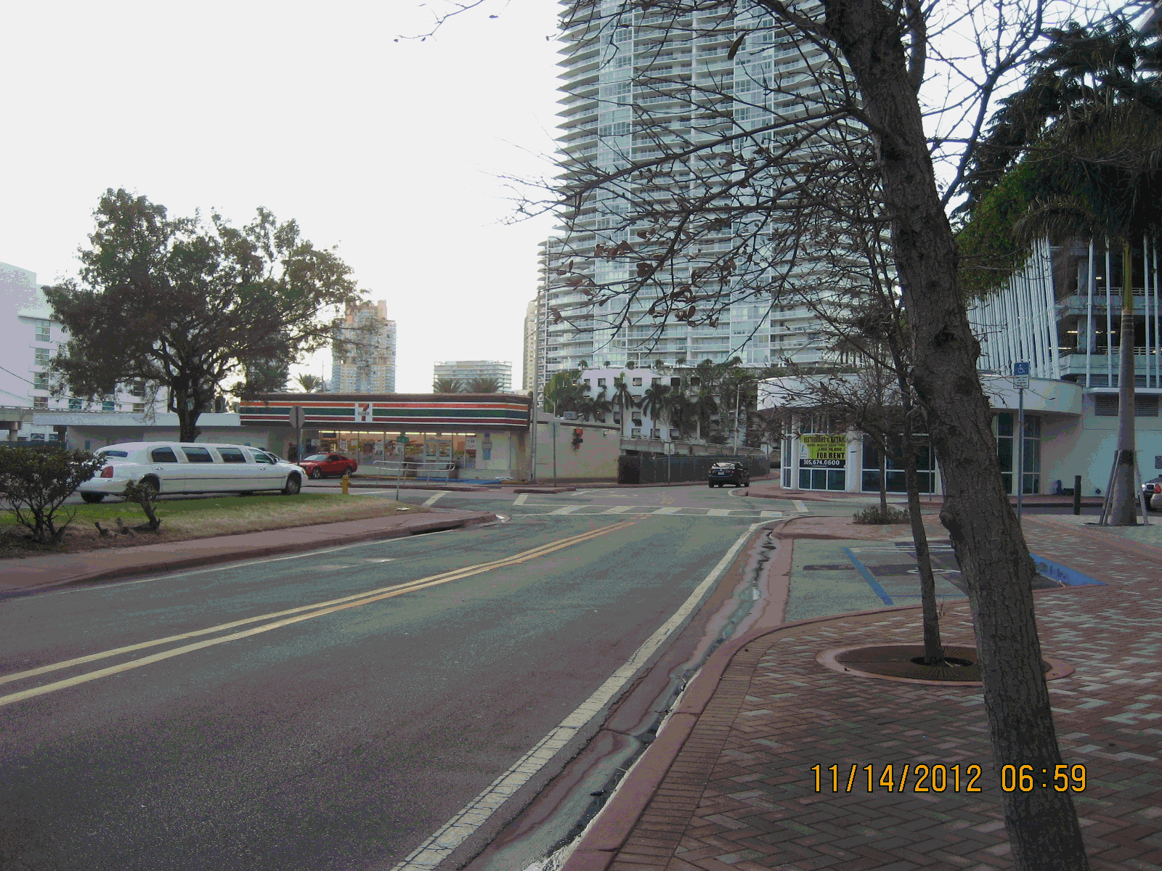
Big Picture Issues
Photo: Mike Sukop, Emily Eisenhauer, Joe Hughes, Florentin Maurrasse

Slide 56
WSC Category 2 Proposal
Research questions…
Can south Florida water supplies be made more resilient to climate change?
What are costs of maintaining built and natural systems, recognizing that socioeconomic pressures, climate change, and SLR may preclude long-term sustainability?
Do economics of water allocation influence preferences for and perception of risks for hydrologic management options?
Notes:
Risk of flood increase or pay $50

Slide 57
WSC Category 2 Proposal
Requires an interdisciplinary approach…
Regional economic valuation of urban, agricultural, ecosystem, and industrial water use
Economic valuation of ecosystem services
(expanded from WSC Category 1)
Surveys of stakeholder risk perception and preferences
Integrating stakeholder preferences into Scenario-driven, regional hydro-economic optimization
Decision-modeling of group interactions in experimental tradeoff negotiations

Slide 58

WSC - Category 2 Proposal
Hydro-economic network optimization
Optimization according to “cost” functions and decision criteria, such as expected value or expected regret
Cost functions include ecosystem
service valuations
Scenario-driven, “robust”
optimization via decision tree
David Watkins, MTU
Notes:
w/o changing infrastructure what make us most robust wrt climate, SLR, pos, land use change? Sustainable requires multiple potential futures; need to be able to adapt.

Slide 59
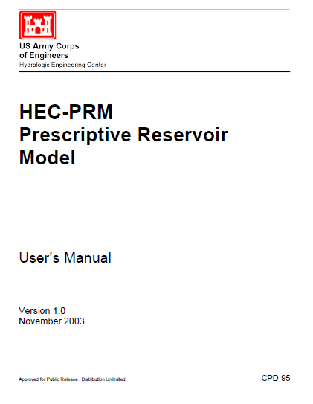
South Florida Systems Analysis Model
Based on Hydrologic Engineering Center Prescriptive Reservoir Model (USACE 1994, 2003) http://www.hec.usace.army.mil/software/hec-resprm/index.html

Slide 60
South Florida Systems Analysis Model
Primary operating goals are flood control, water supply, and environmental preservation and restoration
Objective function is a set of piecewise linear penalty functions, each of which quantifies economic social, or environmental cost of deviating from ideal operation for each operating goal
Identify breakpoints in system operation, including critical storage and flow levels for each objective. Between breakpoints, unit costs are assigned according to relative importance of meeting various objectives
Can force model with steep penalties (e.g., seepage)
Can use real economics

Slide 61
Penalty Function: Water Supply
Watkins, D., Kirby, K., and Punnett, R. (2004). ”Water for the Everglades: Application of the South Florida Systems Analysis Model.” J. Water Resour. Plann. Manage., 130(5), 359–366.
doi: 10.1061/(ASCE)0733-9496(2004)130:5(359)
~10⁶ m³/month
Notes:
Cost of high flows here is damage to estuaries.

Slide 62
Penalty Function: Everglades
Watkins, D., Kirby, K., and Punnett, R. (2004). ”Water for the Everglades: Application of the South Florida Systems Analysis Model.” J. Water Resour. Plann. Manage., 130(5), 359–366.
doi: 10.1061/(ASCE)0733-9496(2004)130:5(359)
Notes:
Iterative process based on conversations with operators and feedback from operators following model completion

Slide 63
Results: Proposed new storage
Proposed new storage helps some areas but not others
Ft. Meyers, FL
Miami, FL
Watkins, D., Kirby, K., and Punnett, R. (2004). ”Water for the Everglades: Application of the South Florida Systems Analysis Model.” J. Water Resour. Plann. Manage., 130(5), 359–366.
doi: 10.1061/(ASCE)0733-9496(2004)130:5(359)

Slide 64
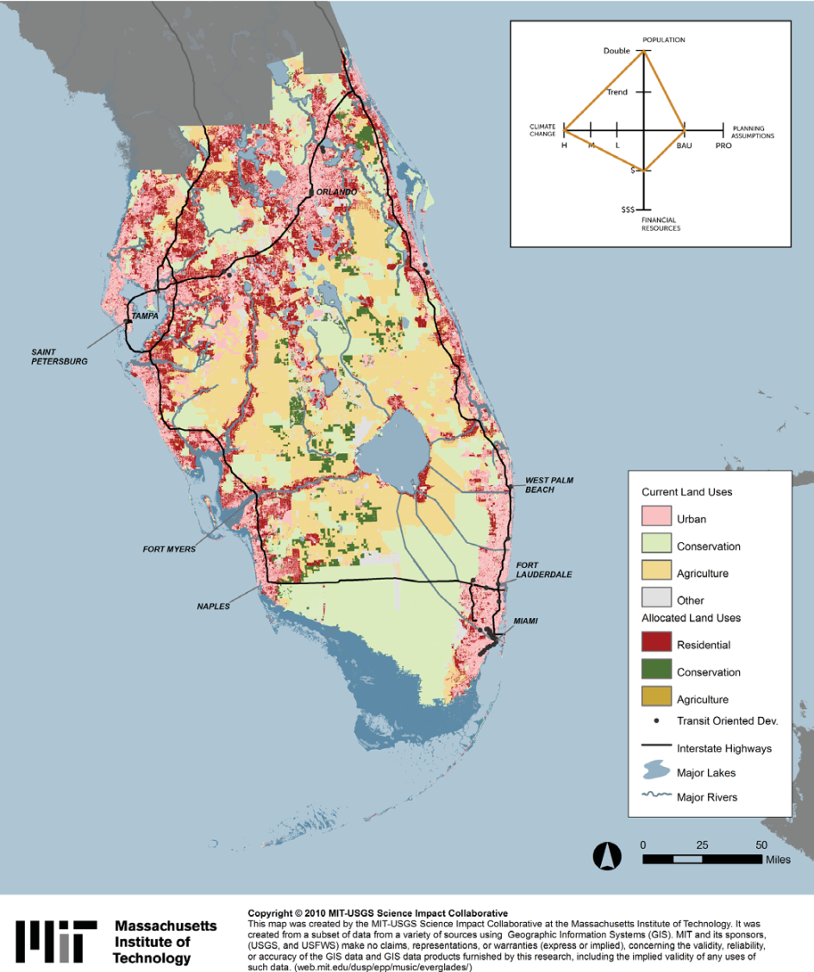
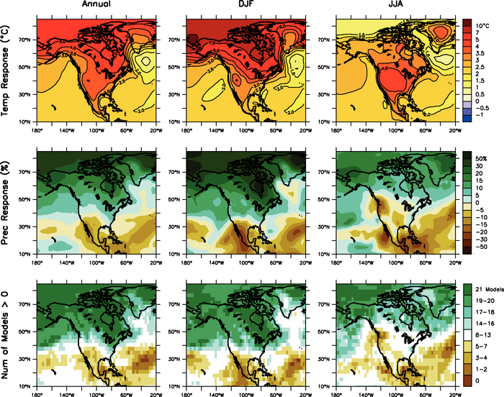

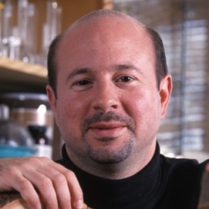
WSC - Category 2 Proposal
Scenarios of climate, land use, population, sea level rise, and economic setting utilized in a decision-scaling approach
Michael Mann PSU
GeoAdaptive Inc.
Mike Flaxman MIT
Notes:
Business As Usual, Progressive (conservation-minded)
Decision-scaling: Vulnerability assessment of water resources eg. Strength of dry season March-April-May rainfall depends on NAO; pick climate scenarios that show changes in MAM rain fall – not all available scenarios. Model simulates particular parameter well and works well in region
Insert hydrologic opt model
IPCC change between 1980 to 1999 and 2080 to 2099, averaged over 21 models
http://www.ipcc.ch/publications_and_data/ar4/wg1/en/figure-11-12.html

Slide 65
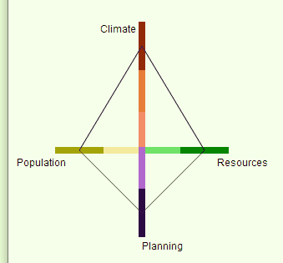
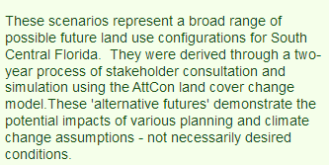
WSC - Category 2 Proposal
Scenarios of climate, land use, population, sea level rise, and economic setting utilized in a decision-scaling approach
Business as usual
Public spending high
Business as usual
Business as usual
GeoAdaptive Inc.
Notes:
Business As Usual, Progressive (conservation-minded)
Decision-scaling: Vulnerability assessment of water resources eg. Strength of dry season MAM rainfall depends on NAO; pick climate scenarios that show changes in MAM rain fall – not all available scenarios. Model simulates particular parameter well and works well in region
Insert hydrologic opt model
IPCC change between 1980 to 1999 and 2080 to 2099, averaged over 21 models
http://www.ipcc.ch/publications_and_data/ar4/wg1/en/figure-11-12.html

Slide 66
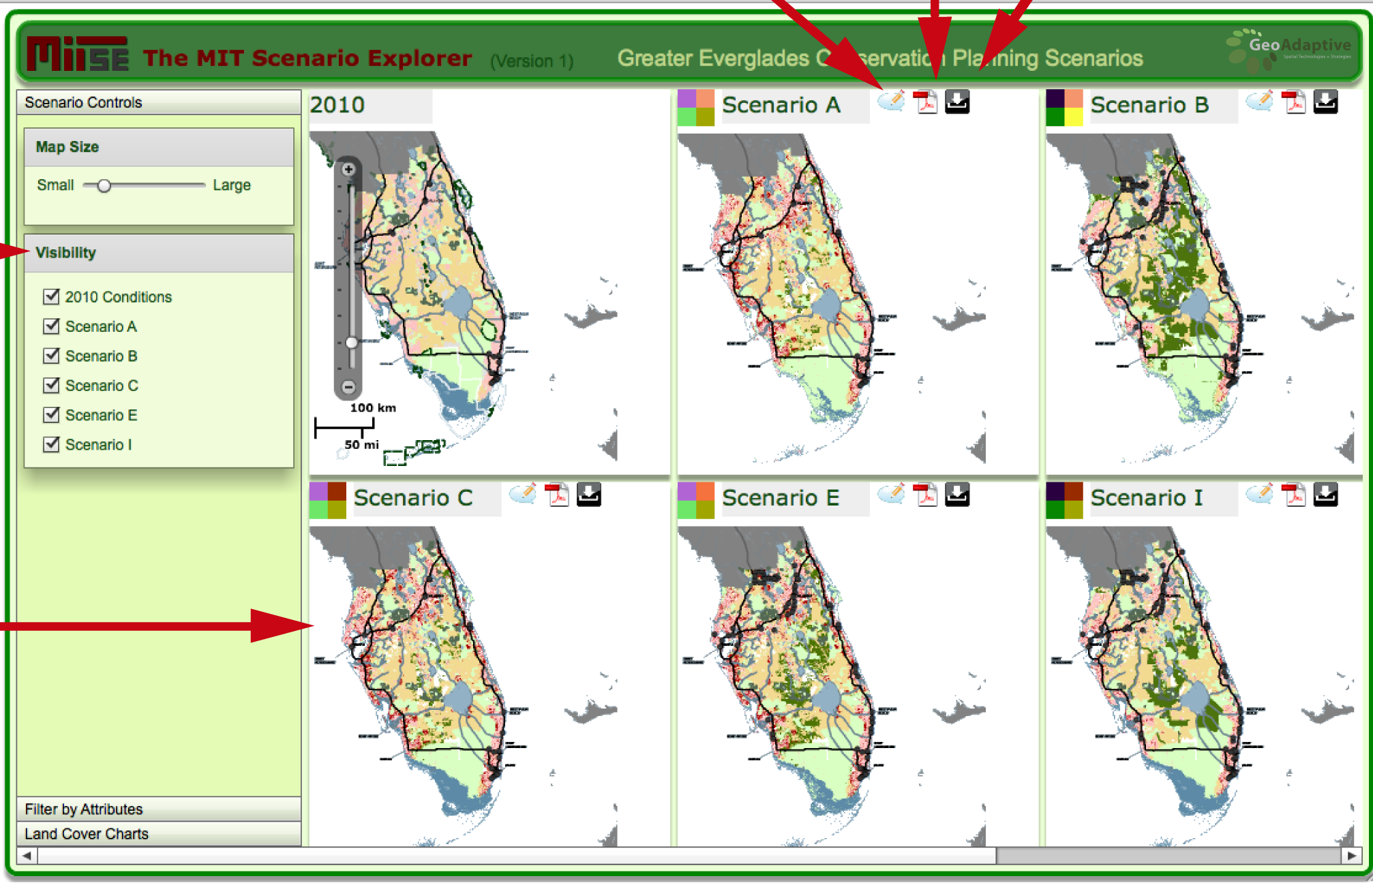
WSC - Category 2 Proposal
GeoAdaptive Inc.
Notes:
Business As Usual, Progressive (conservation-minded)
Decision-scaling: Vulnerability assessment of water resources eg. Strength of dry season MAM rainfall depends on NAO; pick climate scenarios that show changes in MAM rain fall – not all available scenarios. Model simulates particular parameter well and works well in region
Insert hydrologic opt model
IPCC change between 1980 to 1999 and 2080 to 2099, averaged over 21 models
http://www.ipcc.ch/publications_and_data/ar4/wg1/en/figure-11-12.html

Slide 67
WSC - Category 2 Proposal
Scenario A
Relatively low estimate of sea-level rise (3.6 inches by 2060)
Population within the study region doubles from 14.4 million people in 2007 to 28.8 million by 2060
Governing agencies will follow a business-as-usual trend in terms of planning and conservation efforts with low levels of financial resources to achieve objectives
GeoAdaptive Inc.
Notes:
Business As Usual, Progressive (conservation-minded)
Decision-scaling: Vulnerability assessment of water resources eg. Strength of dry season MAM rainfall depends on NAO; pick climate scenarios that show changes in MAM rain fall – not all available scenarios. Model simulates particular parameter well and works well in region
Insert hydrologic opt model
IPCC change between 1980 to 1999 and 2080 to 2099, averaged over 21 models
http://www.ipcc.ch/publications_and_data/ar4/wg1/en/figure-11-12.html

Slide 68
WSC - Category 2 Proposal
GeoAdaptive Inc.
Notes:
Business As Usual, Progressive (conservation-minded)
Decision-scaling: Vulnerability assessment of water resources eg. Strength of dry season MAM rainfall depends on NAO; pick climate scenarios that show changes in MAM rain fall – not all available scenarios. Model simulates particular parameter well and works well in region
Insert hydrologic opt model
IPCC change between 1980 to 1999 and 2080 to 2099, averaged over 21 models
http://www.ipcc.ch/publications_and_data/ar4/wg1/en/figure-11-12.html

Slide 69
WSC - Category 2 Proposal
2010
2060
GeoAdaptive Inc.
Notes:
Business As Usual, Progressive (conservation-minded)
Decision-scaling: Vulnerability assessment of water resources eg. Strength of dry season MAM rainfall depends on NAO; pick climate scenarios that show changes in MAM rain fall – not all available scenarios. Model simulates particular parameter well and works well in region
Insert hydrologic opt model
IPCC change between 1980 to 1999 and 2080 to 2099, averaged over 21 models
http://www.ipcc.ch/publications_and_data/ar4/wg1/en/figure-11-12.html

Slide 70
WSC - Category 2 Proposal
Decision Scaling
Reverse normal goal of reducing uncertainty and selecting an optimal plan for the likely future
Accept irreducible uncertainty and identify strategies that will perform well over a wide range of climate futures
Top-down approaches use ‘down-scaled’ climate change projections from General Circulation Models
Bottom-up approaches look at socio-economic system of interest and try to identify the vulnerabilities or risks related to climate
Decision Scaling is processing of GCM projections focused on critical climate conditions known to be critical through bottom up analysis
Brown, Casey. “Decision-scaling for Robust Planning and Policy under Climate Uncertainty.” World Resources Report, Washington DC. Available online at http://www.worldresourcesreport.org
Notes:
Business As Usual, Progressive (conservation-minded)
Decision-scaling: Vulnerability assessment of water resources eg. Strength of dry season MAM rainfall depends on NAO; pick climate scenarios that show changes in MAM rain fall – not all available scenarios. Model simulates particular parameter well and works well in region
Insert hydrologic opt model
IPCC change between 1980 to 1999 and 2080 to 2099, averaged over 21 models
http://www.ipcc.ch/publications_and_data/ar4/wg1/en/figure-11-12.html

Slide 71
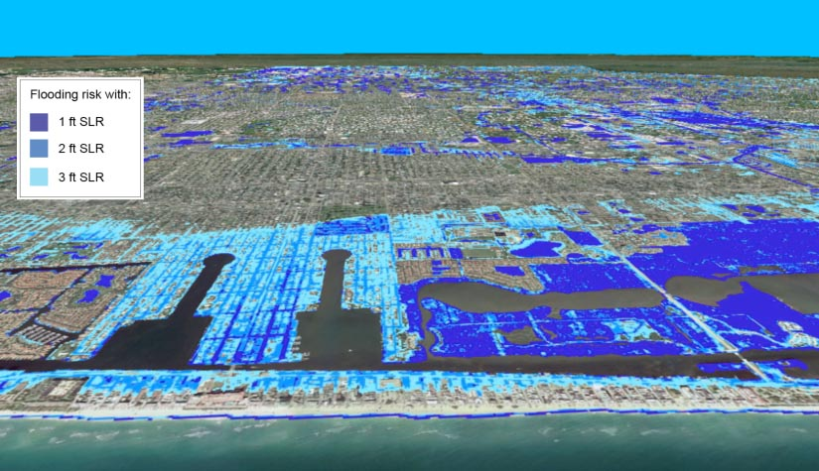

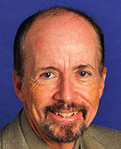
WSC - Category 2 Proposal
Photo-realistic imaging of changes in land- and hydro-scapes
Behavioral Decision Analyses
Kenny Broad, UM
Robert Meyer, UP
Hypothesis:
Information type and format influences risk perception and preferences for hydrologic management scenarios

Slide 72


WSC - Category 2 Proposal
Decision Analysis
4. IPCC climate and SLR forecasts
1. Stakeholder
Preferences
3. Land use, Pop., Econ. scenarios
2. Hydro-economic optimization
5. “Robust” optimization
7. Stakeholder
evaluations
6. Scenario visualization

